Slide 1
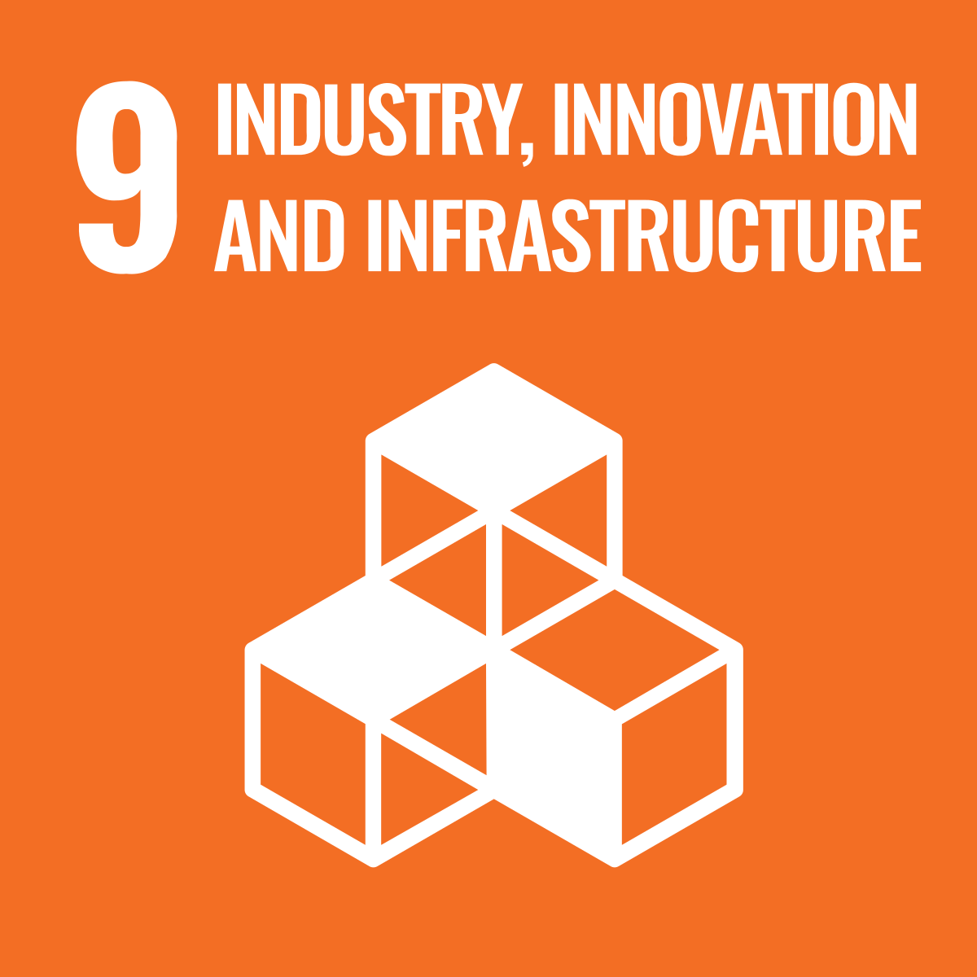
Industry, Innovation and Infrastructure
Build resilient infrastructure, promote inclusive and sustainable industrialisation, and foster innovation
Digital Introduction to the Sustainable Development Goals in Higher Education Teaching Regional Aspects in Implementing the SDGs from Brazil and South Africa

Slide 2
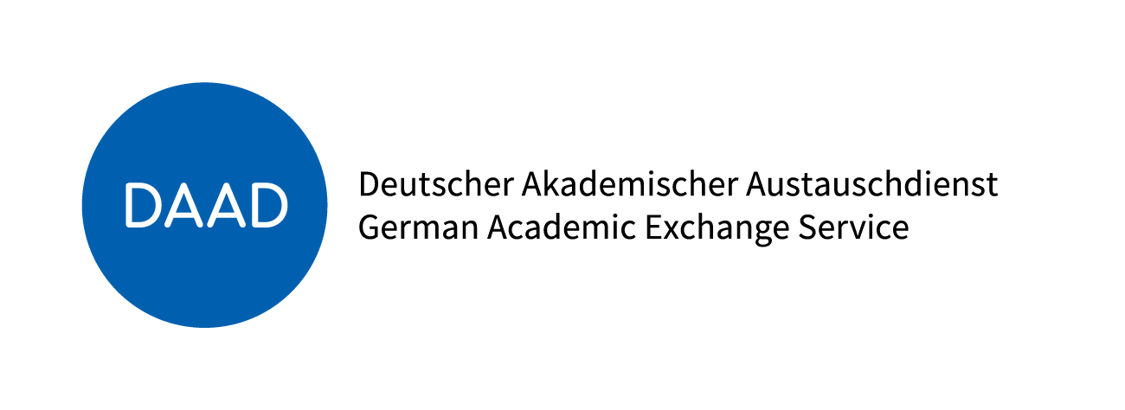
This project is funded by the German Academic Exchange Service

Slide 3
Table of Contents
1. Introduction to the SDGs
2. Defining SDG 9
3. Overview of global crises that have negatively impacted on the achievement of SDG 9
4. Progress towards the achievement of SDG 9 by 2030
5. Case Studies
6. Exercises and Assessment
7. Concluding remarks
Notes:
The aim of this module is to present an introduction to the SDG 1 “No poverty” covering its definition, the impact of global crisis on the achievement of its targets, the regional contexts progress towards SDG 1, case studies with good practices and examples of exercise that can be applied with students.

Slide 4
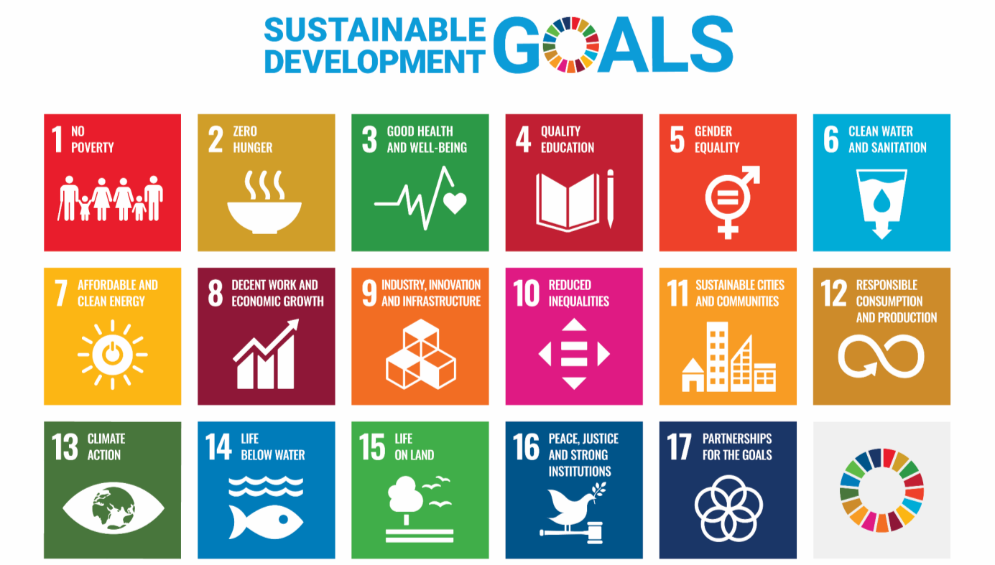
1. Introduction to the SDGs
Notes:
As you may be aware, here is the set of 2030 Agenda and the17 SDGs that integrated it.

Slide 5
2. Defining SDG 9
2.1 Significance
2.2 Interdependencies
2.3 Advantages
2.4 Challenges in the implementation
Notes:
The following chapter of the module explores the SDG1 definition covering four aspects: significance, interdependencies, advantages and challenges

Slide 6
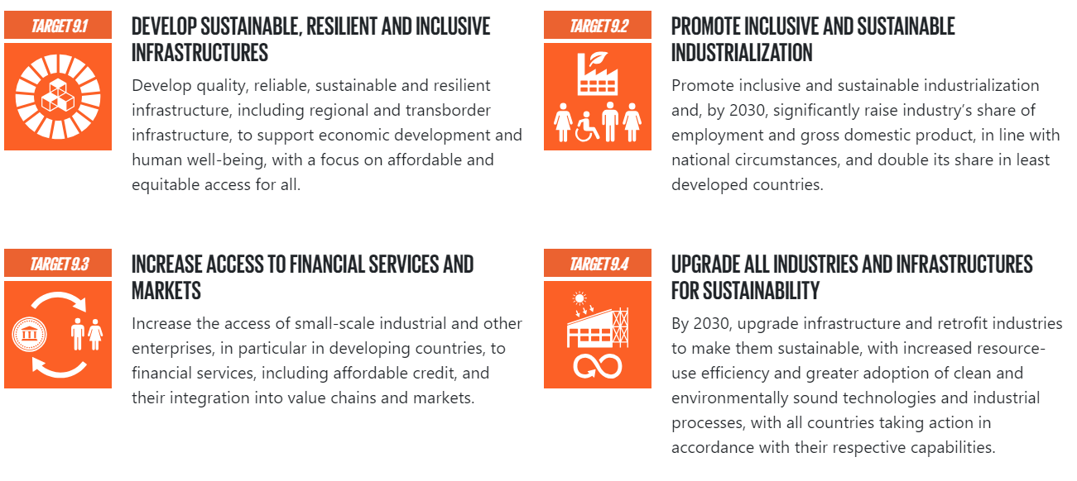
2. Defining SDG 9
Notes:
SDG 1 calls for action to “End poverty in all its forms everywhere” . It has five suggested global outcome targets and two additional targets referred as means of implementation, each one with one or more indicators to monitor progress over time. The targets cover topics such as extreme poverty, social protection systems, access to basic services, vulnerability and resilience, and resources and policies for implementation.

Slide 7
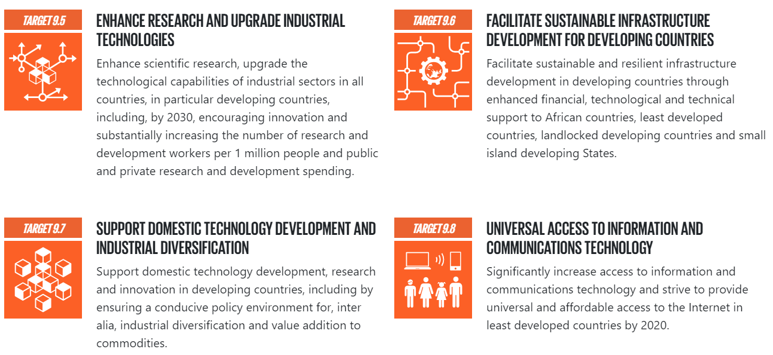
2. Defining SDG 9
Notes:
SDG 1 calls for action to “End poverty in all its forms everywhere” . It has five suggested global outcome targets and two additional targets referred as means of implementation, each one with one or more indicators to monitor progress over time. The targets cover topics such as extreme poverty, social protection systems, access to basic services, vulnerability and resilience, and resources and policies for implementation.

Slide 8
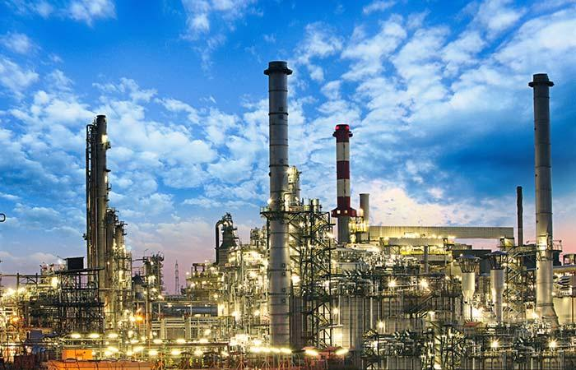
2. Definition SDG 9
INDUSTRY
Inclusive industrialization: Increase the industry's share of employment and GDP, with special attention to the least developed countries.
Sustainable industrialization: Improve resource efficiency and promote the adoption of clean technologies and environmentally friendly industrial processes.
Transition to a Green Economy: Characterized by low carbon emissions, resource efficiency, and social inclusion.
Notes:
to understanding what is behind the SDG 1, we present three important and closely connected concepts with the goal.

Slide 9
2. Definition SDG 9
INOVATION
Involves research and development (R&D) and new technologies.
Objetive: To find lasting solutions to economic and environmental challenges.
Examples of Impact: Creation of new jobs and promotion of energy efficiency.
Notes:
to understanding what is behind the SDG 1, we present three important and closely connected concepts with the goal.

Slide 10
2. Definition SDG 9
INFRASTRUCTURE
Quality infrastructure: It should be reliable, sustainable, and resilient, providing equitable access for all.
Impacts of sustainable infrastructure: Generates positive economic and social outcomes.
Resilient infrastructure: The ability to adapt to changing conditions, such as more adaptable systems that can withstand the impacts of a changing climate.
Notes:
to understanding what is behind the SDG 1, we present three important and closely connected concepts with the goal.

Slide 11
Advantages
Improved Infrastructure
Economic Growth
Innovation and Technological Advancement
Inclusive Development
Resilience to Climate Change and Disasters
Global Partnerships
Lack of innovation
Technology is traditionally dominated by large corporations
Digital divides within countries
Lack of investment in research and development (R&D)
Need to revolutionize capabilities and exchanges in science, technology, and innovation
Challenges
Notes:
What would be the posiive impacts if we achieve poverty alliviation?

Slide 12
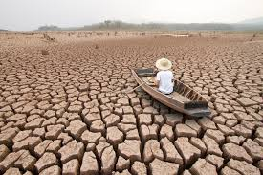
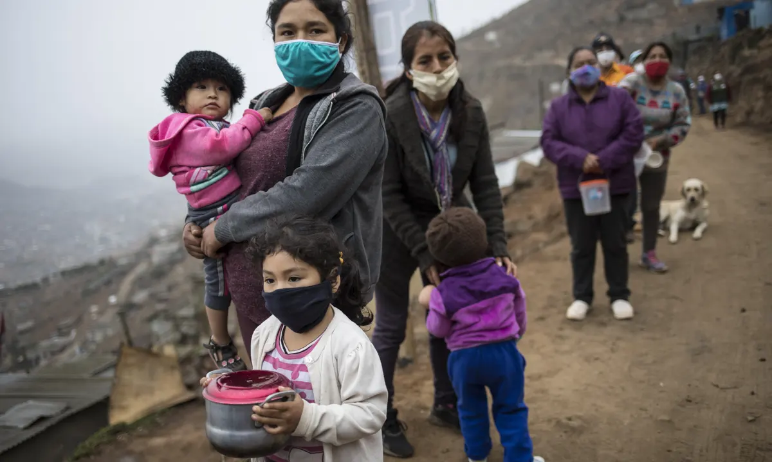
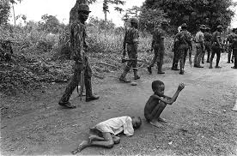
3. Overview of global crises
3.1 Climate Change
3.2 COVID-19 Pandemic
3.3 Conflict

Slide 13
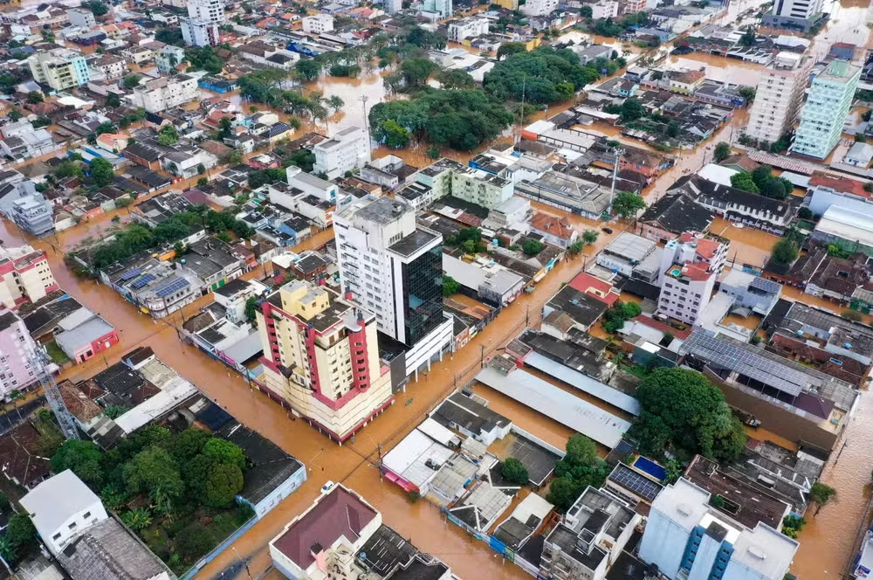
Climate Change
Damage to infrastructure
Disruption of industrial activity
Instability of energy systems
Financial risks
Reduced focus on innovation practices
Effect of the cyclone in Lajeado (September 2023), in Rio Grande do Sul — Photo: Marcelo Caumors / Instagram

Slide 14
COVID-19 Pandemic
Disruptions in supply chains and declines in demand and revenue in affected industries have hindered progress on SDG 9.
Infrastructure projects experienced delays due to the pandemic.
Lockdowns resulted in a significant economic halt, leading to decreased investment and economic stagnation.
The pandemic accelerated the adoption of digital technologies and remote work practices, which can enhance efficiency and innovation.
However, it also highlighted disparities in access to technology and digital infrastructure, especially in rural and underserved areas.

Slide 15
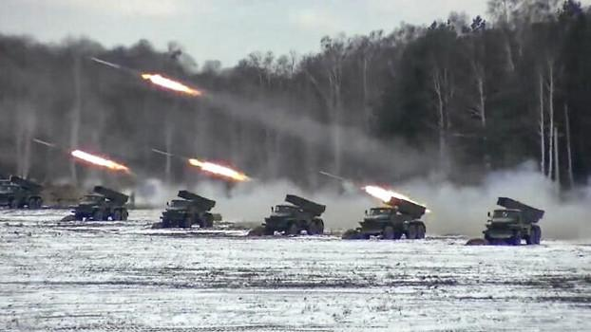
Conflict
Interruptions in economic activities, compromising growth and investments in innovative and sustainable practices.
Significant impact on infrastructure, industries, and services, requiring additional investments for reconstruction.
Increased uncertainties, leading to a reduction in investments.
Population displacement leads to refugee crises and lack of access to basic services, exacerbating poverty, food, and water insecurity.
Companies may shut down or relocate operations, resulting in job losses and reduced investment in infrastructure and industrial development.
Greater challenge in advancing technology and focusing on research and development, with some regions falling further behind in innovation and progress toward sustainability goals.
Notes:
https://www.statista.com/chart/21652/countries-with-armed-clashes-reported/

Slide 16
4. Progress towards the achievement of SDG 9

Slide 17
4. Progress towards the achievement of SDG 9

Slide 18
4. Progress towards the achievement of SDG 9

Slide 19
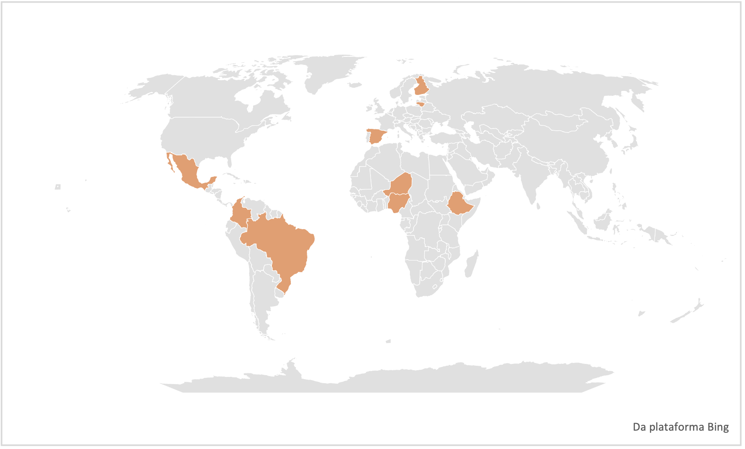
5. Case studies
5.1 Colombia
5.2 Mexico
5.3 Brazil
5.4 Niger
5.5 Nigeria
5.6 Ethiopia
5.7 Finland
5.8 Spain
5.9 Lithuania

Slide 20
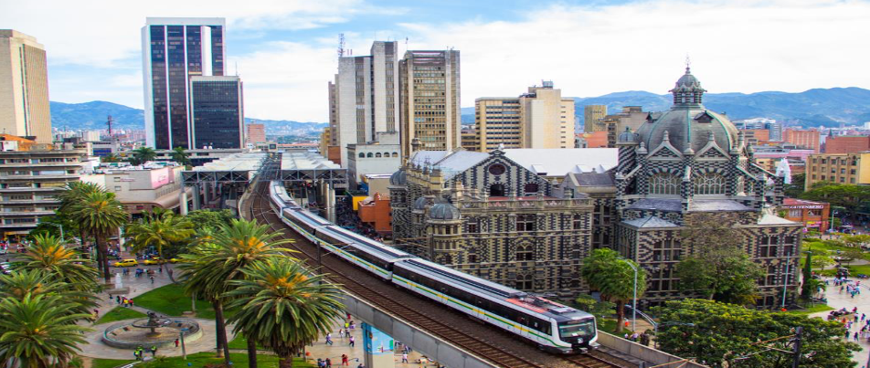
5.1 Case Studies in Latin America
Colombia: MDE – Medellín Smart City
Formerly known for security challenges, it has transformed into a global hub for technological and social innovation.
Strategic interventions have turned it into a smart city, with a focus on mobility, environmental management, and security.

Slide 21
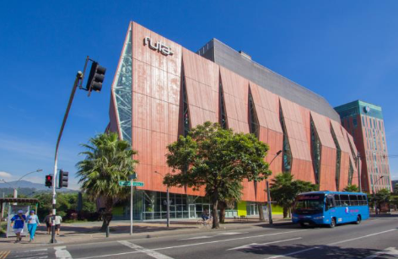
5.1 Case Studies in Latin America
Colombia: MDE – Medellín Smart City
Smart Mobility System (SIMM)
Early Warning System (SIATA)
Noise Monitoring Network and Air Quality Network
Integrated Metropolitan Emergency and Security System (SIES-M)
Key technological enablers:Big Data, Blockchain, Cloud Services, Digital/Open Government, Artificial Intelligence, Internet of Things (IoT), and 5G/fibre.

Slide 22
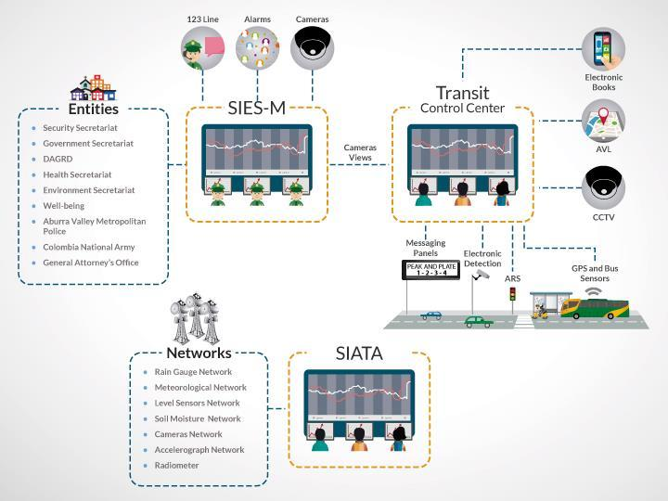
5.1 Case Studies in Latin America
Colombia: MDE – Medellín Smart City
Economy: More than 2,500 technology companies in the IT sector are operating in the city.
Thriving tech hub: Job creation, with 26,669 new jobs in the sector in 2021 alone.

Slide 23
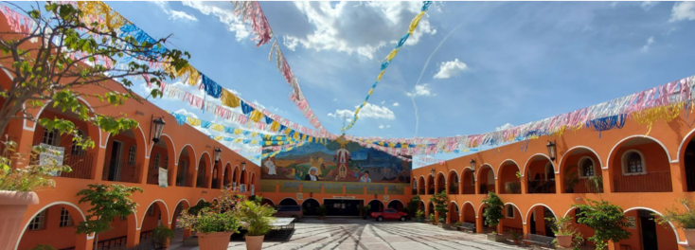
5.1 Case Studies in Latin America
Mexico: Guadalajara – Digital Empowerment in a Conflict Zone

Slide 24
5.1 Case Studies in Latin America
Mexico: Guadalajara – Digital Empowerment in a Conflict Zone
FabLabs are digital fabrication laboratories that are part of the maker movement, promoting community engagement, entrepreneurship, creativity, and education.
There are over 1,600 FabLabs worldwide, including 27 in Mexico.They serve as incubators for community development solutions and responses to global challenges.
FabLab Nueva Santa Maria was inaugurated in 2018 in the Cerro community.
Established in partnership with ITESO University and the local community.
Its operational model divides the FabLab’s activities into two main buckets: (1) training and (2) creative space.

Slide 25
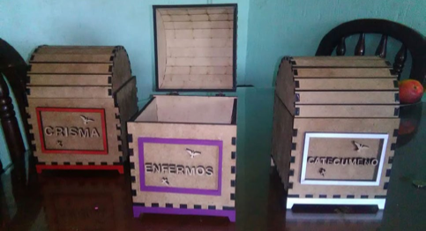
5.1 Case Studies in Latin America
Mexico: Guadalajara – Digital Empowerment in a Conflict Zone
Training community members to create various items using equipment such as a laser cutter, a 3D printer, and a computer numerical control (CNC) router.
Driven by: community ownership, operational self-sufficiency, and the need for success stories within the community.

Slide 26
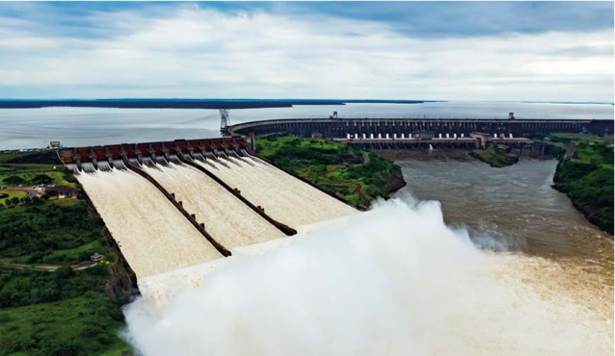
5.1 Case Studies in Latin America
Brazil: Itaipu Binacional
Established in 1974 by Brazil and Paraguay, Itaipu is a binational institution created to harness the power of the Paraná River—which forms the border between the two countries—for hydroelectric energy generation. Today, the Itaipu Hydropower Plant is the world’s largest producer of renewable energy.

Slide 27
5.1 Case Studies in Latin America
Brazil: Itaipu Binacional
Construction of cross-border bridges
Implementation of the Regional Infrastructure Development Programme
Technological upgrading of the Itaipu Hydropower Plant
Sustainable rural development
Sustainable territorial management
Center for Advanced Studies in Dam Safety
Laboratory for Automation and Simulation of Electrical Systems
Territorial Intelligence Center
Pilot Project for Microgrids in Western Paraná

Slide 28
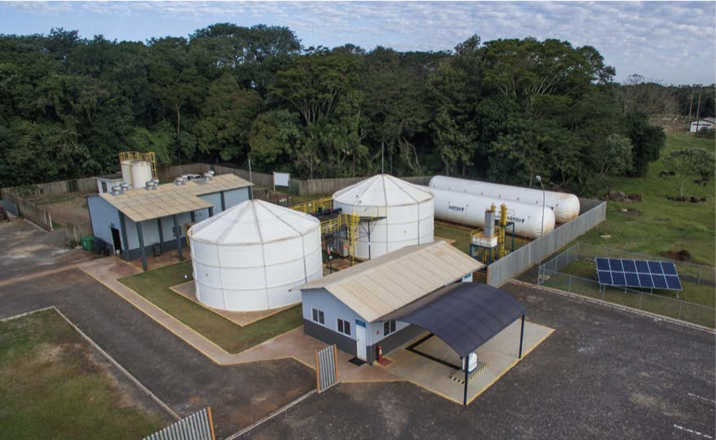
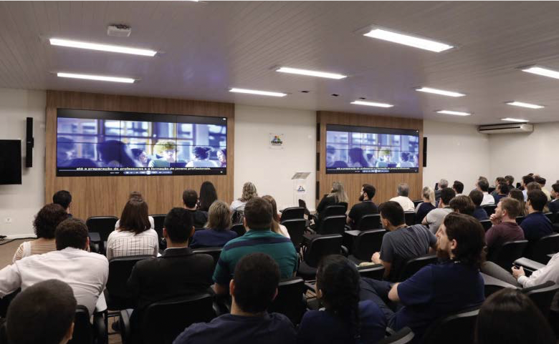
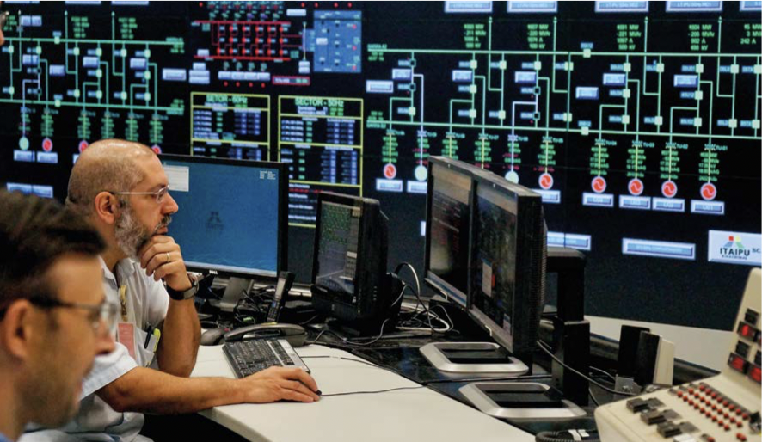
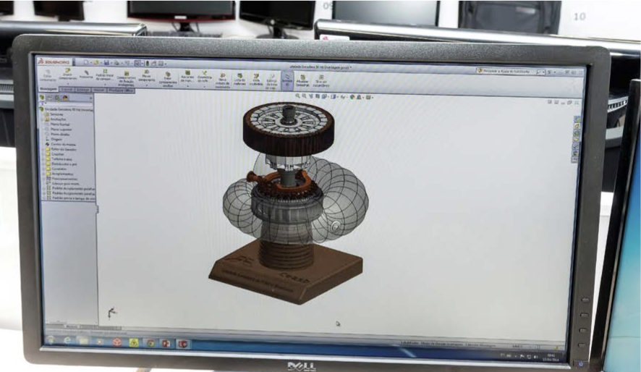
Brazil: Itaipu Binacional

Slide 29
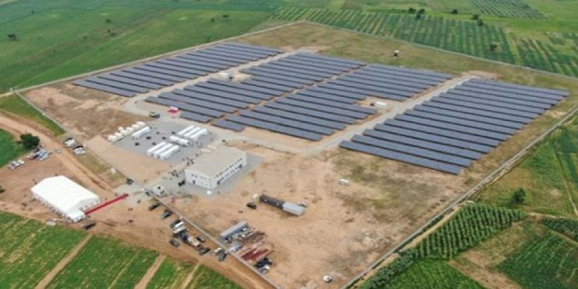
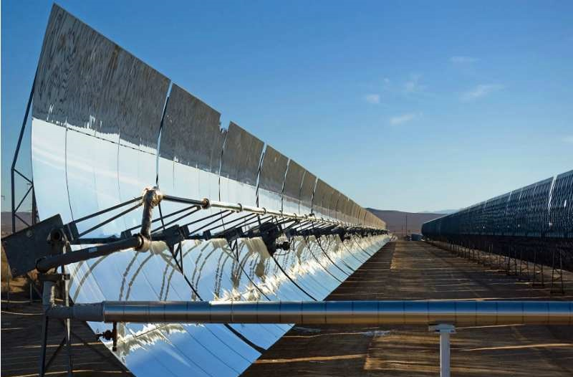
5.2 Case Studies – Africa
Gorou Banda Solar Power Plant (Niger)

Slide 30
5.2 Case Studies – Africa
Gorou Banda Solar Power Plant (Niger)
The largest solar park in Niger, with 55,776 solar panels.
Each panel generates 540W of power, making it the first renewable energy source connected to the national grid in the country.
Located 12 km from Niamey, the plant was established to reduce Niger’s energy dependence on neighbouring countries.
The project involved an investment of over 30 million euros, with contributions from the EU, AFD, and the Government of Niger.
Its objectives include increasing renewable energy coverage, reducing electricity imports, investing in sustainable infrastructure, and attracting foreign investors.

Slide 31
5.2 Case Studies – Africa
Gorou Banda Solar Power Plant (Niger)
Inaugurated on July 5, 2023, marking a significant milestone for the Niamey region in Niger.
The plant has played a key role in reducing power rationing in the region, producing 53 GWh of electricity per year—enough to supply 70,000 households or 500,000 people.
It is also expected to prevent the emission of up to 23,000 tonnes of CO₂ annually.
The project included the construction of 330 kV high-voltage lines to facilitate electricity exchange with other member countries of the Economic Community of West African States (ECOWAS).

Slide 32
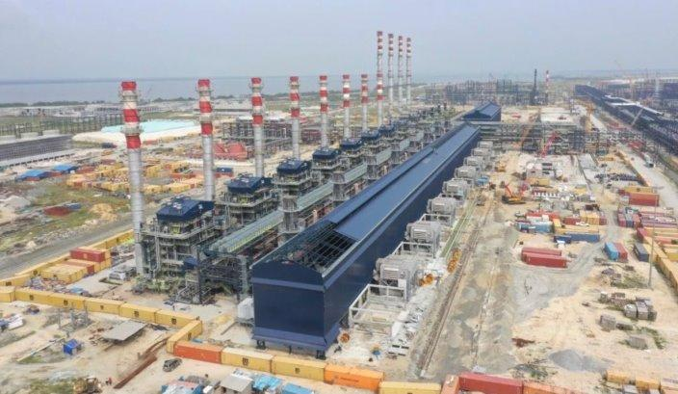
5.2 Case Studies – Africa
Dangote Refinery Project, Nigeria

Slide 33
5.2 Case Studies – Africa
Dangote Refinery Project, Nigeria
Inaugurated on May 22, 2023, the project aims to end gasoline imports and boost Nigeria’s oil sector.
It is the first privately-owned oil refinery in Nigeria, with an initial production capacity of 350,000 barrels per day, eventually reaching 650,000 barrels per day.
The project seeks to increase refining capacity, eliminate fuel shortages, and improve fuel quality.
The refinery is expected to have a significant impact on Nigeria’s energy sector, making the country self-sufficient in refining capacity and a potential exporter of refined petroleum products.
At full capacity, it will meet 100% of Nigeria’s needs for gasoline, diesel, kerosene, and jet fuel.

Slide 34
5.2 Case Studies – Africa
Dangote Refinery Project, Nigeria
Creates 9,500 direct jobs and 25,000 indirect jobs.
Around 900 young engineers were trained abroad in refinery operations.
The project included on-site infrastructure development such as a pipeline system, access roads, tank storage facilities, and crude oil and product handling systems.
The plant also houses a fertiliser factory, which uses refinery by-products as raw material, thereby avoiding waste generation.
By reducing petroleum imports, Nigeria is expected to save around USD 30 billion in foreign exchange, while also generating an additional USD 10 billion in foreign currency through the export of refined petroleum products.
The establishment of the Dangote Refinery is expected to reduce gas prices for consumers, which have tripled since 2022.

Slide 35
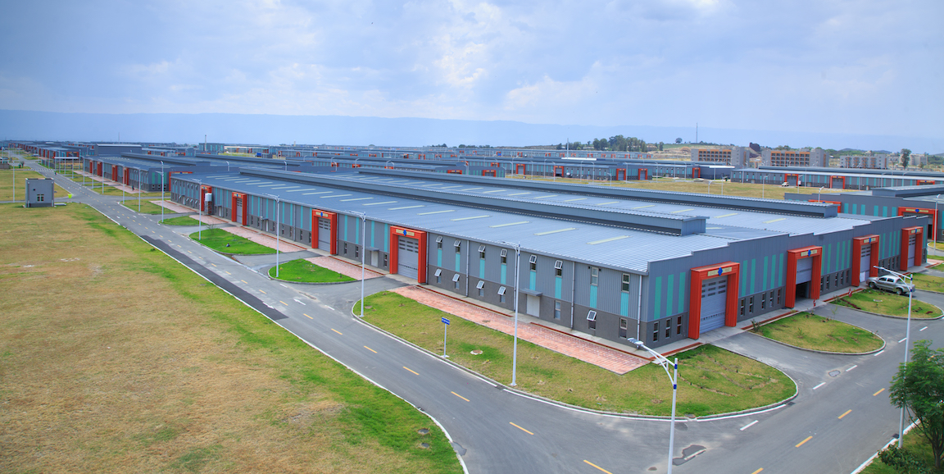
5.2 Case Studies – Africa
Hawassa Industrial Park (HIP)

Slide 36
5.2 Case Studies – Africa
Hawassa Industrial Park (HIP)
The Ethiopian government launched an industrialisation strategy based on the creation of special economic zones as hubs for export-oriented light manufacturing.
Inaugurated on July 13, 2016, it is the largest in Sub-Saharan Africa.
Located in Hawassa, southern Ethiopia, the park focuses on garment and textile manufacturing, aiming to boost the sector.
The first phase covers around 130 hectares, with the potential to expand to 400 hectares, and was built by the China Civil Engineering Construction Corporation (CCECC).
The Ethiopian federal government views the development of industrial parks as a strategic approach to attract investment and accelerate the growth of the manufacturing sector, in line with SDG targets 9.2 and 9.3.
As of 2021, the Hawassa Industrial Park employed over 35,000 workers, generating more national export revenue and employing more people than the rest of Ethiopia’s textile and apparel manufacturing industry combined.

Slide 37
5.2 Case Studies – Africa
Hawassa Industrial Park (HIP)
The park is expected to create between 60,000 and 80,000 jobs and increase textile and apparel export revenues from USD 100 million to USD 1 billion.
It has led to the installation and development of infrastructure such as roads, water, electricity, telecommunications, and public services to create a conducive environment for industrial clusters.
Anchored by global textile company PVH, the park has also attracted investment from over 20 other companies.
Despite facing challenges in 2022, the park demonstrated its potential to revitalise the sector by generating over USD 32 million in revenue in the last three months of 2022.

Slide 38
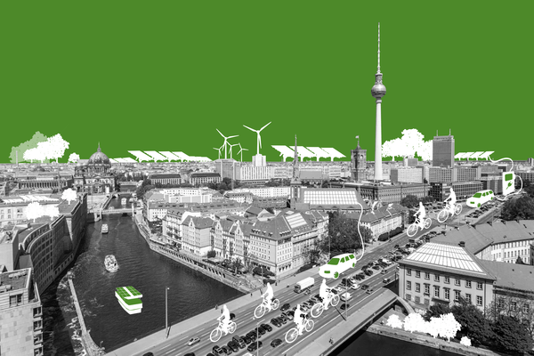
5.3 Case Studies – Europe
Finland: Helsinki Climate Street Project

Slide 39
5.3 Case Studies – Europe
Finland: Helsinki Climate Street Project
Since 2015, the Climate Street initiative in Helsinki and neighbouring Vantaa has identified three key streets—Iso Roba, Tikkurila, and Asematie—as testing grounds for innovative, resource-efficient, and low-carbon solutions.
Through collaborative efforts involving local residents, property owners, businesses, and NGOs, the Climate Street team aims to co-create and share knowledge on smart climate practices and technologies.
Pilot projects have introduced innovative methods to monitor energy consumption in buildings and reduce food waste in commercial establishments.
Environmentally friendly lighting has been installed, climate-resilient vegetation cultivated, and underground stormwater retention facilities established.

Slide 40
5.3 Case Studies – Europe
Finland: Helsinki Climate Street Project
The success of Climate Street is attributed to meticulous engagement with diverse stakeholders, fostering trust and collaboration from the outset.
The project has achieved significant milestones, with tangible impacts already evident.
Its sustainability is grounded in the proactive involvement of informed and engaged residents, as well as ongoing collaboration among members of the business community, supported by networking initiatives.
The project also engages the younger generation, as seen in events like Earth Hour, which promote awareness and education on climate conservation.

Slide 41
5.3 Case Studies – Europe
Spain: DIVERSITOURS

Slide 42
5.3 Case Studies – Europe
Spain: DIVERSITOURS
Selection of territories based on criteria such as cultural diversity and development potential
Training of intercultural guides to narrate local stories
Creation of neighbourhood narratives based on exploratory studies
Development of intercultural visit routes and mapsImplementation of in-person routes
Production of virtual reality content
Involvement of various stakeholders, including local institutions, social entities, and citizens
Led by organisations such as the Bilbao City Council
Collaboration among various governmental, academic, and social entities

Slide 43
5.3 Case Studies – Europe
Spain: DIVERSITOURS
The DIVERSITOURS project had a significant impact, involving a wide range of participants and gaining recognition at local, national, and international levels.
Between 2021 and 2023, 27 tours were conducted, engaging 597 people with a diverse demographic composition.
Over 400 individuals participated in the virtual experience during the 2022 Loturak Festival.
Project effectiveness was positively evaluated, with an average satisfaction score of 9.24 out of 10 for the in-person routes.
Effective communication—including branding, informational materials, and the use of social media—helped increase the project’s visibility and engagement.

Slide 44
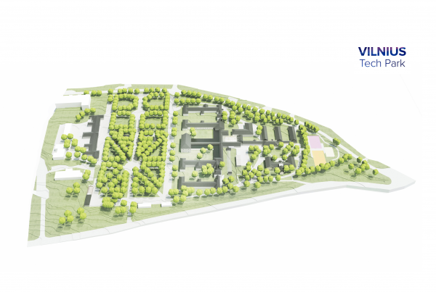
5.3 Case Studies – Europe
Lithuania: Vilnius Tech Park

Slide 45
5.3 Case Studies – Europe
Lithuania: Vilnius Tech Park
Vilnius Tech Park has been a leader in creating cutting-edge facilities since 2016, including a conference centre and the Sapiegos Corporate space for collaboration between companies and entrepreneurs.
The park is committed to community engagement, offering programmes such as CodeAcademy for programming skills and Miesto Laboratorijos, a citizen lab focused on eco-gardening.
In addition, Vilnius Tech Park contributes significantly to Vilnius’ cultural scene, collaborating on events such as Culture Night.Vilnius Tech Park is the leading ICT hub in the Nordic and Baltic regions.

Slide 46
5.3 Case Studies – Europe
Lithuania: Vilnius Tech Park
An eight-hectare area was revitalised to create over 9,000 square metres of office space.
The park hosts more than 65 cutting-edge companies and has become an attractive hub for foreign ventures and individual talent.
Vilnius has gained greater visibility as a tourist destination, with increasing numbers of visitors and the emergence of local tour businesses each year.
Sapieha Park serves as the epicentre of leisure activities in the city, fostering community engagement and startup participation.

Slide 47
6.1 Exercises
Case study analysis: Lecturers can either provide students with real-world case studies (some examples are available on the Urban Sustainability Exchange website, and additional resources can be accessed from the Springer Nature website) related to SDG 9, or ask students to look for cases and bring these to class. Students can analyse these cases, identify the challenges and opportunities related to SDG 9, and propose sustainable solutions.
Group discussions and debates: Lecturers can organise group discussions and debates on various aspects of SDG 9, such as the role of resilience, innovation and technology. The discussions could include the way in which SDG 9 connects with the other goals, and promote the analysis of different perspectives.
Guest lectures: Students can be asked to invite guest lecturers to class; these could be guest speakers from relevant industries, innovation agencies, or government agencies who would share their experiences and insights and practical knowledge related to SDG 9.
Notes:
Following we have some suggested exercise that proveque students demonstrate empathy by designing a campaign for those affected by poverty,

Slide 48
6.1 Exercises
Good practices: Choose one practice on the good practices platform (https://sustainabledevelopment.un.org/partnerships/goodpractices), and present it to and discuss it with the group: What are the lessons learnt, and how can it be replicated in other contexts? Compare and discuss the data on economic growth in Latin America, Africa and Europe.
Notes:
An exercise that students should assess different strategies communities around the world are applying to face poverty challenges
And also an exercise to allows to reflect on the conditions of living in extreme poverty

Slide 49
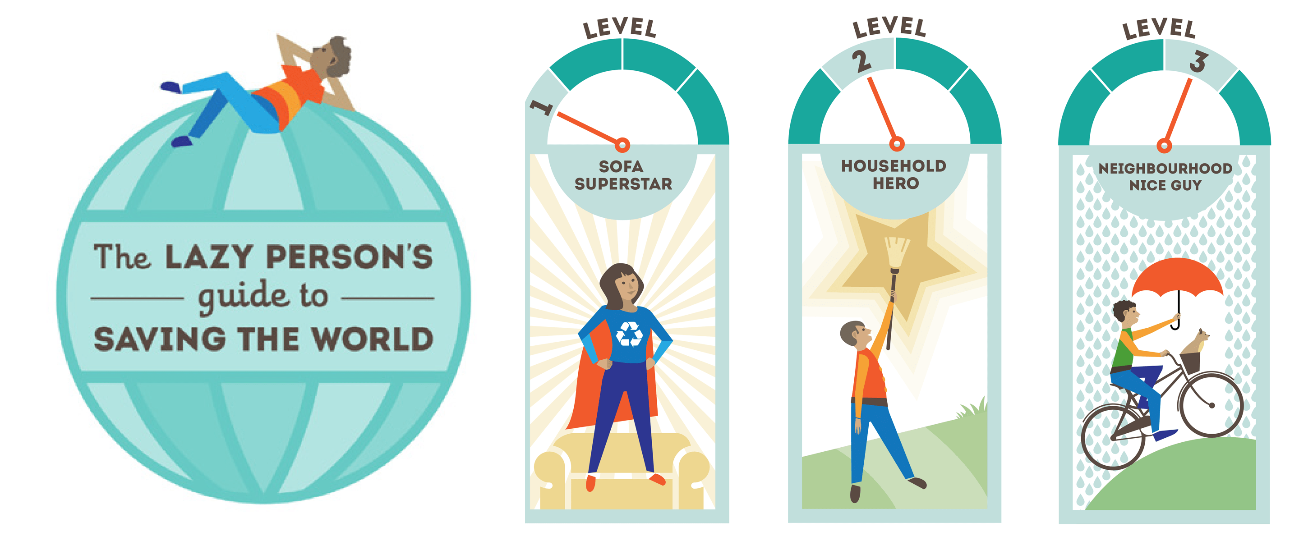
7 Concluding remarks
Introduction to the key aspects of SDG 9 – Industry, Innovation and Infrastructure, also addressing the impacts of various crises on the achievement of this goal, as well as the regional contexts and progress in Latin America, Africa, and Europe.
Case studies and good practices are included to support teaching with examples of different strategies used around the world and within the studied regions to promote resilient infrastructure, sustainable industrialisation, technological development, and innovation.
How can we be the change in the way forward?
Source: United Nations (2023a).
Source: United Nations (2023b).
Notes:
We hope all of you have learned bit more about the SDG1 in this class, we have Reinforced the continued relevance of the 2030 Agenda for Sustainable Development and finally give you an advace... we can do it wecan do it...

Slide 50
Thank you!
Project funded by the German Academic Exchange Service
Prof. Dr. Luciana Brandli Titular professor at the University of Passo Fundo / College of Engineering and Architecture
brandli@upf.br
Prof. Dr. Rudi Pretorius College of Agriculture and Environmental Sciences, University of South Africa
pretorw@unisa.ac.za
Prof. Dr. Dr. Walter Leal Head of Research & Transfer Center Sustainability & Climate Change Management at HAW Hamburg
walter.leal2@haw-hamburg.de

