Slide 1
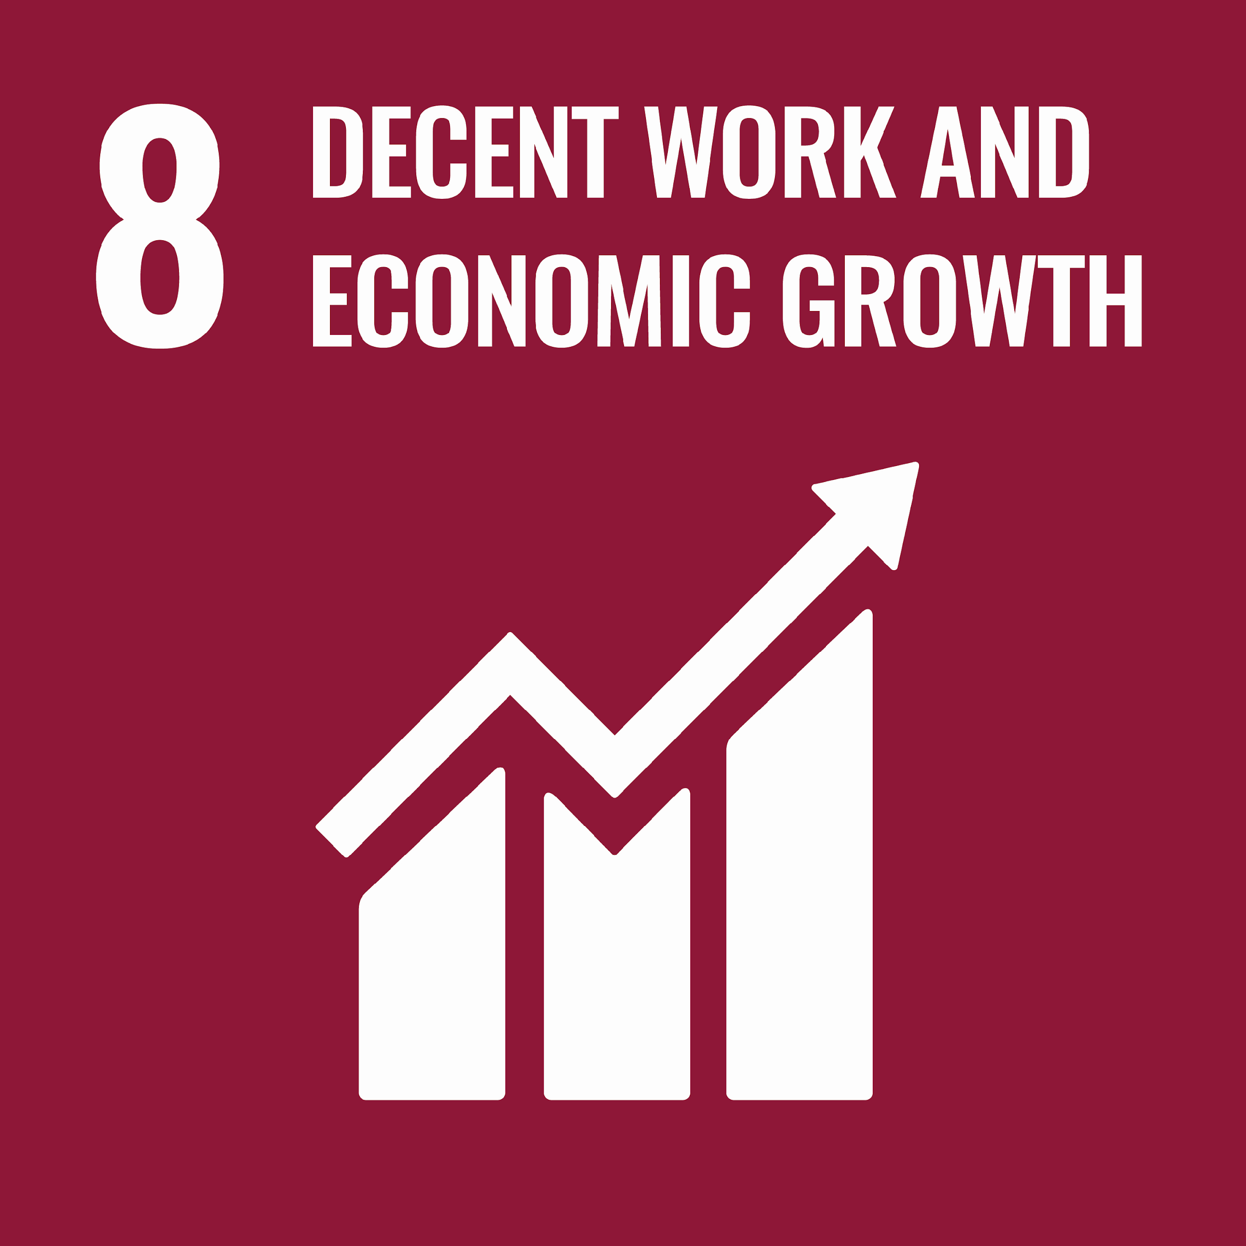
Decent work and economic growth
Promote sustained, inclusive and sustainable economic growth, full and productive employment and decent work for all
Digital Introduction to the Sustainable Development Goals in Higher Education Teaching Regional Aspects in Implementing the SDGs from Brazil and South Africa

Slide 2
Table of Contents
1. Introduction to the SDGs
2. Defining SDG 8
3. Overview of various crises that have negatively impacted on the achievement of SDG 8
4. Progress towards the achievement of SDG 8 by 2030
5. Case Studies
6. Exercises and Assessment
7. Concluding remarks
Notes:
The aim of this module is to present an introduction to the SDG 8 “Decent work and economic growth” covering its definition, the impact of global crisis on the achievement of its targets, the regional contexts progress towards SDG 8, case studies with good practices and examples of exercise that can be applied with students.

Slide 3
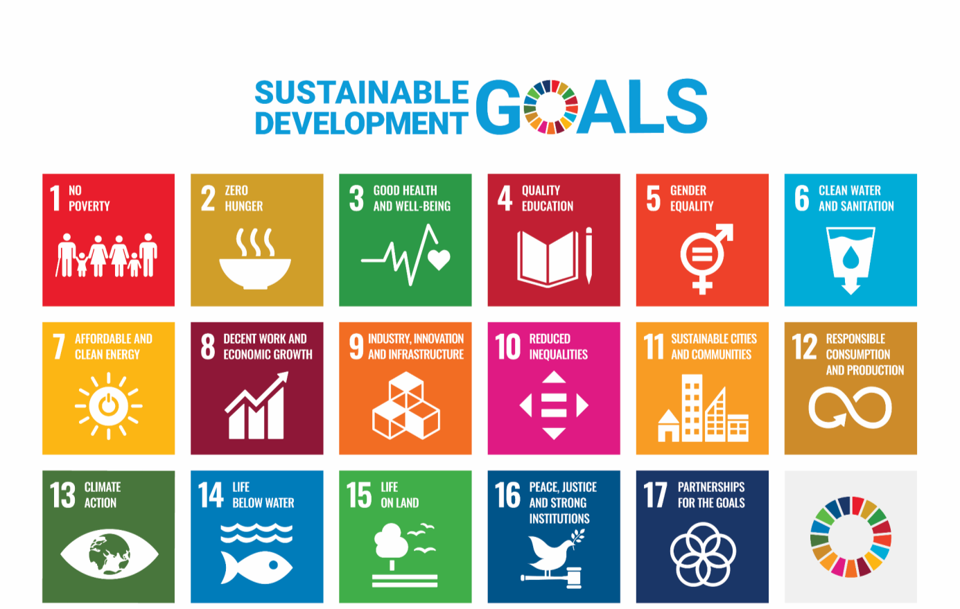
1. Introduction to the SDGs
Notes:
As you may be aware, here is the set of 2030 Agenda and the17 SDGs that integrated it.

Slide 4
2. Defining SDG 8
2.1 Significance
2.2 Interdependencies
2.3 Advantages
2.4 Challenges in the implementation
Notes:
The following chapter of the module explores the SDG8 definition covering four aspects: significance, interdependencies, advantages and challenges

Slide 5
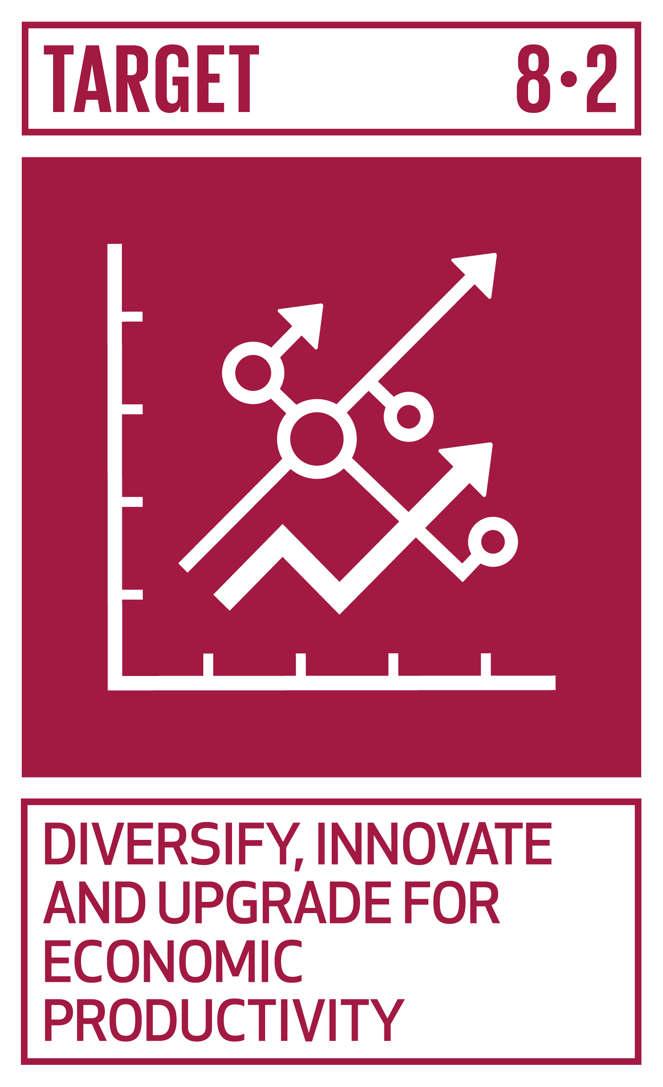
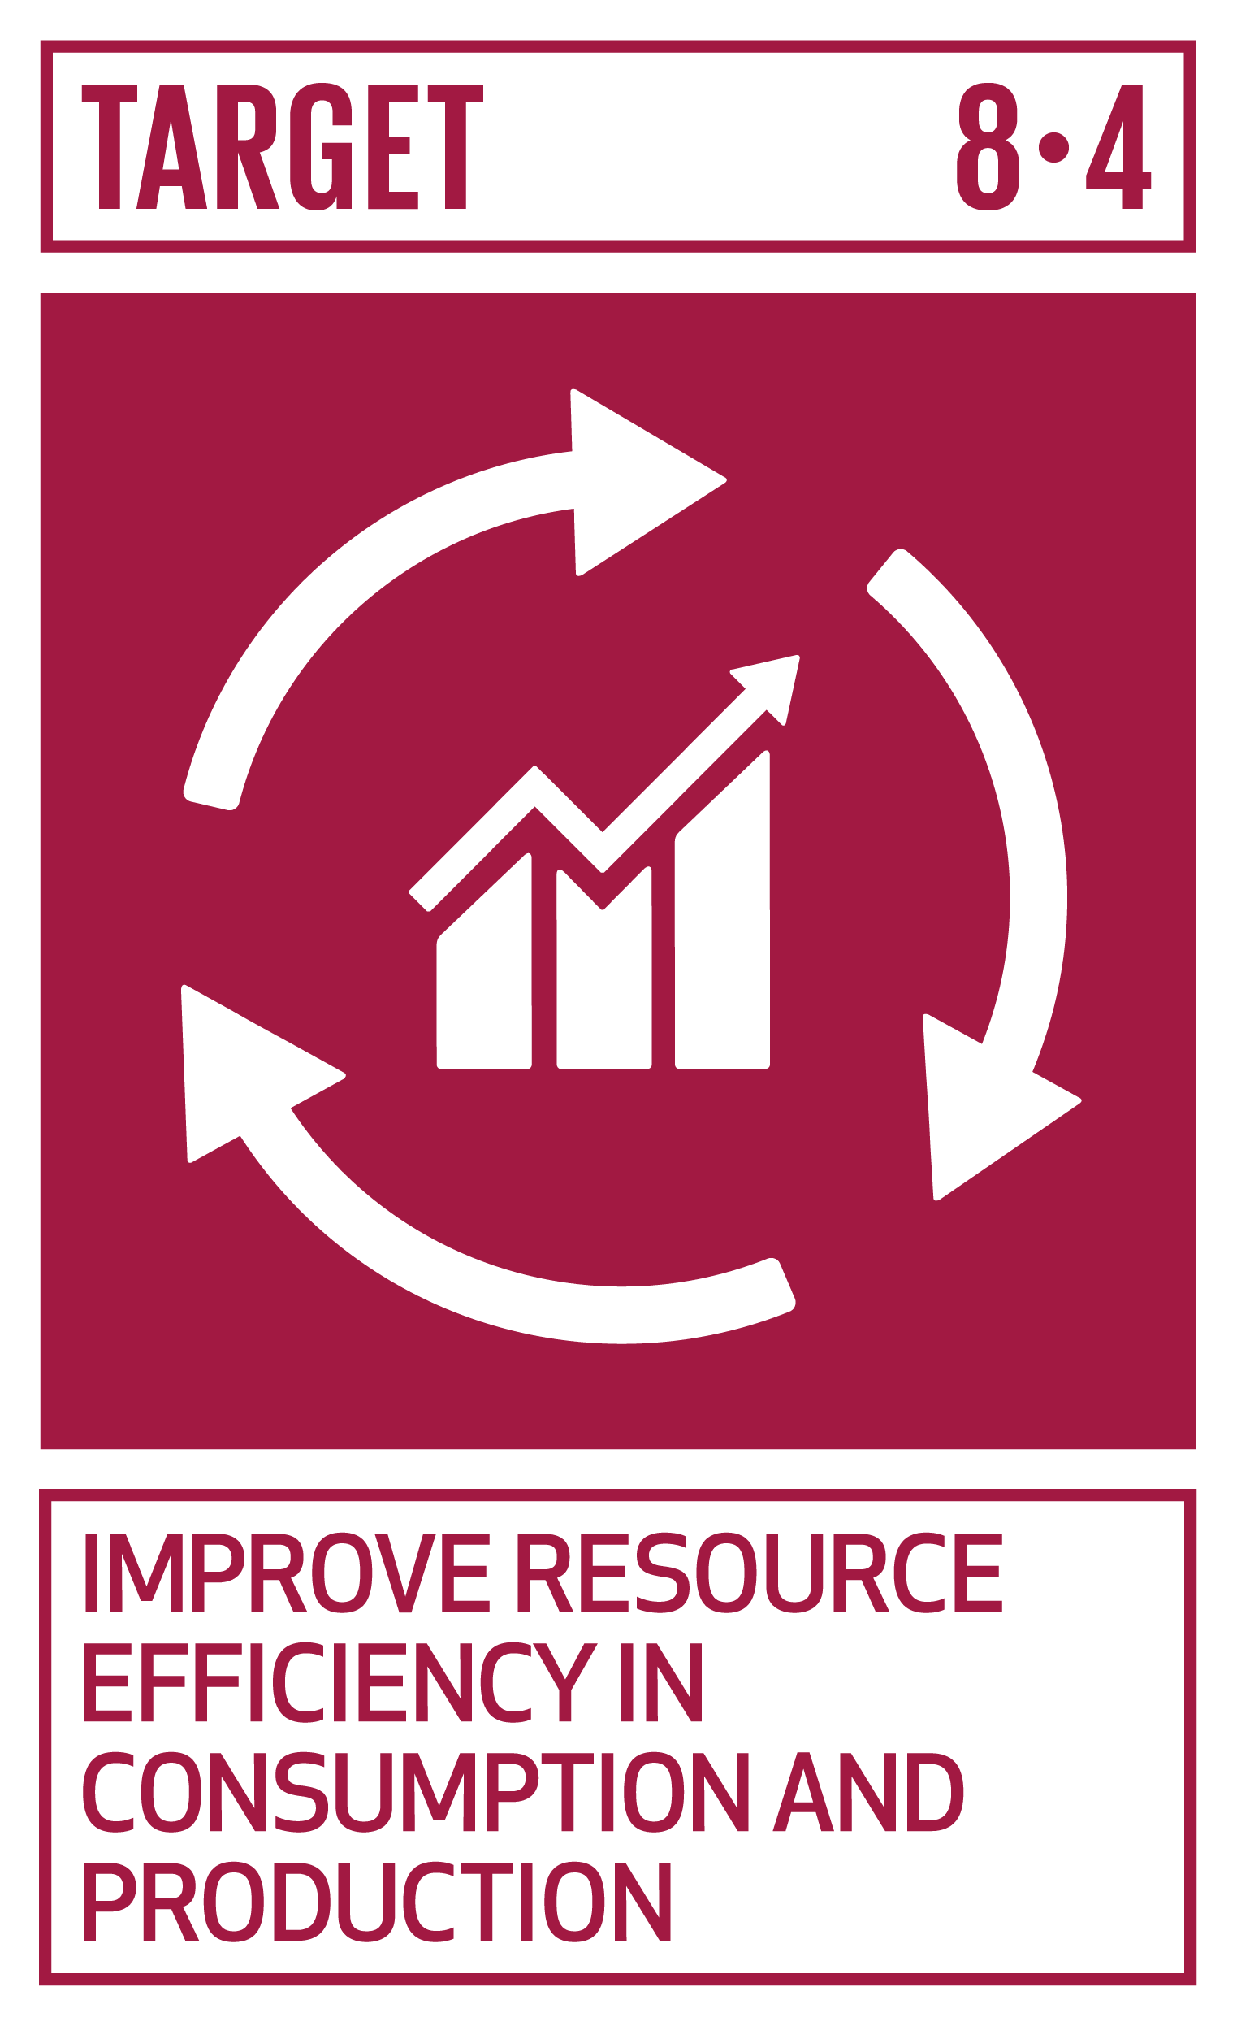
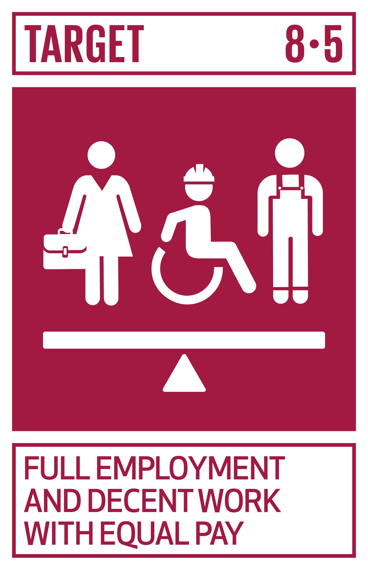
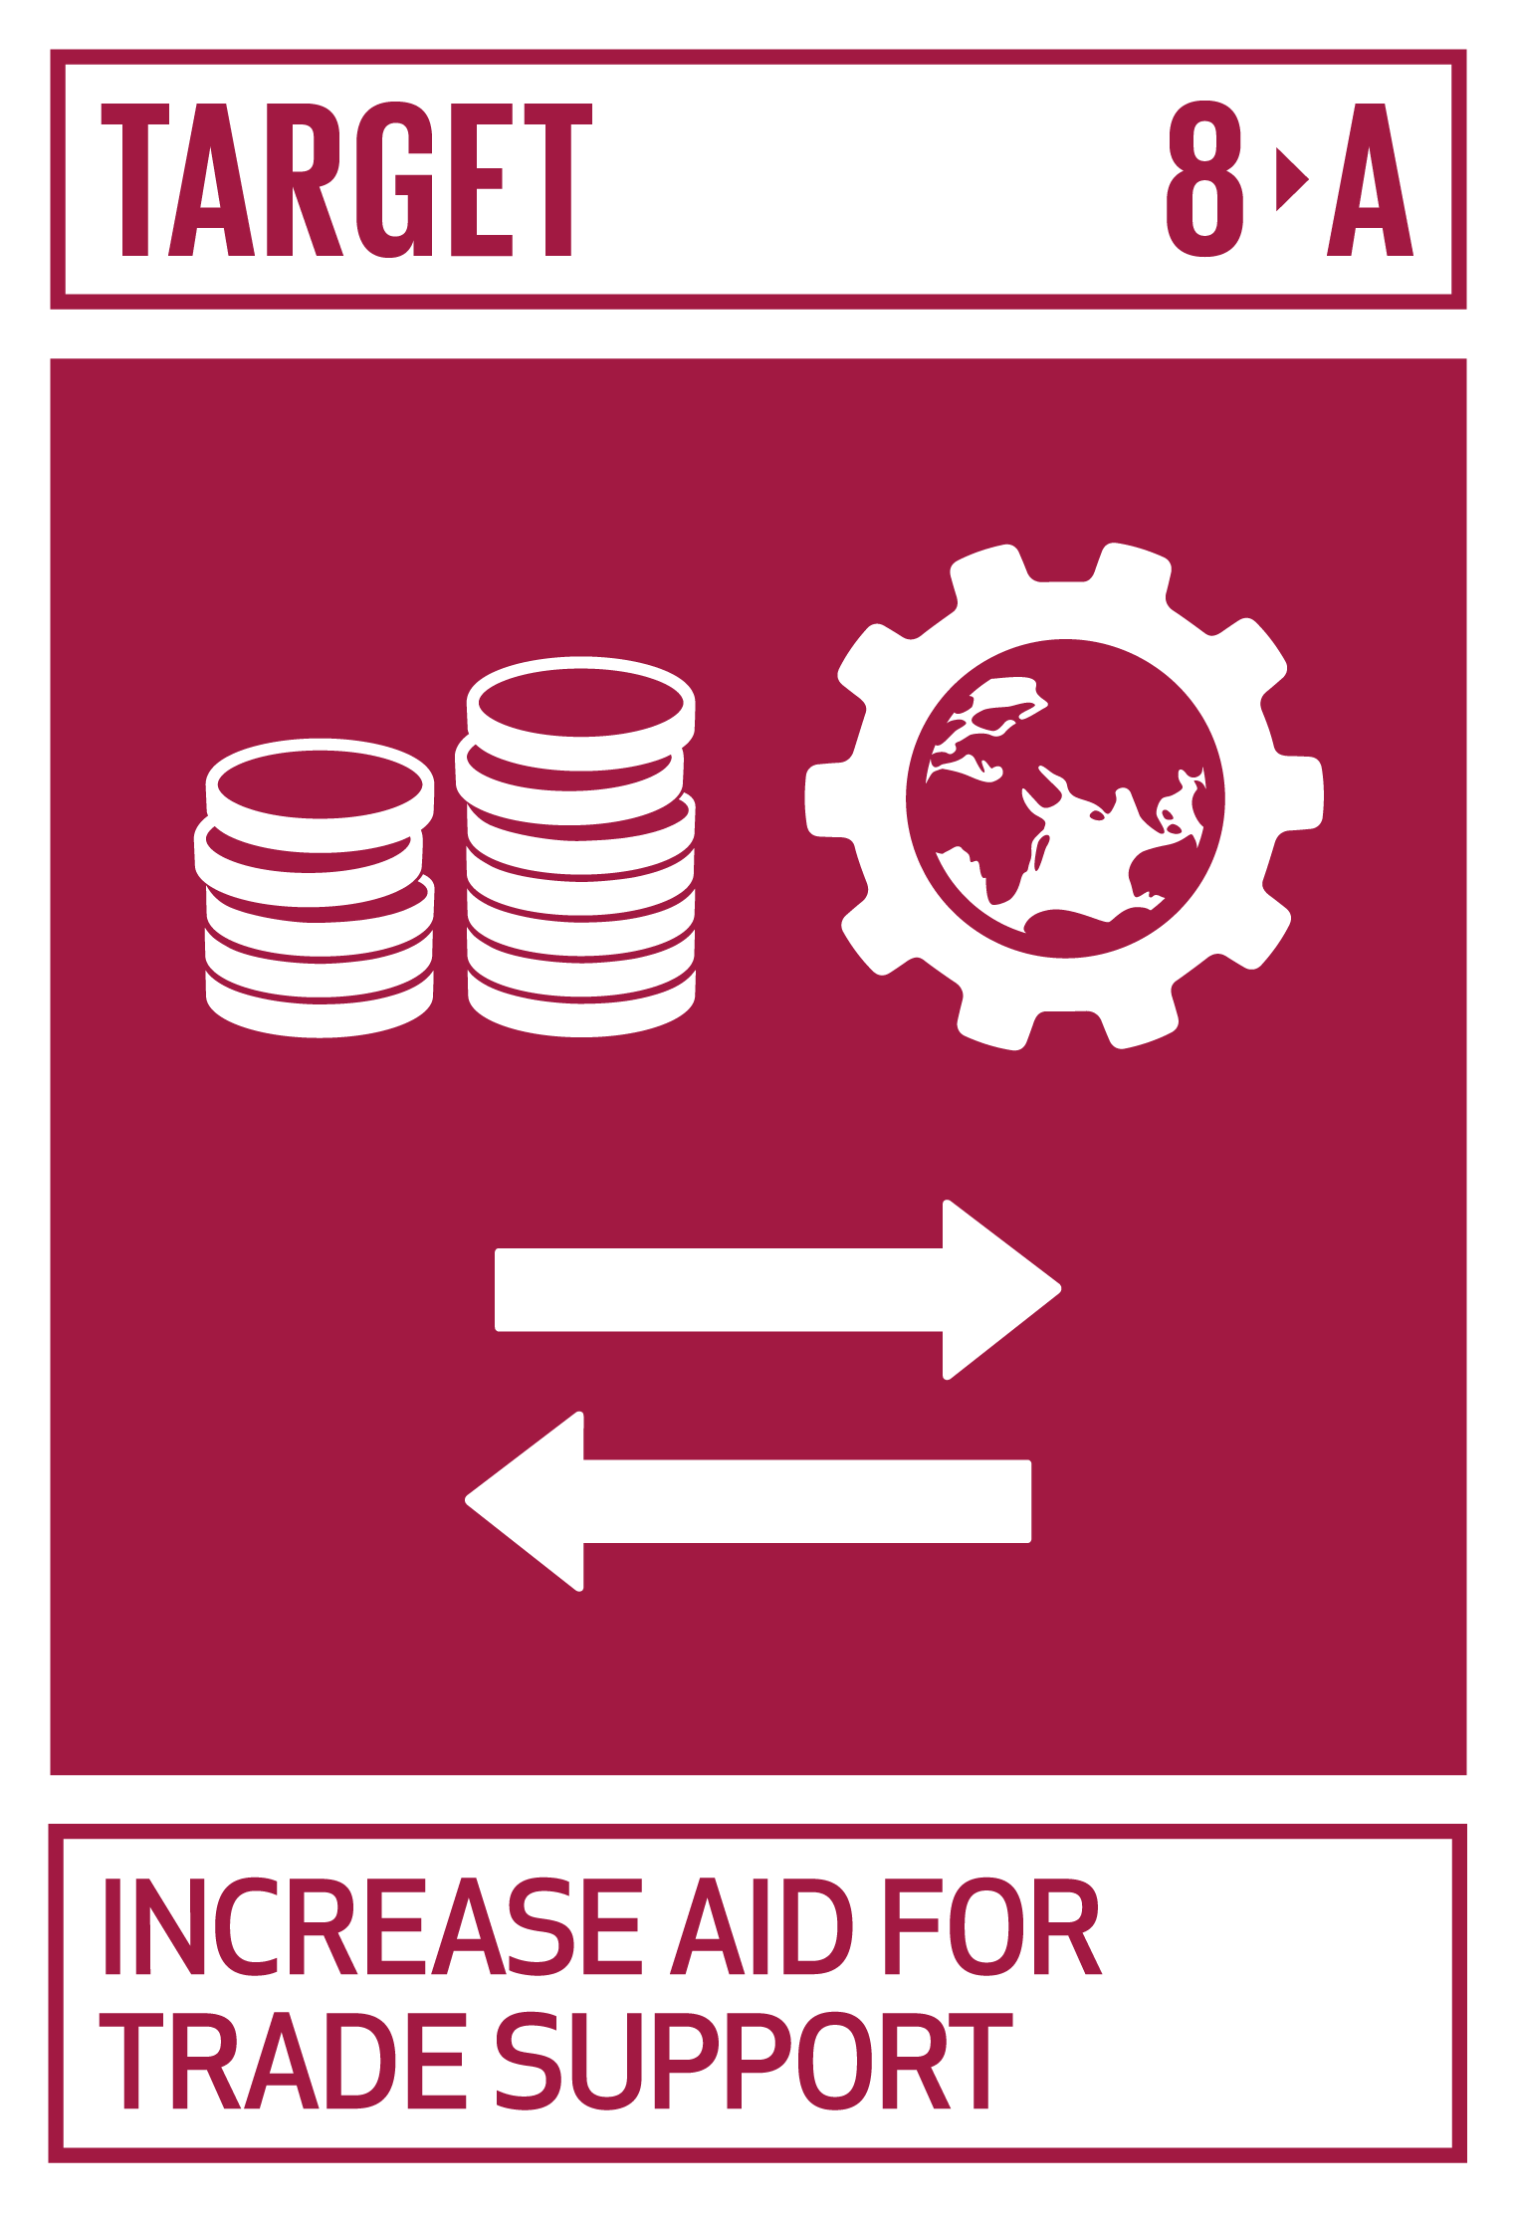
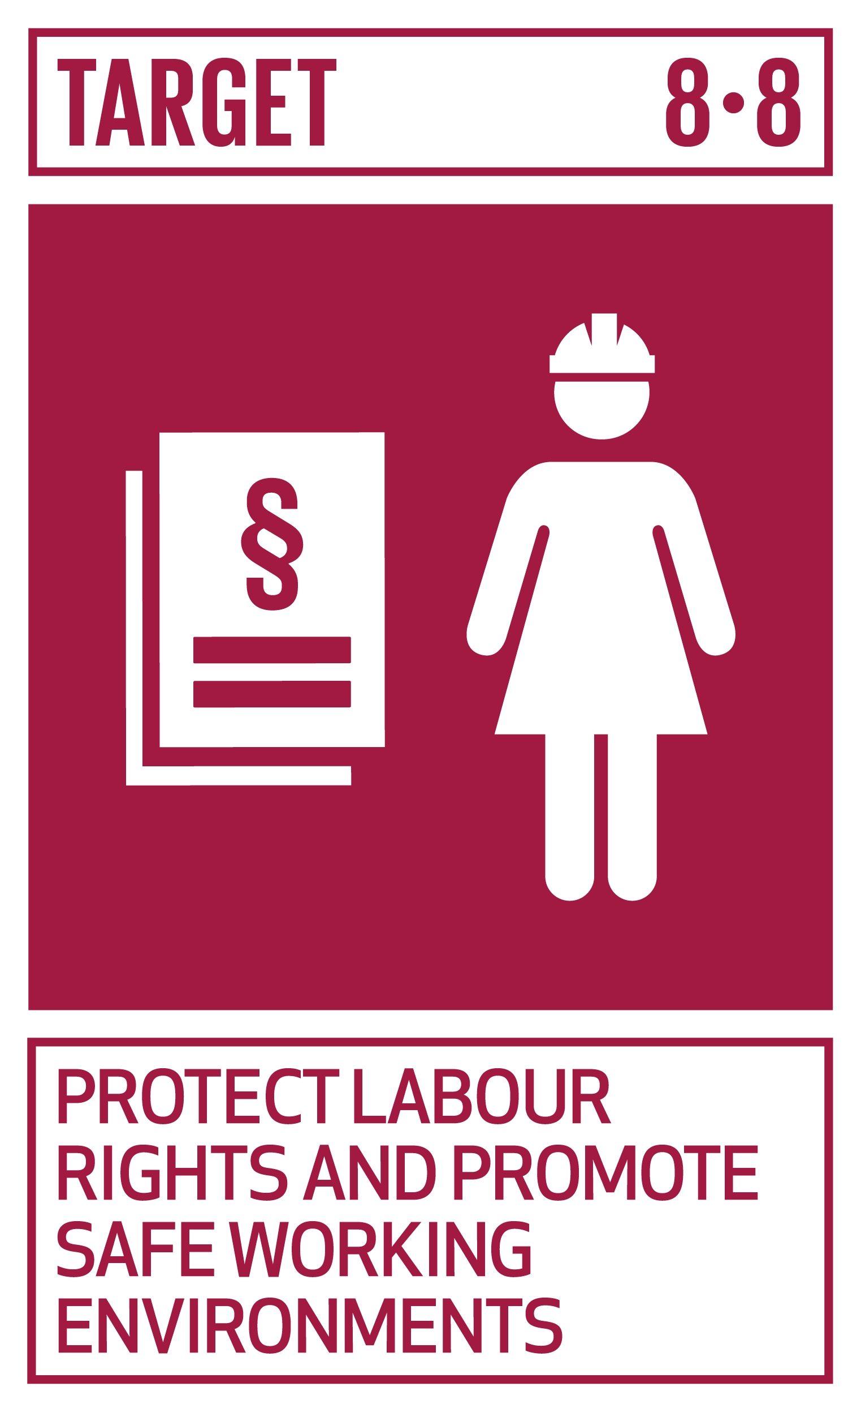
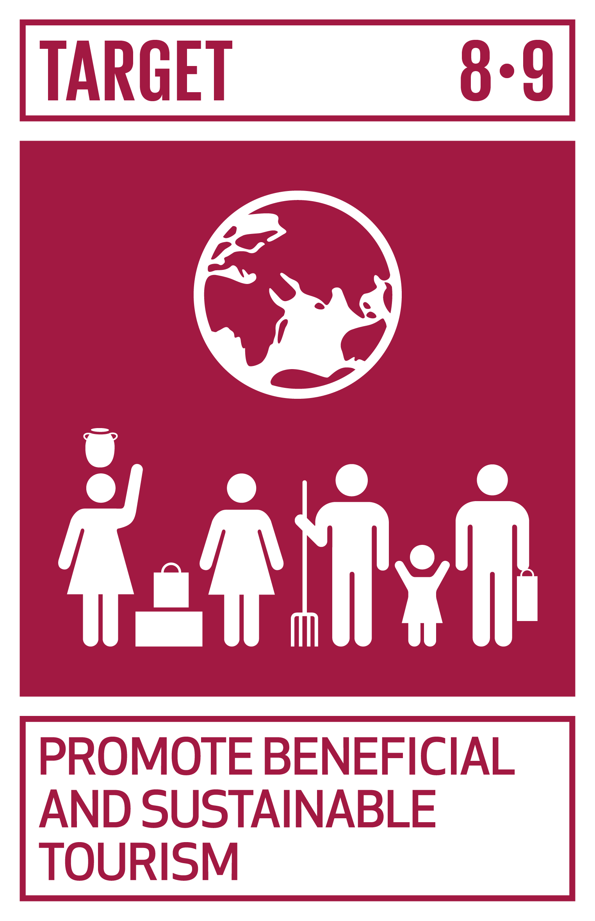
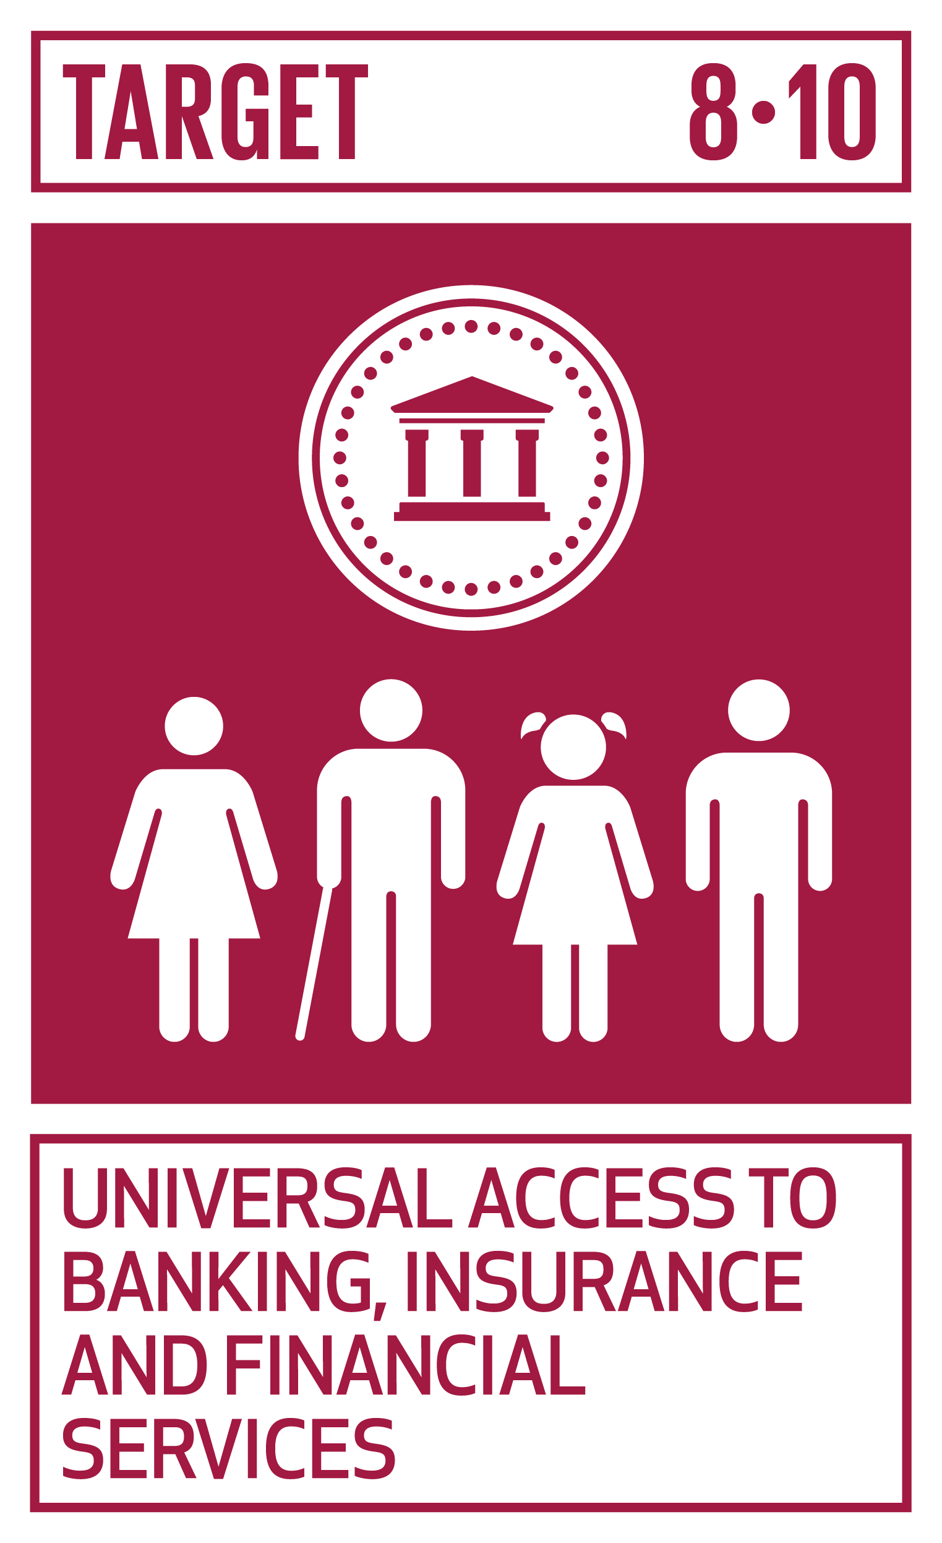
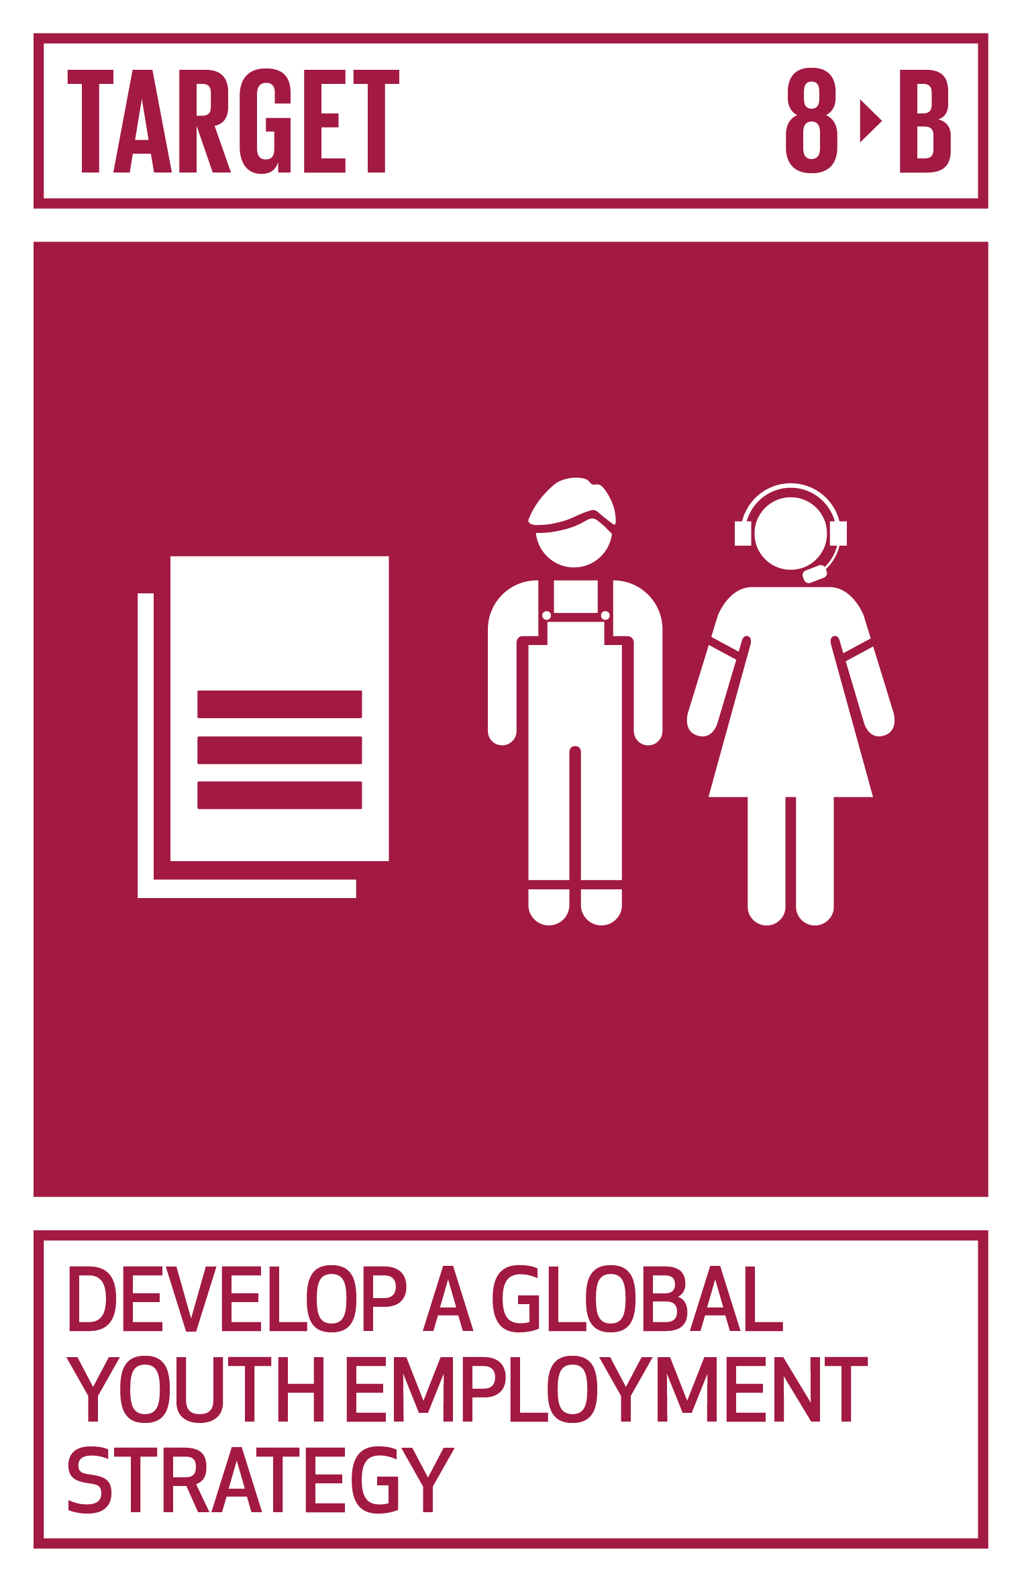
Notes:
SDG 8 calls for action to “Promote sustained, inclusive and sustainable economic growth, full and productive employment and decent work for all” . It has ten suggested global outcome targets and two additional targets referred as means of implementation, each one with one or more indicators to monitor progress over time. The targets cover topics such as sustainable economic growth, youth employment and training, labour rights, green economy, sustainable tourism and social protection.

Slide 6
Source: UNWTO (2016).

Slide 7
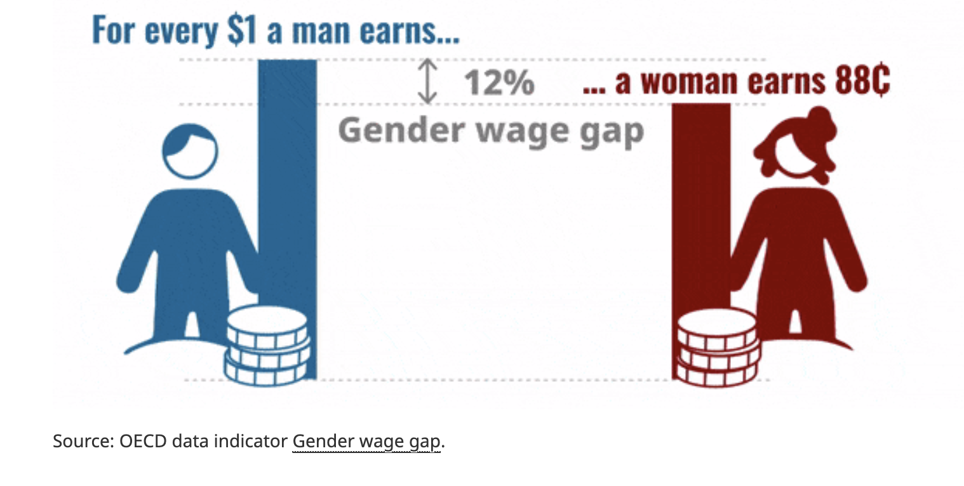

Slide 8
2.1 Significance of SDG 8
Green Economy | Sustainable Tourism | Employment, decent work for all and social protection
According to current trends, the global per capita use of natural resources will increase by 70 per cent by 2050. Green economy is based on low-carbon development and low carbon growth, which focuses specifically on investments which reduce carbon emissions and promote resource efficiency and waste reduction. | Tourism that considers its current and future economic, social and environmental impacts, addressing the needs of visitors, the industry, the environment and host communities. Sustainable tourism can be seen as a driver of economic growth and job creation, particularly in developing countries. | The goal advocates decent work, employment creation, social protection, rights at work and social dialogue. Globally, labour productivity has increased and unemployment is back to pre-financial crisis levels, 58.0% of those employed were in informal employment in 2022, amounting to around 2 billion workers in precarious jobs, most lacking any form of social protection.
Notes:
to understanding what is behind the SDG 8, we present three important and closely connected concepts with the goal.

Slide 9
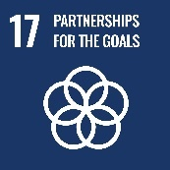
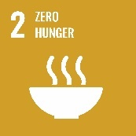
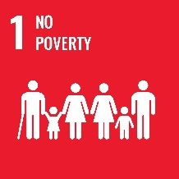
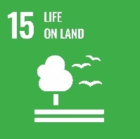
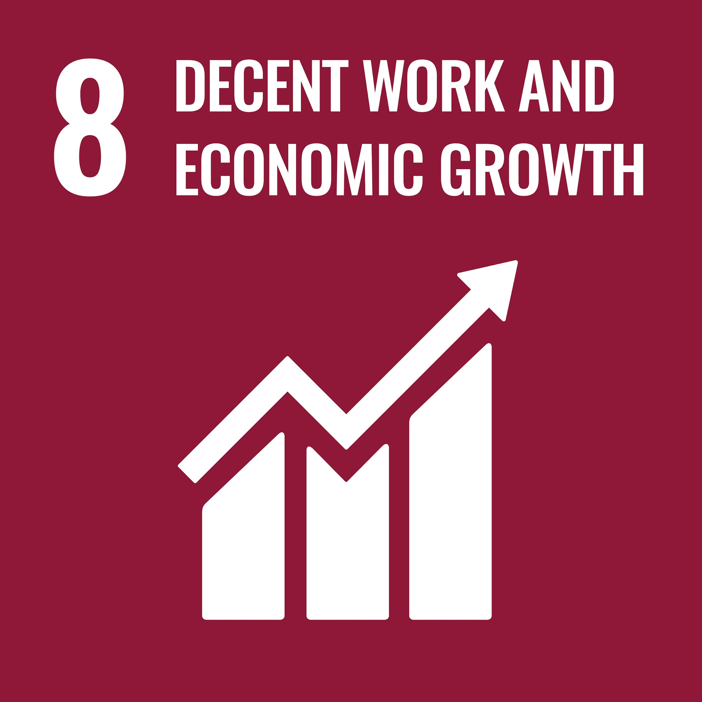
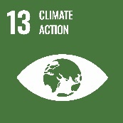
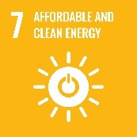
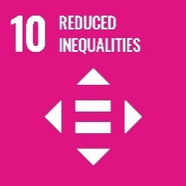
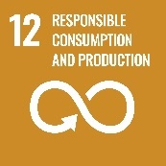
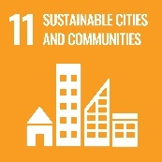
2.2 Interdependencies of SDG 8
Notes:
You may already now that all SDGs are connected one with another. 🇧🇷
Improvements in one, impact improvements in another, and so on.
It is the same with SDG 8. There are impacts and connections among all others 16. however, the strongest connections is marked by the SDGs that contemplate the basic services that are the fundamental needs to improve people’s live

Slide 10
2.3 Advantages of SDG 8
SOCIAL
- Sustained and inclusive economic growth: leads to poverty reduction and improves living standards
- More job opportunities, entrepreneurship, and investments in productive sectors
- Reduced unemployment: improved social inclusion and reduced inequalities
- Promotion of sustainable and low-carbon practices
- Focus on reducing environmental impacts and carbon emissions
- Resilience: diversifying economies, promoting entrepreneurship, and improving access to finance
- Innovation: reduces dependency on specific sectors
- Inclusive and resilient economies: contribute to poverty reduction and social inclusion
ENV.
ECON.
Notes:
What would be the posiive impacts if we achieve poverty alliviation?

Slide 11
2.4 Challenges in the implementation of SDG 8
Economic inequality within and among countries
Technological advancements and automation
High levels of unemployment and underemployment
Income disparities, lack of access to resources, and unequal distribution of wealth
Informal and vulnerable employment, lacking access to social protection, fair wages, and adequate working conditions
Notes:
Lets now talk about the challenges in reduze poverty.

Slide 12
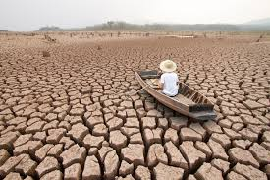
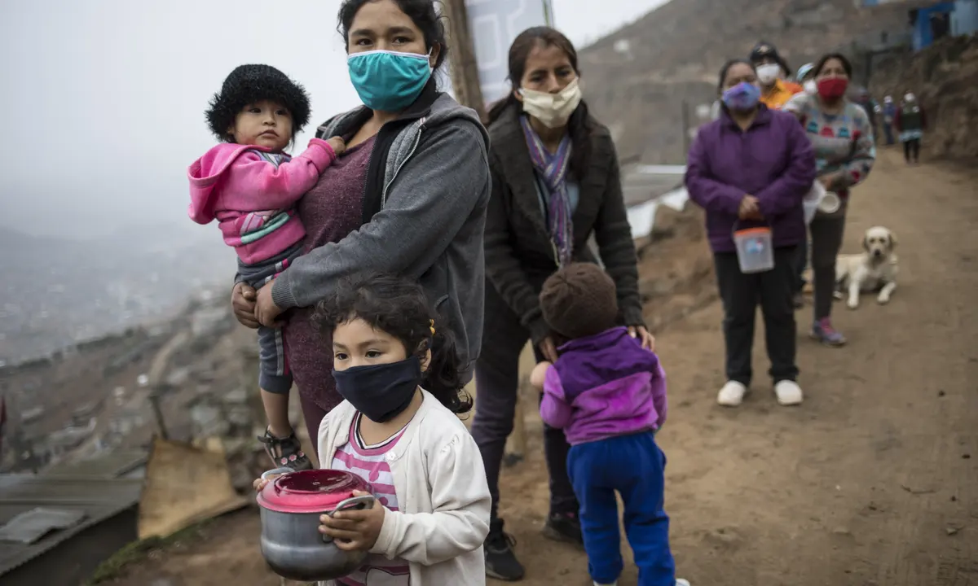
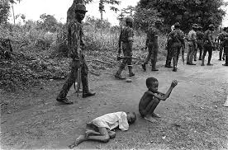
3. Overview of global crises
3.1 Climate Change
3.2 COVID-19 Pandemic
3.3 Conflict

Slide 13
3.1 Climate Change
Damage to infrastructure and resources needed for repairing
Difficulties in generating income from economic activities that are at risk due to climatic conditions and that depend on natural resources, such as agriculture, fishing and tourism
It threatens the sources of income and jobs of many families in communities that depend on natural resources, especially populations that are already vulnerable
The increase in temperature is related to the thermal stress of workers, exposure to vector-borne diseases, aspects that make it difficult to achieve well-being conditions

Slide 14
3.1.1 Climate Change in Latin America
Reduction in job creation and economic growth, especially in vulnerable populations
Agricultural productivity: drops in crop yields
Tourism in Latin America, especially in the Caribbean, is severely affected, resulting in reduced income and unemployment
Extreme weather events, such as hurricanes and floods, cause damage to infrastructure and lead to significant adaptation costs
Water scarcity affects the energy sector, especially hydropower production, resulting in increased costs and energy shortages
Impact on industries dependent on natural resources, such as fishing, forestry and mining

Slide 15
3.1.2 Climate Change in Africa
Africa has been identified as the most vulnerable region to the impacts of climate change (Serdeczny et al., 2017).
Significant drop in Gross Domestic Product (GDP). Specific projections indicate that an increase of 1°C to 4°C above pre-industrial levels would result in an annual decrease in African GDP of more than 2% (Du, Zhao, & Huang, 2017).
Negative consequences for job creation and economic growth, affecting dominant economic sectors such as agriculture, forestry, fishing and tourism.
Degradation of natural resources due to climate change results in adverse impacts such as soil erosion, desertification, droughts, floods and crop failures, affecting prevailing economic sectors.

Slide 16
3.1.2 Climate Change in Africa
The dependence on natural resources makes workers more vulnerable to health risks related to climate change, including heat stress, malnutrition, and water-borne and vector-borne diseases.
The increasing frequency and intensity of natural disasters cause significant damage, leading to human losses, displacement of people and damage to infrastructure, which undermines the ability to create jobs and negatively impacts GDP growth.
The focus on disaster recovery often diverts resources from job creation and economic growth.
Sectors such as renewable energy and green technology can provide employment opportunities in response to climate change.

Slide 17
3.1.3 Climate Change in Europe
Climate change and its impacts represent one of the main challenges to achieving SDG 8 goals in Europe.
The year 2022 has been identified as the hottest summer in Europe, likely due to greenhouse gas emissions.
Europe is the fourth largest emitter of greenhouse gases, after China, India and the USA.
The European Union recognizes the need for action and has implemented initiatives such as the European Green Deal and other policies to combat global warming.
Extreme weather events such as floods, heatwaves, droughts and storms pose a threat to economic growth and job creation in Europe.

Slide 18
3.1.3 Climate Change in Europe
FLOODS can occur in countries such as the Netherlands, United Kingdom, France and Germany, causing damage to infrastructure and economic activities, leading to job losses, reduced productivity and negative impacts on business.
HEAT WAVES and droughts mainly affect southern Europe, impacting agriculture and workers' health.
Sectors such as agriculture and tourism in Europe are also susceptible to the effects of climate change, with potential losses for rural activities and the tourism industry.

Slide 19
3.2 COVID-19 Pandemic
Increase in unemployment rates and economic recession due to the economic shutdown.
Loss of jobs and threat to families' financial security, increasing social inequalities.
Developed countries were able to offer social protection and unemployment insurance, evidencing inequalities between nations.
Informal workers, important to the economy, were severely affected by the lack of social protection.

Slide 20
3.2.1 COVID-19 Pandemic in Latin America
Significant drop in economic development, employment and income in the region.
Key sectors such as tourism, manufacturing and services have been severely affected.
Disruption of supply chains and reduced demand have affected productivity.
Many businesses, especially in the informal sector, have closed or reduced operations.
Notes:
Most Latin American countries have been extremely affected

Slide 21
3.2.1 COVID-19 Pandemic in Latin America
Job losses and reduced opportunities for entrepreneurship and innovation.
Small and medium-sized businesses faced challenges with limited access to financial assistance.
Women, young people and informal workers were particularly impacted.
Pressure on natural resources and ecosystems has increased.
Disruptions to education and training programs have affected youth employability.
Notes:
Most Latin American countries have been extremely affected

Slide 22
3.2.2 COVID-19 Pandemic in Africa
2.1% contraction in the continent's economic growth in 2020.
Containment measures such as lockdowns and social distancing have resulted in economic slowdown, socioeconomic disruptions and precarious working conditions
The crisis has increased the vulnerability of workers in the informal sector, who represent the majority of employment opportunities in Africa and have limited access to social protection and healthcare.
Policies such as expansion of social protection and support for companies have been implemented, but they face challenges such as fiscal limitations and unequal access to vaccines.

Slide 23
3.2.1 COVID-19 Pandemic in Europe
The economic crisis has resulted in contractions, unemployment, gender inequalities and difficulties in achieving specific SDG 8 targets.
Countries such as Italy, Spain and Germany have been affected in different ways due to their dependence on the tourism sector and disruptions to supply chains.
To overcome these challenges, European nations are investing in innovative sectors, strengthening social safety nets and implementing inclusive policies.
Notes:
Most Latin American countries have been extremely affected

Slide 24
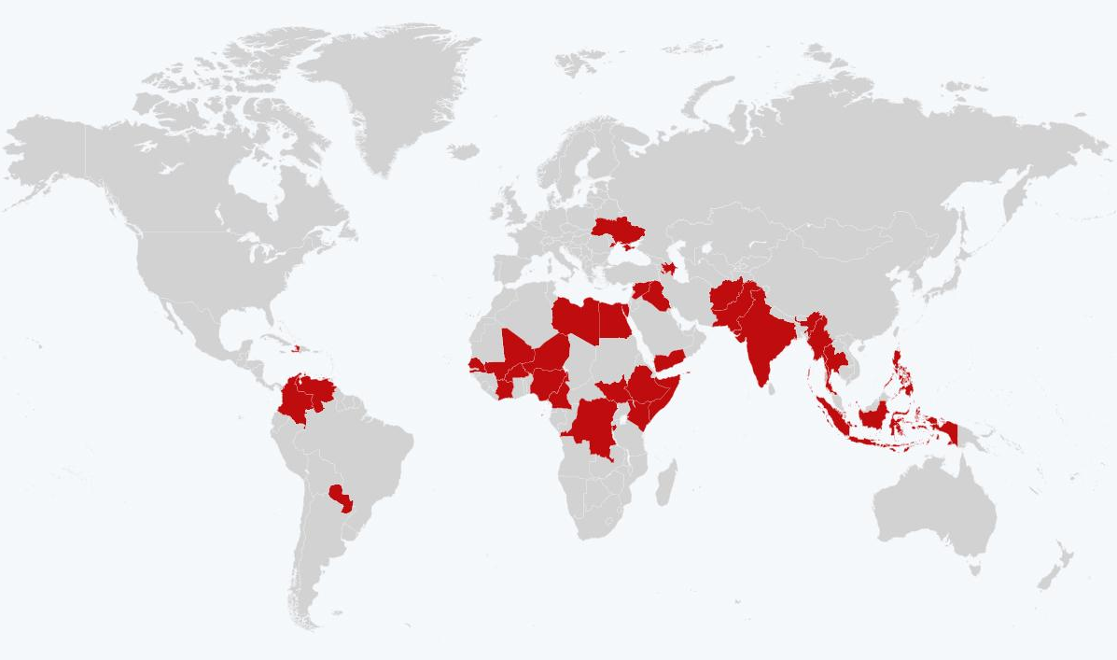
3.3 Conflict
Countries were armed clashes involving state forces
and/or rebel groups were reported in 2022
The existence of conflicts in a country or region causes serious economic crises due to the instability generated.
This interrupts economic activities, affecting infrastructure, industries and services.
Conflicts, both internal and external, increase uncertainty and reduce investment.
Political instability in conflict zones results in job losses and poor working conditions.
Source: Armstrong (2022)
Notes:
https://www.statista.com/chart/21652/countries-with-armed-clashes-reported/

Slide 25
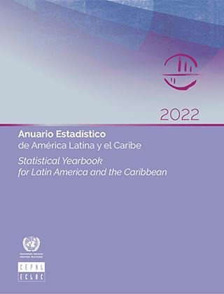
3.3.1 Conflict in Latin America
The region faces challenges due to changes in the global production structure, weakening globalization.
The war in Ukraine has added uncertainty to the global economy, impacting the region's main trading partners.
Dependence on primary products influenced the impact of supply disruptions.
Social and economic crises are observed in several countries in the region, such as Colombia, Chile, Haiti and Venezuela.
The crisis in Venezuela has resulted in large numbers of refugees and migrants, mainly in Latin America and the Caribbean.

Slide 26
3.3.2 Conflict in Africa
Since the 2000s, the number of conflict-related deaths has increased in sub-Saharan Africa, affecting economic growth.
Countries such as South Sudan, Sudan, Nigeria face challenges due to violent conflicts.
Population displacement also has negative economic effects, and the countries face a cycle of conflict and underdevelopment.
It is crucial to mobilize efforts to resolve the causes of conflicts and implement peace agreements.
It is essential to mobilize more resources to recover from protracted conflicts.

Slide 27
3.3.3 Conflict in Europe
The war in Ukraine has affected trade, drained resources and dismantled infrastructure, hampering economic growth.
Economic innovation and diversification have been hampered by the corrosive influence of conflict.
Women have been disproportionately affected, with gender inequality deepening.
Youth face difficulties in accessing quality education and employment due to the conflict.
A safe working environment for everyone, including migrant workers, is essential, but war puts that promise at risk.
Ukraine faces economic instability, population displacement and an uncertain future, while neighboring countries like Poland and Hungary deal with an influx of refugees.

Slide 28
4. Progress towards the achievement of SDG 8
Regional progress in Latin America
Regional progress in Africa
Regional progress in Europe

Slide 29
4.1 Progress in Latin America
For the year 2020 in Latin America and the Caribbean, GDP growth was -7.57% while the world average was -4.29%, showing that the region was more impacted than the world average.
Some countries in this region presented high values in GDP per capita when measured by GDP per employed person.
In 2020, the unemployment rate in Latin America was the highest recorded since 1991, reaching 10.6% while the world average was 6.57%. For the year 2021 there was a reduction in unemployment to 9.96% while the world average was 6.18%.

Slide 30
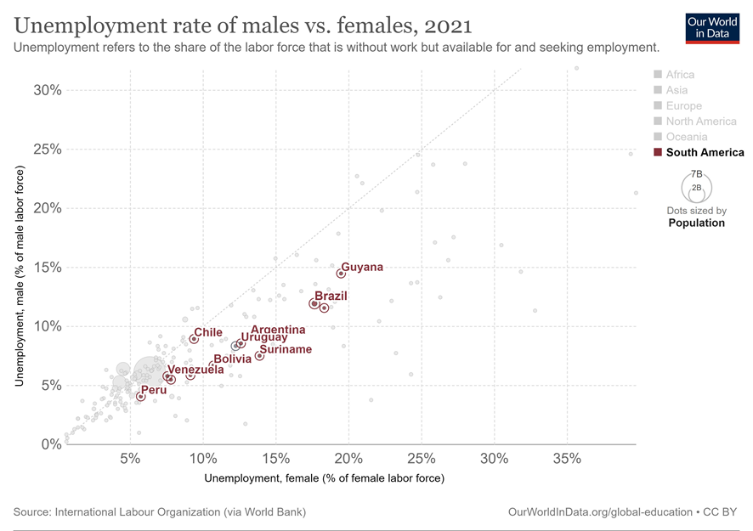
4.1 Progress in Latin America

Slide 31
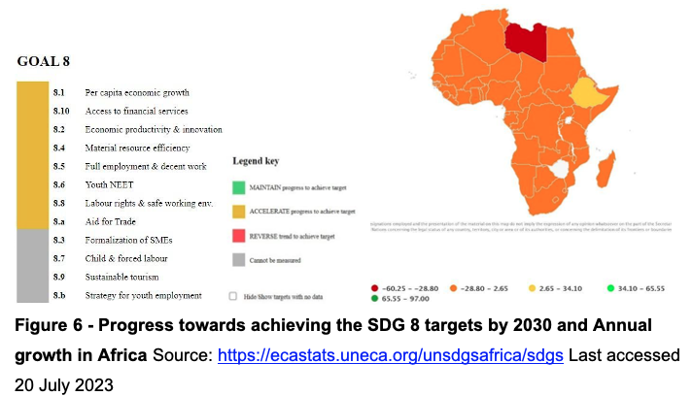
4.2 Progress in Africa

Slide 32
4.2 Progress in Africa
Approximately 60% of jobs in Africa are considered vulnerable, less than 1% of the unemployed receive unemployment benefits and only 19% of the African population (excluding North Africa) is covered by social insurance.
The highest gender unemployment gap is found in Northern Africa with the female youth unemployment rate almost double that of young men, reaching as high as 44.3%.
In 2019, Africa was ranked as the world’s least banked region, with an estimated 80% of its one billion people lacking access to formal banking services.

Slide 33
4.3 Progress in Europe
Countries with robust industrial bases and diversified economies, such as Germany and the Nordic nations, have propelled sustainable economic growth, leveraging technological innovation and efficient labour practices
Southern European countries like Greece and Spain, underscore the fragility of economic progress and the need for resilient growth strategies. These countries continue to grapple with high levels of youth unemployment.

Slide 34
4.3 Progress in Europe
Disproportionate impacts on sectors with higher female representation, such as retail and hospitality, have emphasised the need for sustained efforts to ensure equal pay for equal work and dismantle gender-based disparities.
Bridging these divides while harnessing technology for equitable growth and employment remains a fundamental challenge for Europe. Estonia's success in leveraging e-governance and digital education initiatives to create a tech-savvy workforce showcases the transformative potential of technological integration.

Slide 35
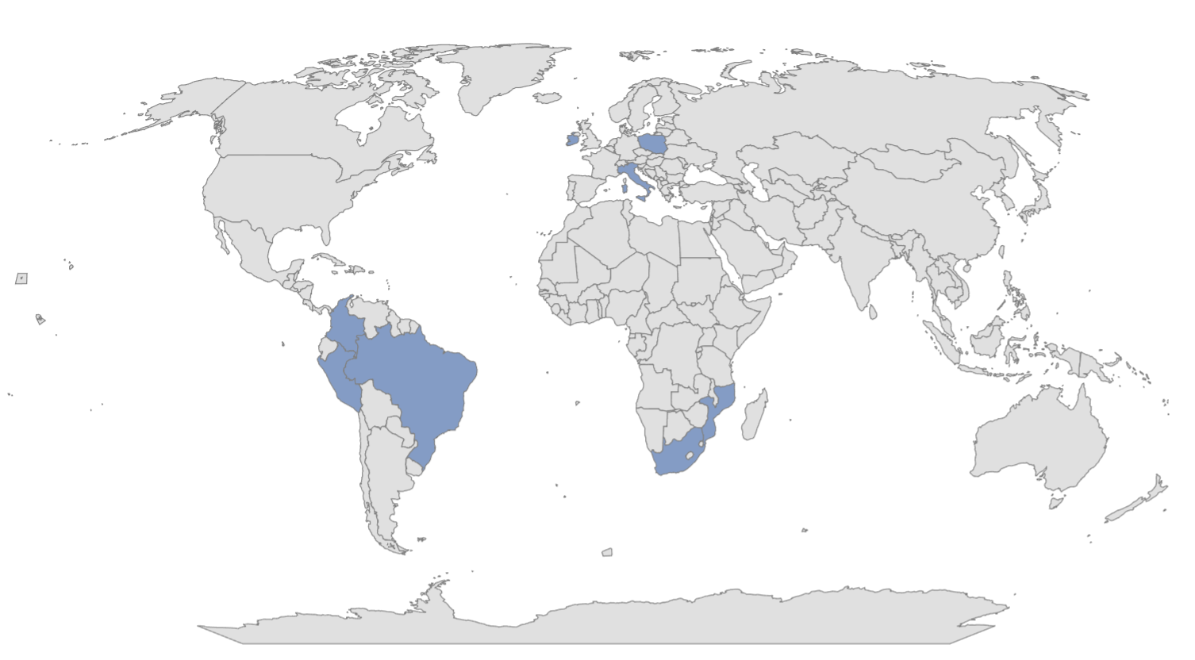
5. Case Studies
5.1 Brazil
5.2 Colombia
5.3 Peru
5.4 Mozambique
5.5 South Africa
5.6 South Africa
5.7 Ireland
5.8 Poland
5.9 Italy

Slide 36
5.1 FORSOFT Academy in Brazil: preparing young people for the technology job market
Aim: to train young people aged between 18 and 36 in socially vulnerable situations for the technology job market and Information technology (IT) area.
All regions of Brazil are covered and special attention is given to young people from regions far from large centres and peripheral areas. The interested students should enroll in the course and after the selection process (always prioritising young people from vulnerable communities) the students begin the course as an online or in person training, and as FORSOFT Academy is a social program, the training is completely free.

Slide 37
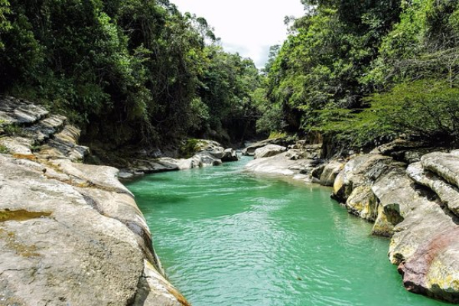
5.2 Ecotourism Project Vínculos territoriales en el municipio de Lejanías: El ecoturismo en la región del Ariari, Colombia
With the support of the City Hall and other actors involved in the strategy, it was possible to carry out studies to investigate the region's tourism capacity, develop a tourist profile based on visitors, strengthen the sector's information system. Also, more opportunities to generate income could be offered, featuring farms with potential for ecotourism in the region.

Slide 38
5.3 Pilot study “Monitoring green growth in the LAC region” in Peru
The main objective of the project was to carry out a pilot study to evaluate and validate the applicability of OECD green growth indicators in the context of Latin America and the Caribbean (LAC). The intention was to measure how well these indicators could capture the sustainable and environmental aspects of economic growth in the region. Countries participating in the project included Colombia, Costa Rica, Ecuador, Guatemala, Mexico, Paraguay and Peru. In the context of Peru, several significant challenges were identified:
Integration of sustainable growth indicators into policies
Creation of a comprehensive institutional framework for reporting these indicators
Establishment of an operational working group tasked with assessing and improving the quality of information related to sustainable growth for reporting purposes.

Slide 39
5.4 Mozambique: Joint programme for “more and better jobs in Cabo Delgado and Nampula province – harnessing the job opportunities in the new economy in Mozambique.”
The program was created to involve the population of the provinces of Cabo Delgado and Nampula, focusing on young people and women seeking employment for a better livelihood or to establish small businesses.
A Capacity Building Strategy for Rural Economic Empowerment was implemented, which involved 380 local youth who received training and start-up kits, providing them with the necessary skills to start their local businesses as a source of livelihood.
472 companies were registered on the Subcontracting and Partnership Platform, with 129 correspondences between buyers and suppliers.

Slide 40
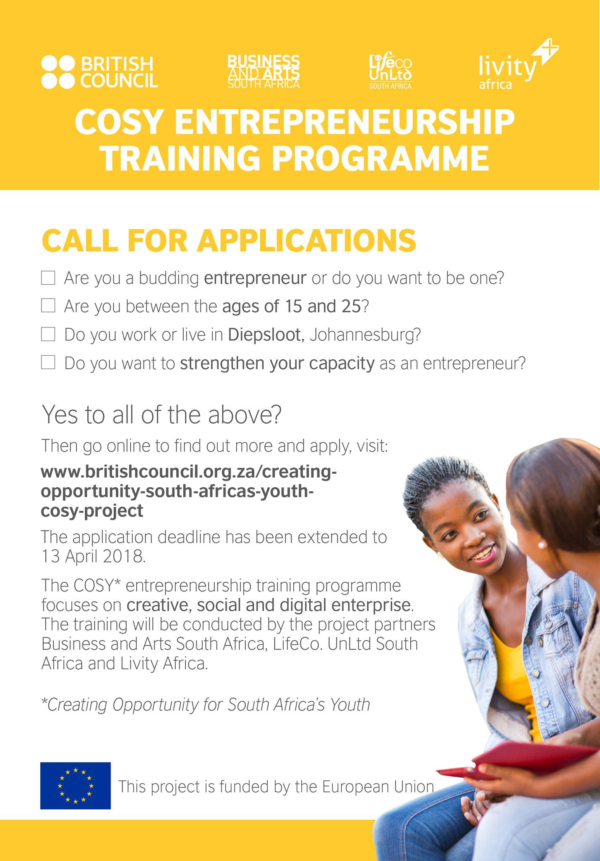
5.5 South Africa: Creating Opportunity for South Africa’s Youth (COSY)
The project was funded by the European Union and coordinated by the British Council, in partnership with Business and Arts South Africa, LifeCo UnLtd South Africa and Livity Africa.
Objective of promoting inclusive growth. Providing digital skills to young people, especially young women, in rural and peri-urban areas of South Africa as part of its broad entrepreneurship program.
Supporting sustainable futures for young people in some of South Africa's most excluded communities.

Slide 41
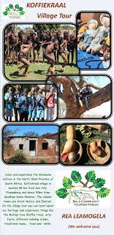
5.6 South Africa: Community-based asset programme for empowerment to drive grassroots sustainable development in the villages of Koffiekraal/Brakkuil in the Northwest Province
This case study documents the collaboration of stakeholders from the University of South Africa and a non-profit organization (NPO) with the communities of Koffiekraal/Brakkuil in the North West Province of South Africa from 2012 to 2016. The aim of the collaboration was to empower the community to drive its own sustainable development.

Slide 42
5.6 South Africa: Community-based asset programme for empowerment to drive grassroots sustainable development in the villages of Koffiekraal/Brakkuil in the Northwest Province
A workshop identified community members skilled in handicrafts. They received 18 months of training, resulting in 15 participants receiving certificates. Six formed a collective and created a business plan. They received training in budgeting and had opportunities to sell their handicrafts at markets and to multi-national companies.
The University also developed a learning strategy on village tours. Two groups merged and formed the BIG 5 Community Tourism Forum. The trial runs of the tours offered by this forum were community-driven, with the University and NPO staff participating in advisory capacity.

Slide 43
5.7 Ireland: Economic Recovery Plan and improving equal access to decent work and fair remuneration
The Economic Recovery Plan introduced in June 2021 aimed for sustainable economic rebound and employment growth through a shift towards a decarbonized and digital economy. It focused on helping individuals return to work, supporting resilient businesses, promoting inclusive recovery, and ensuring stable public finances for long-term recovery (Ireland’s 2023 Voluntary National Review).

Slide 44
5.8 Poland: The lowest unemployment rate in the EU in light of the strategy to support the labour market and vocational activation
"The Constitution of Business" (in force since April 30, 2018).
Set of 5 laws that constitute the "systemic core" of business activities.
It introduced, among other things, the presumption of honesty for entrepreneurs, the obligation to resolve factual and legal doubts in favor of the entrepreneur, as well as the possibility of indefinitely suspending commercial activities, conducting business on a small scale without the need for registration and exemption of social security contributions for new entrepreneurs in the first 6 months.

Slide 45
5.9 Italy:
"The Constitution of Business" (in force since April 30, 2018).
Set of 5 laws that constitute the "systemic core" of business activities.
It introduced, among other things, the presumption of honesty for entrepreneurs, the obligation to resolve factual and legal doubts in favor of the entrepreneur, as well as the possibility of indefinitely suspending commercial activities, conducting business on a small scale without the need for registration and exemption of social security contributions for new entrepreneurs in the first 6 months.

Slide 46
5.3.3 Italy: Digitalisation, community, creativity – innovative environment
Crescere in Digitale Initiative: Led by the Italian Union of Chambers of Commerce in partnership with Google
Objective: improving the employability of young people who are not involved in formal education through digital skills. It empowers young people in search of jobs and promotes digital growth in companies.
50-hour online training course: website building, social media engagement and online advertising. Participants connect with companies for hands-on experience and potential 6-month paid internships.
This project has already trained thousands of young people and helped hundreds of companies to reap the benefits of these new skills.

Slide 47
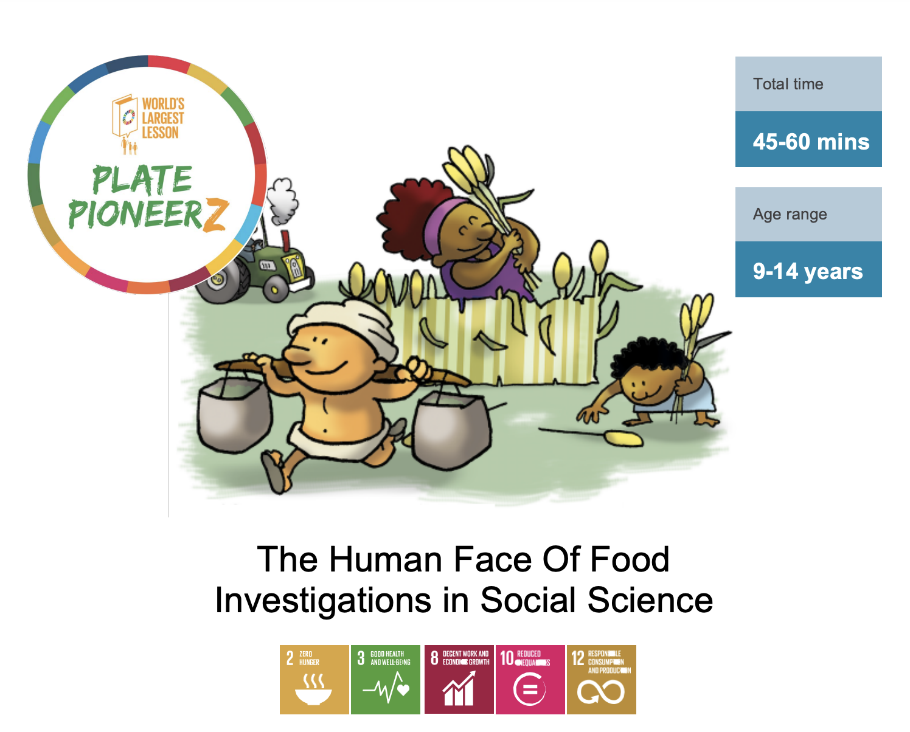
6.1 Exercises
The Human Face Of Food: This exercise is aimed at stimulating students to think about the agricultural, rural, and fishing industries that produce food across the world.
Notes:
Following we have some suggested exercise that proveque students demonstrate empathy by designing a campaign for those affected by poverty,

Slide 48
Careers: What is My Place in the World?: This exercise help students explore career options, the impacts on their lives and on the world around them, and careers in a global context. Suggestion: use the link https://www.16personalities.com/br to understand your professional profile.
Notes:
An exercise that students should assess different strategies communities around the world are applying to face poverty challenges
And also an exercise to allows to reflect on the conditions of living in extreme poverty

Slide 49
Case Study Analysis: Lecturers can either provide students with real-world case studies (some examples are available in the Urban Sustainability Exchange website, and additional resources can be accessed in the Springer Nature website) related to SDG 8, or ask students to look for cases and bring to class. Students can analyze these cases, identify the challenges and opportunities related to SDG 8, and propose sustainable solutions.
Group Discussions and Debates: Lecturers can organise group discussions and debates on various aspects of SDG 8, such as the role of entrepreneurship in job creation, the impact of automation and technology on employment, and working conditions. The discussions could include the interconnection of SDG 8 with the other goals, and promote the analysis of different perspectives.

Slide 50
Business Plan for Sustainable Startups: Students can develop business plans for startups that focus on sustainable products or services. They would need to consider factors such as environmental impact, social responsibility, and long-term viability to promote sustainable economic growth. Suggestion: the CANVAS method might be useful here.
Sustainable Tourism: Students select tourism destinations and assess their sustainability practices, such as waste management, resource conservation and community involvement.
Sustainable Job Fair: Lecturers and students can organize a sustainable job fair where students can interact with employers, especially in areas such as renewable energy, green technology, or social enterprises.

Slide 51
6.2 Assessment
1. Introduction to the SDGs
Name the five areas of critical importance to which the 17 SDGs are linked and explain why this is referred to as the 5 P’s.
Explain the link between the MDGs and the SDGs.
Explain how the SDGs differ from the MDGs.
2. Defining SDG 8
What are the main aspects of SDG 8?
What is the focus of the first ten targets of SDG 8?
What is the focus of the last two targets of SDG 8?

Slide 52
6.2 Assessment
2.1 Significance of SDG 8
What is the status of the progress to achieve SDG 8 by 2030?
Explain the main characteristics of the key aspects of SDG 8: Green Economy, Sustainable Tourism, and Employment, decent work for all and social protection.
2.2 Interdependencies of SDG 8
How is SDG 8 interconnected with the other SDGs? What other Goals do you think will be most affected if Goal 8 is not achieved?
Select any three SDGs and briefly explain how they interact with SDG 8. Use examples from your region to illustrate your explanation.

Slide 53
6.2 Assessment
2.3 Advantages of SDG 8
What would the main advantages be for the world if the goal of economic growth is achieved?
Select any two of the targets of SDG 8 and explain the specific advantages which will manifest with the attainment of these targets. Link it to advantages for your specific region.
2.4 Challenges in the implementation of SDG 8
How have different global crises been affecting the implementation of SDG 8?
What are the difficulties in implementing SDG 8 in your country? Which are the main barriers? And how can they be overcome?

Slide 54
6.2 Assessment
3. Overview of global crisis that have negatively impacted on the achievement of SDG 8
Name at least 3 global crisis that affect the achievement of the targets of SDG 8.
3.1 Climate Change
How has climate change negatively impacted the progress around economic growth and employment?
How these impacts are percevied in your region?
3.2 COVID-19
What are the effects of the COVID-19 pandemic on the targets of SDG 8?
How these effects are percevied in your region?
3.3 Conflict
Explain how conflicts negatively impact the efforts to achieve SDG 8.
How these impacts are percevied in your region?

Slide 55
6.2 Assessment
4. Progress towards the achievement of SDG 8 by 2030
How does your current life pattern affect the achievement of the SDG 8 targets?
4.1 Regional progress in Latin America
In your opinion, will the countries in Latin America be able to achieve the SDG 8 targets by 2030?
What are the main obstacles in achieving SDG 8 in your region/country?

Slide 56
6.2 Assessment
4.2 Regional progress in Africa
In your opinion, will the countries in Africa be able to achieve the SDG 8 targets by 2030?
What are the main obstacles in achieving SDG 8 in your region/country?
4.3 Regional progress in Europe
In your opinion, will the countries in Europe be able to achieve the SDG 8 targets by 2030?
What are the main obstacles in achieving SDG 8 in your region/country?

Slide 57
6.2 Assessment
5. Case Studies and best practices
List some good practices that target the implementation of SDG 8.
What could be your own contribution to SDG 8?
Select a case study in your country that reflects a best practice in terms of achieving the SDG 8 targets. Briefly explain this case study and explore how the best practice can contribute towards achieving SDG 8.

Slide 58
7 Concluding remarks
The module explores the impacts of various crises on achieving SDG 8.
Analyzes regional contexts and progress in Latin America, Africa and Europe.
Includes case studies and best practices to exemplify global and regional strategies to support economic development, green economy, sustainable tourism and employment opportunities.
Notes:
We hope all of you have learned bit more about the SDG1 in this class, we have Reinforced the continued relevance of the 2030 Agenda for Sustainable Development and finally give you an advace... we can do it wecan do it...

Slide 59
Thank you!
Prof. Dr. Luciana Brandli Titular Professor at the University of Passo Fundo Faculty of Engineering and Architecture
brandli@upf.br
Prof. Dr. Rudi Pretorius College of Agriculture and Environmental Sciences, University of South Africa
pretorw@unisa.ac.za
Prof. Dr. Dr. Walter Leal Head of Research & Transfer Center Sustainability & Climate Change Management at HAW Hamburg
walter.leal2@haw-hamburg.de

