Slide 1
Introduction to SDG 2 (Zero hunger):
Impact of crises and regional specificities
A brief overview of the OER teaching materials developed for SDG 2 as part of the
collaborative project:
Digital Introduction to the Sustainable Development Goals in Higher Education Teaching : Regional Aspects in Implementing the SDGs from Latin America, Europe and Africa

Slide 2
Compliled by:
Prof Rudi Pretorius Prof Melanie Nicolau
Affilliation: Department of Geography
Unisa, South Africa

Slide 3
Presentation Content
Introduction
Defining SDG 2
Key Drivers of World Hunger
Progress towards Achievement of SDG 2
Case Studies
Exercises and Assessment
Closing Words References
Contact information

Slide 4
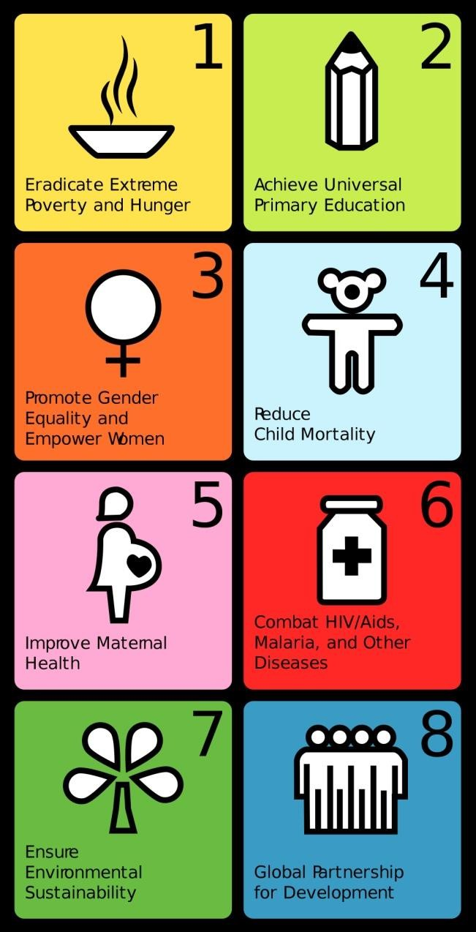
1. Introduction
In 2001 the eight MDG’s were launched, following
pre-2000 concerns on several global issues
Commitments for international cooperation to address these issues, 2001-2015
Emphasized human capital, infrastructure and human rights
Close to end of period: Uneven progress evident, some countries high achievers, others lagging behind

Slide 5
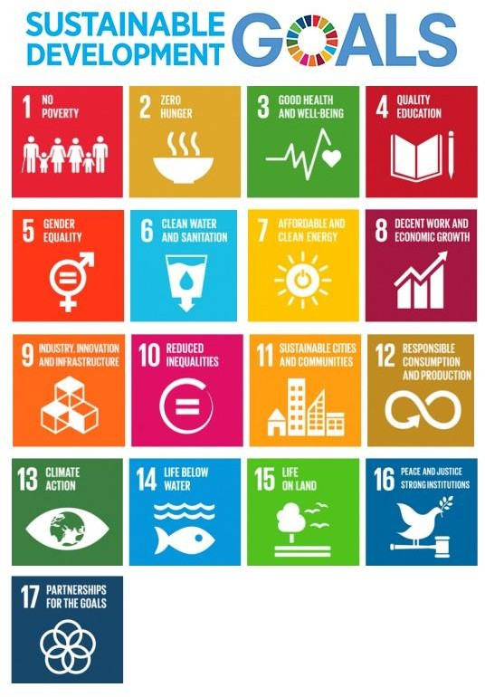
MDG’s were replaced with 17 SDG’s in 2015
SDG’s link up with five critical areas: People, Prosperity, Planet, Peace & Partnership
They consist of Goals, Targets & Indicators
Connection/interaction between SDG’s of prime importance
This OER deals with SDG 2 – Zero Hunger. It falls in the area of People
Of critical importance: Number of hungry people doubled over the last two years

Slide 6
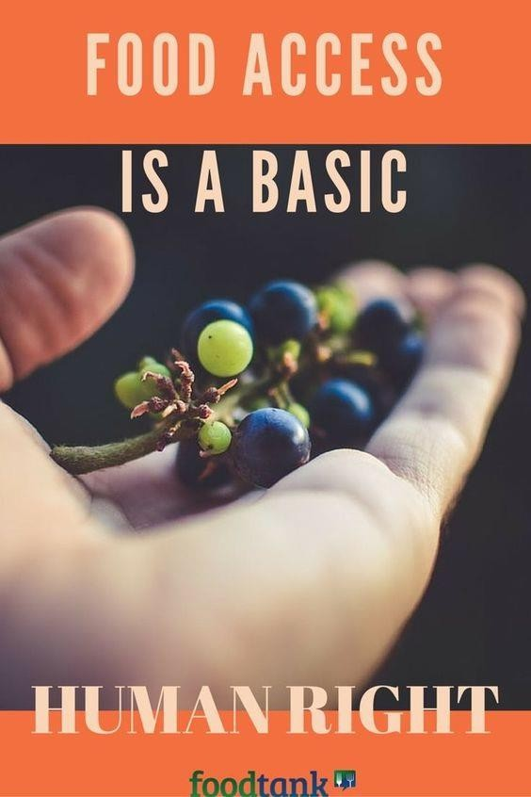
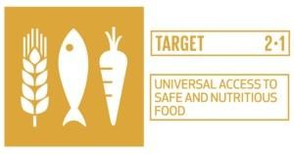
2. Defining SDG 2
Eight targets, which covers the social, economic and environmental dimensions of the issue of hunger

Slide 7
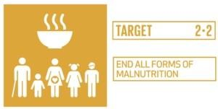
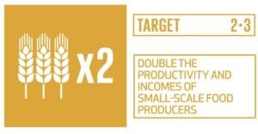
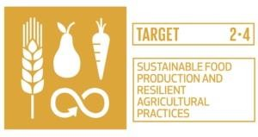
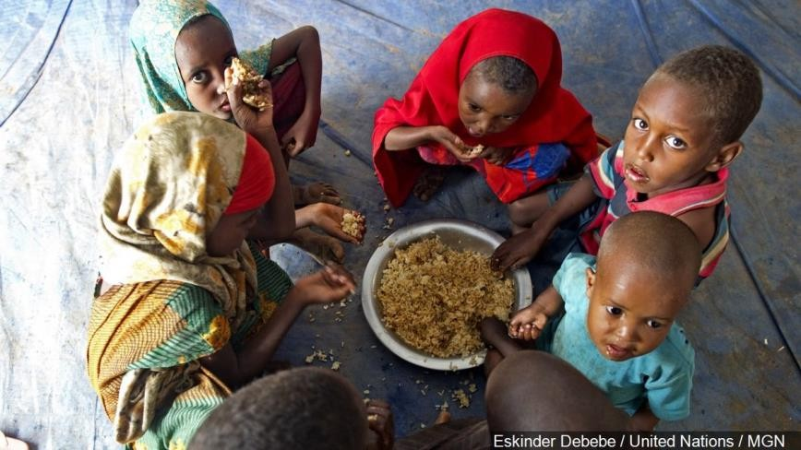
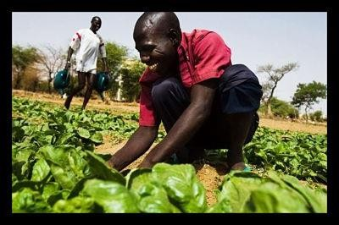

Slide 8
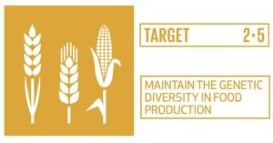
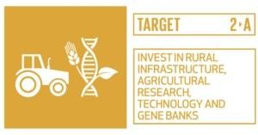
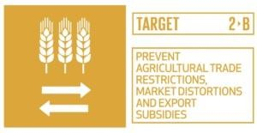
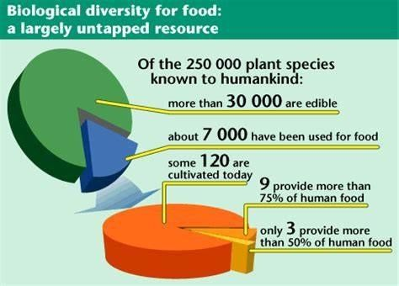
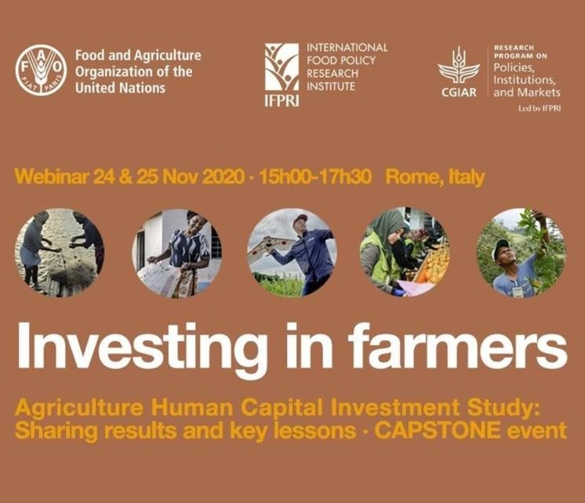

Slide 9
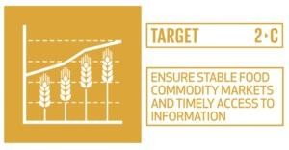
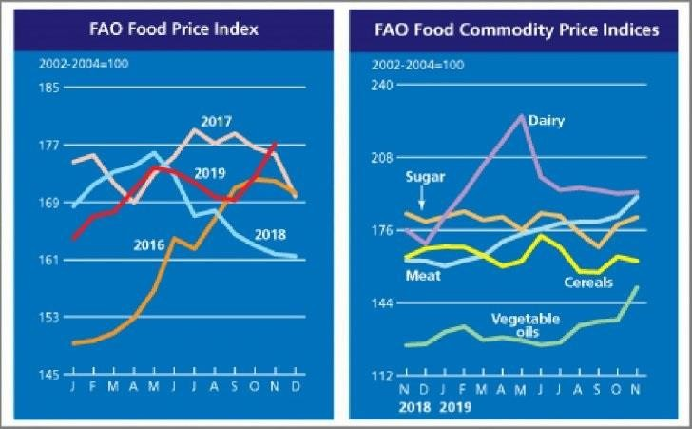
To summarize the definition of SDG 2
The dimensions of food security, nutrition, and sustainable, resilient agriculture are integrated with this SDG
It also emphasizes the role of small producers in agriculture, which can be regarded as a key for safeguarding agro- ecosystems.

Slide 10
Significance of SDG 2
While food is at the heart of civilization and prosperity, the world had 828 million hungry people in 2021. This is 150 million more than in 2019.
Pressure on global food systems presents development challenges, with risks for business, government, community & environment.
Three thematic areas can be distinguished in SDG 2, which serve as illustration of the wide-reaching scope, comprehensiveness, and associated significance of SDG 2.

Slide 11
Hunger and Malnutrition | Food security | Sustainable Agriculture
Less productive people, more prone to illness, unable to earn more, cannot improve livelihoods. ±1 in 10 people suffer from hunger ±1 in 3 people do not have regular access to safe, nutritious and sufficient food. Africa and Asia worst off. Zero hunger will have a positive impact. | Food insecurity is about unhealthy, irregular diets. 149.2 million children under 5 years: stunted growth. Estimated 840 million people to go hungry by 2030. Aftermath of COVID: further deterioration Key strategy: Increase agricultural productivity & income of small scale food producers | Food production impacts on environment: water withdrawal, biodiversity loss, greenhouse gases, etc 1/3 of global food produced (±1.3 billion tons/year) lost along supply chain or wasted. Exacerbated through vulnerability of agriculture to climate change Poor & developing countries hardest hit by crisis.
SDG 2
Three Thematic Areas
Significance of SDG 2: More people than ever before subjected to hunger & food insecurity and showing an increasing trend. Complicated by a combination of factors on a world-wide scale.

Slide 12
Interdependencies of SDG 2
SDG 2 has many complex interdependencies with other SDGs.
In fact, it is one of the SDGs with the most of such interdependencies.
Example: Negative impact of climate change (SDG 13) on food security.
Climate change mitigation and adaptation thus required to protect and safeguard the quality and quantity of harvests.
Working towards SDG 2 directly and indirectly advances SDGs 1 (Poverty), 3 (Health) & 8 (Decent work & Economic Growth) through increasing incomes in rural areas and developing countries, thereby increasing access to nutrition.
A few more examples of interdependencies are supplied in the next slide.

Slide 13
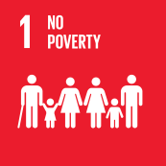
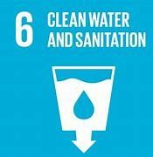
Examples of interdependencies between SDG 2 and some other SDGs
The goal that all people always have access to safe, sufficient, and nutritious food always is directly linked to the eradication of poverty.
Malnutrition contributes greatly to the global occurrence of disease. Malnourishment holds definite risks to health and well-being.
Undernutrition jeopardizes education and complicates and expands the negative impacts of many aspects of poverty.
For women hunger needs to be ended, and nutrition improved due to their role in food production and preparation, and their vulnerabilities in terms of reproductive health
Since agriculture is a major water user, SDG 2 depends on the availability of and sustainable management of water and sanitation.
Sustainable agriculture, food security and nutrition depend on energy security and reliable energy.

Slide 14
Advantages of SDG 2
Attaining SDG 2 is generally viewed as crucial to ensure a better future for everyone.
This will mean that many of the targets of the SDGs would be achieved, since there is a bit of SDG 2 in each one of the SDGs.
Well-nourished people: Live more productive and longer lives, during which they can contribute to economic growth, human development, environmental health, and innovation.
On contrary: With hunger continuing to limit human development in large parts of the world, achievement of the SDGs is unlikely.

Slide 15
Some advantages of SDG 2
Changes in agriculture can potentially provide nutritious food for many/all people, while generating incomes, supporting rural development and protecting the environment.
Development of good governance mechanisms can provide for inclusive and just policies regarding food and nutrition.
Facilitation of improved access to food addresses the issue of shortcomings in the process of making food available to everyone who needs it.
Achievement of a more food-secure future.
Adaptation of food systems can reduce or even eliminate the waste or loss of food.
Alongside improved nutrition and hygiene, educational initiatives to support mothers, children and elderly people, provides impetus to reduce malnutrition.
Fostering sustainability is the final (and ultimate) advantage associated with SDG 2.

Slide 16
Challenges in the Implementation of SDG 2
SDG 2 comprises of vastly differing objectives, but simultaneously closely interacting. This makes realization of this goal inherently challenging .
Major challenges while implementing SDG 2 relates to its multiple interdependencies with other SDGs, plus uncertainties involved, and the lack of sufficient, accurate data.
Several global crisis contribute to these challenges and will be dealt with in the next part of this presentation.
Dealing with these challenges requires a radical reconfiguration of food systems, but which is easier said than done

Slide 17
SDG 2 challenges in context
Understand Goal 2:Zero Hunger (Secondary)(https://www.youtube.com/watch?v=JjE76M0a054&t=7s) Copyright: 2019 by Participate, Inc. This work is licensed under the Creative Commons Attribution-Share Alike 4.0 International License. To view a copy of this license, visit http://creativecommons.org/licenses/

Slide 18
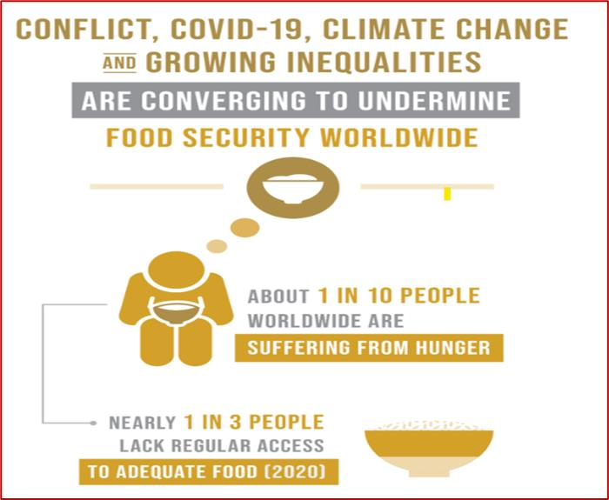
3. Key Drivers of World Hunger
The triple C’s
COVID-19
CONFLICT
CLIMATE CHANGE

Slide 19
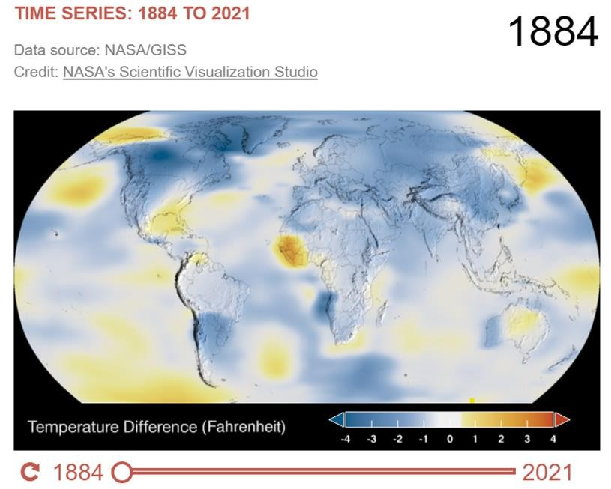
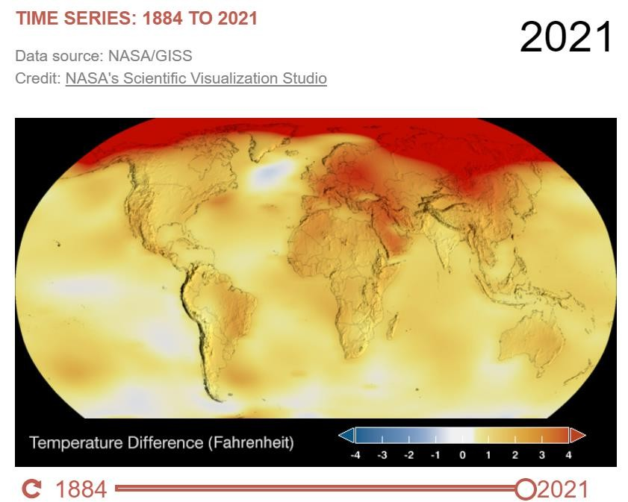
Climate Change
• Negative impact on achieving zero hunger by 2030
Global temperature has increased 1.01 ̊C since 1880

Slide 20
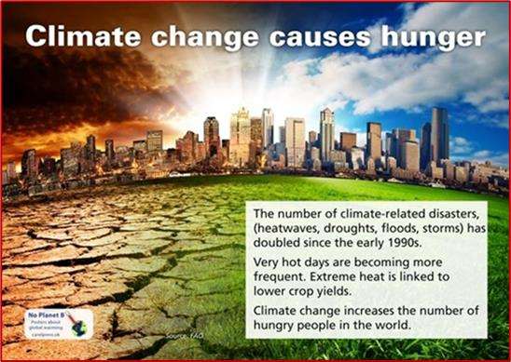
Impact of CLIMATE CHANGE on Hunger
Extreme hot weather, heavy or no precipitation result in more extreme storms, floods and drought
Climate change negatively impacts on all human
systems especially the global food systems
Agriculture will be negatively
affected by changes in
rainfall and temperature patterns
80%
of the worlds rural population depend on
agriculture for their livelihoods and climate change
could exponentially impact on food security in these areas
Urgent climate mitigating strategies are needed to turn the tide of food insecurity and hunger

Slide 21
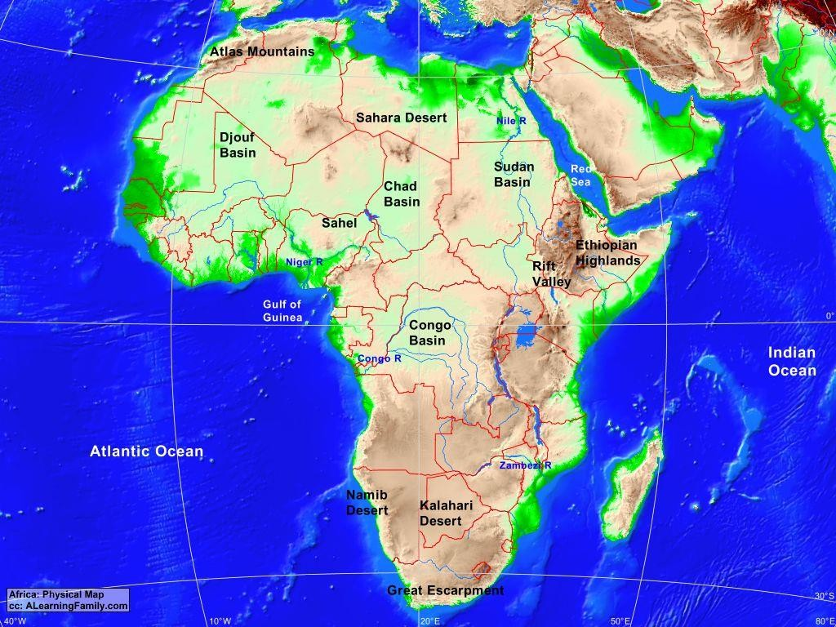
Impact of CLIMATE CHANGE on food for Africa
Most vulnerable region in the world to Climate Change due to limited ability to adapt or mitigate the change.
More food production systems at risk due to high reliance on rain-fed agricultural systems to produce food
Negative impact on crop production and livestock rearing
Average temperature increase between 3 ̊ and 6 ̊ C

Slide 22
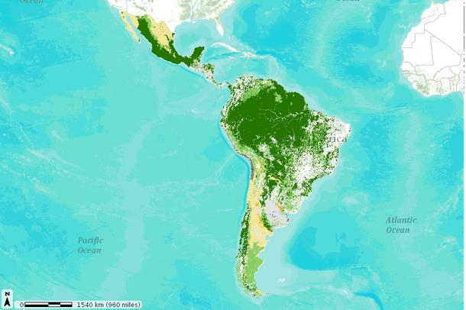
Impact of CLIMATE CHANGE on food for Latin America
Changing rainfall patterns and temperatures have impacted on the agricultural production and crop quality in the region
Growing conditions of crops and planting seasons have changed
The production of soyabeans has already reduced by 20%, while the cereal harvest has declined significantly all due to climate change
Extreme weather events and hazards are already increasing the levels of food
insecurity in the region

Slide 23
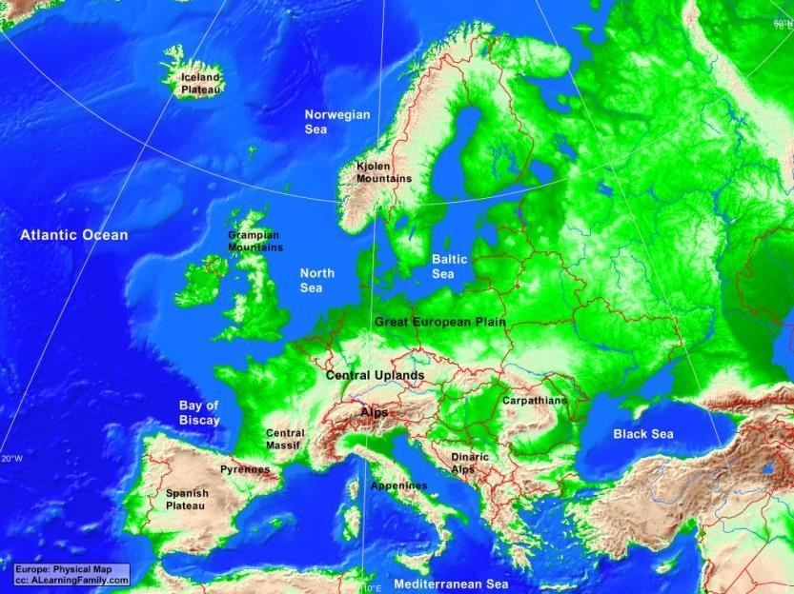
Impact of CLIMATE CHANGE on food for Europe
Increasing evidence of negative impact on Climate Change on food and nutrition security in the EU (especially the newer member states)
Reduced cereal yields in southern Europe, reduced yield & nutrient content of fruit and vegetables, changing fisheries activities, and expanding distribution of livestock infections
Adaptation includes modifying farming practices, and breeding crops that are more resilient to (a)biotic stress

Slide 24
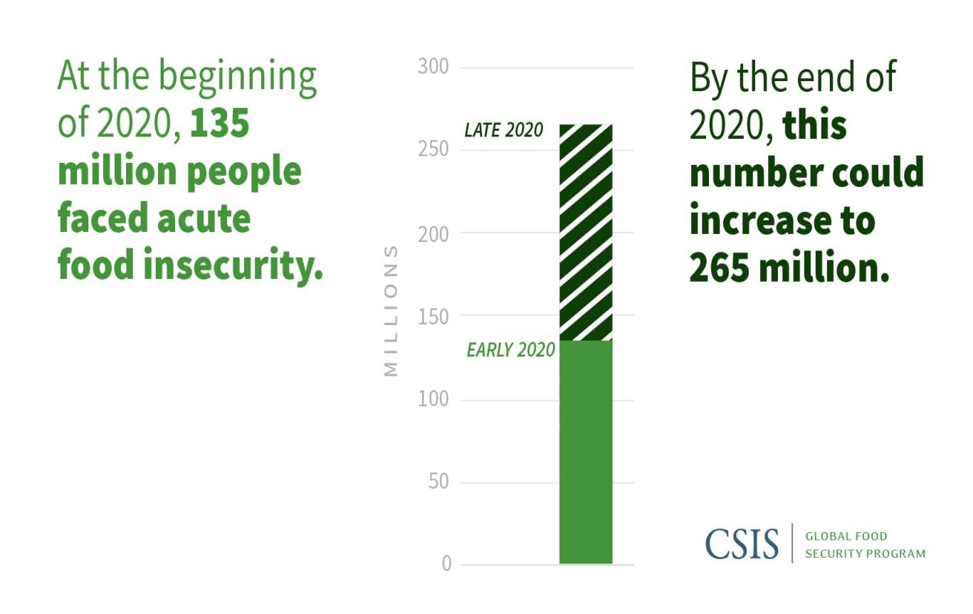
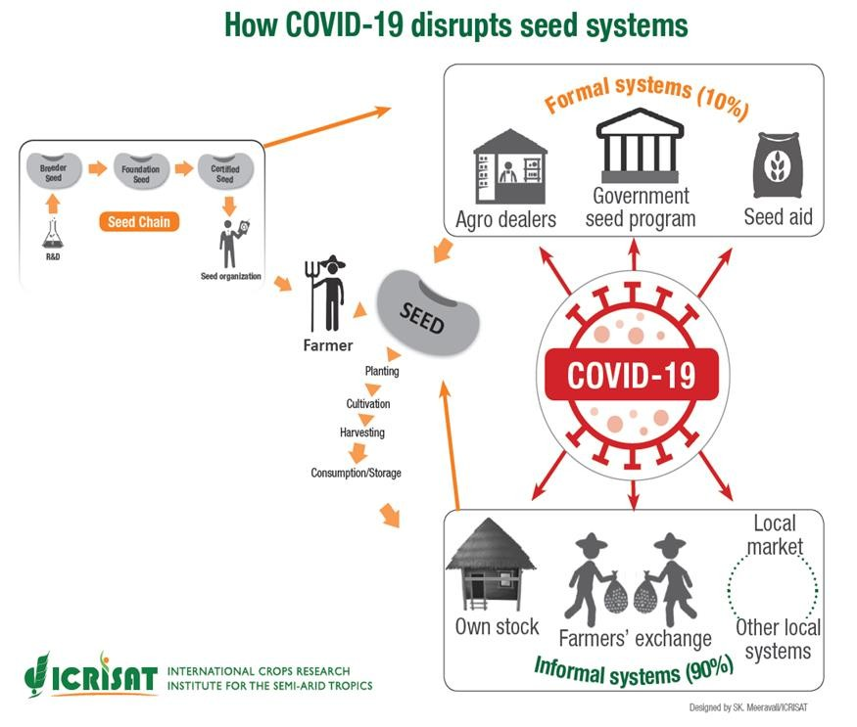
COVID-19
Preliminary data indicates that during the pandemic 350 million people were food insecure across the globe

Slide 25
Impact of COVID-19 on Hunger
Spatial differences of direct and indirect impact
Exposed the extent of insufficient public systems such as social protection, weak public health systems
Exposed structural inequalities in societies.
Global livelihoods and food availability negatively impacted by economic shocks related to pandemic
Lockdowns negatively impacted
economy and agricultural production and the availability of and distribution of food globally
Links between SDG1 and SDG2 enforced
COVID-19 highlighted the interconnectedness of all 17 SDGs

Slide 26
Impact of COVID-19 on food for Africa
Enforced directives to contain virus with no regard for livelihoods and the ability to access food
Urban populations in Africa were hardest hit, triggering implementation of emergency food aid
Major corruption exposed at government levels
Drop in production and limited importation of food meant a projected 73 million more Africans were food insecure by the end of the pandemic

Slide 27
Impact of COVID-19 on food for Latin America
Reduced incomes and disruption in the food supply chains
30% increase in the number of people impacted by hunger during the first year of the pandemic
Higher levels of food insecurity amongst women and rural populations due to increased socio-economic vulnerabilities

Slide 28
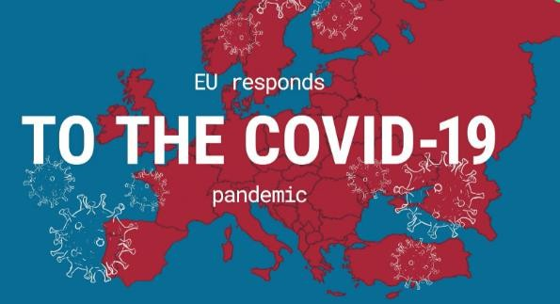
Impact of COVID-19 on food for Europe
The achievement of SDG2 prior to the pandemic was spatially unequal, and just became more challenging during and after the pandemic
Lockdown measures put pressure on vulnerable populations in terms of the labour markets
The impact of early response measures will seen in due time

Slide 29
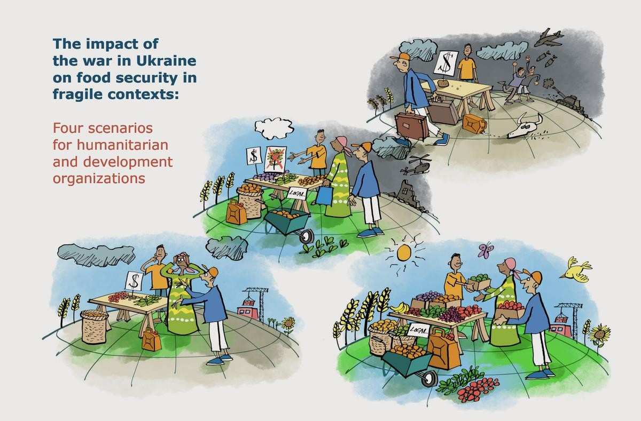
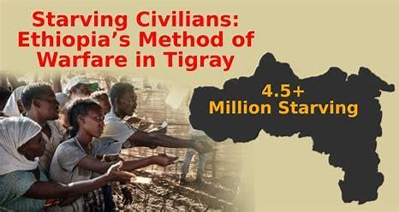
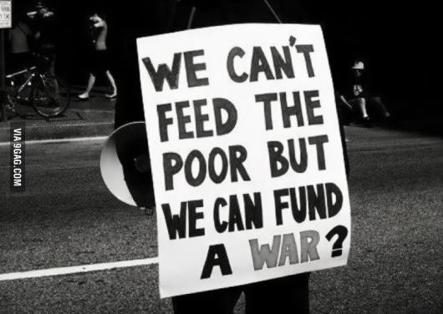
Conflict
Global and regional in nature

Slide 30
Conflict
Destruction and danger,
Reduction in crop production
Environmental deterioration
Displacement of people
Food as a weapon of war
International food trade barriers
Economic recession
Political instability
Energy prices escalation
Availability of pesticides and fertilizers
Significantly reduces the ability to provide and distribute food

Slide 31
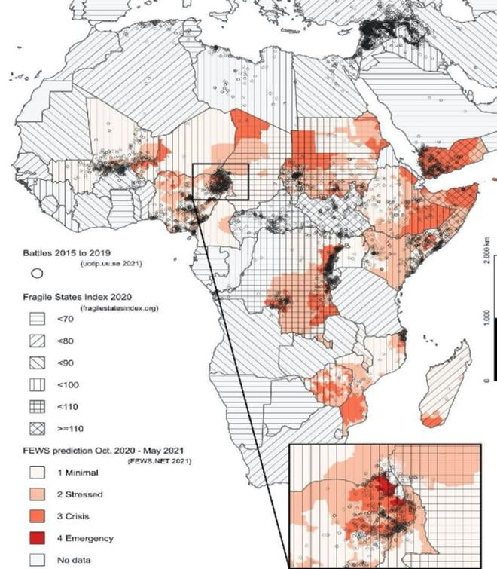
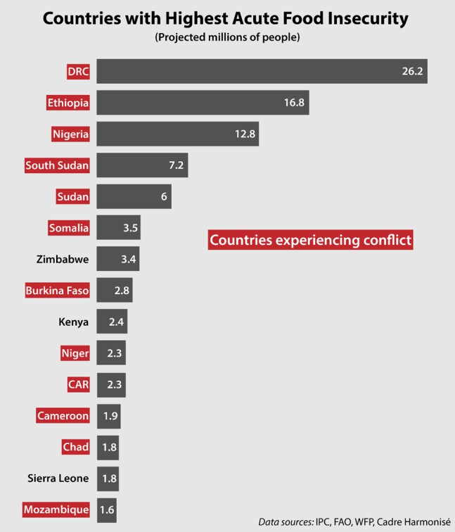
Impact of CONFLICT on food for Africa
Source: Kemmerling et al (2022) Source: Africa Center for Strategic Studies (2021)
Endemic regional conflict in Africa over decades has negatively impacted on all aspects of
food security including agricultural production

Slide 32
Impact of CONFLICT on food for Latin America
Economy is dependent on international market and any instability creates uncertainty and thus economic and trade slowdowns.
The Ukraine War has a varied impact on countries in the region – low levels of economic growth, fall in the GDP, increased inflation
Huge dependency on imported fertilizer from the Ukraine to support its trade surplus of food.
This will affect production and an increase in food prices and increase the percentage of population impacted by food insecurity
A disruption in the fertilizer and fuel systems due to the Ukraine War will negatively impact on the vulnerable populations in the region

Slide 33
Impact of CONFLICT on food for Europe
The Ukraine War has had huge consequences on global food security:
Ukrainian exports are delayed, and this has a cumulative impact on global food security
population displacement and conscription has caused labor shortages on farms
access to fertilizers is restricted and this will reduce yields
Delays in planting and harvesting creates uncertainty in terms of food production
The Ukraine War will result in global food shortages that will make it difficult for the world to achieve the SDG 2 Targets

Slide 34
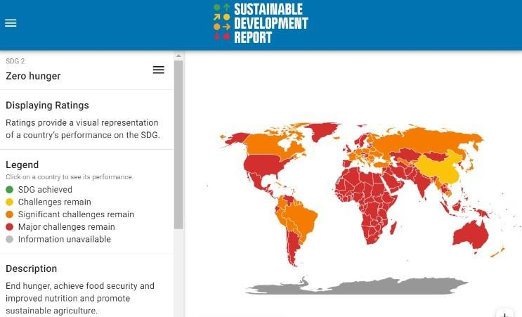
4. Progress towards achieving SDG2
Source: United Nations, 2022

Slide 35
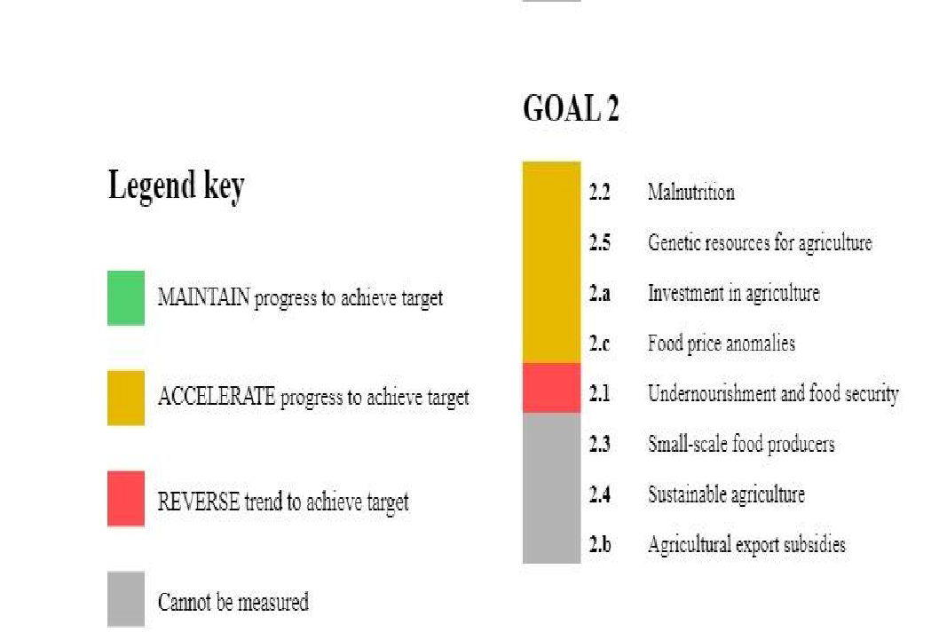
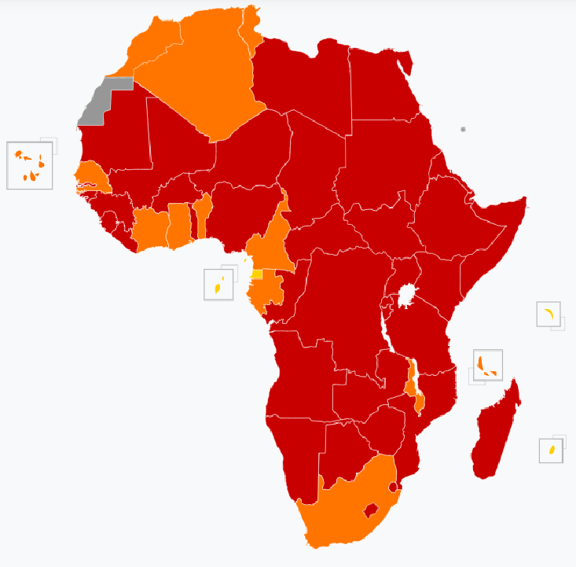
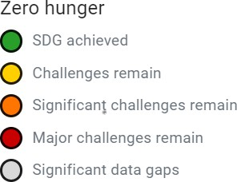
AFRICA Progress towards achieving SDG2
Source: https://ecastats.uneca.org/unsdgsafrica/sdgs

Slide 36
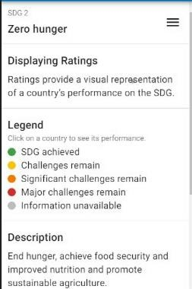
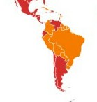
LATIN AMERICA Progress towards achieving SDG2
Food (in)security in Latin America varies spatially
Some countries have made significant progress in the fight against chronic malnutrition in children
In some countries overweight and obesity are increasing at an alarming pace.
Many countries in the region are experiencing the double burden of malnutrition.
Food production exceeds the requirements of the
entire population.
The biggest problem is unequal access to good- quality food products and the right balance of calories and nutrients.
Source: United Nations, 2022

Slide 37
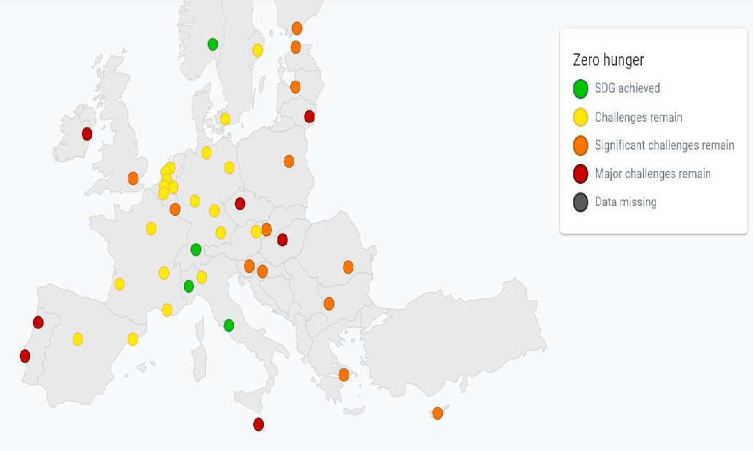
EUROPE Progress towards achieving SDG2
Focus is on combating malnutrition - obesity and pre-obesity is a growing problem in the region
EU is making great progress in making agricultural production more sustainable
Environmental impact of unsustainable agriculture lasting
Food waste has been significantly reduced in the region
Source: Sustainable Development Solutions, 2022

Slide 38
5. Case studies
Three case studies have been developed for each of the regional contexts to showcase best practices.
The purpose is to provide students with actual examples of good case studies that have attempted to address the indicators of the SDG 2.
Each case study provides suggestions on how the ideas, plans and actions in the case study can be replicated in other communities and areas.

Slide 39
5.1 Case studies for Africa
Guinea-Bissau
Multi-level child nutrition programme – Reinforcing capacities of existing centres to treat child malnutrition; Nutrition counseling in 150 vulnerable communities; Good nutrition activities at 150 schools; Capacity building of Ministry of Health
Mozambique
Irrigation, agro production and climate change adaptation programme – Assisting farmers in the Chicualcuala District to cope with drought through irrigation methods and also by up-skilling women, communities and farmer associations
Nigeria
Application of public-private partnerships for youth empowerment in the Kaduna District to enhance agro-food value chains. Involve the Sahara Group, three UN Agencies, SDG Fund ambassadors and the District Government

Slide 40
5.2 Case studies for Europe
Basque Country (Spain)
Integrated approach to localise the SDGs within a multilevel SDGs Ecosystem Framework and specifically a renewed Rural Development Plan and an independent association focused on the reduction of food waste
Helsinki, Finland
Physical Activity Programme to support SDG 2 – based on physical exercise, aiming to change unhealthy lifestyles and tackling the main nutritional problem of overweight
Latvia
Series of actions to support implementation of SDG 2 – Including a dietary scheme for schools, preferential treatment for organic farm produce, and food support for disadvantage households

Slide 41
5.3 Case studies for Latin America
Brazil
Fome Zero Program (Zero Hunger) – Project to combat hunger and ensure food security for the Brazilian population
Colombia
The National Food and Nutrition Program – Established in 2007 to improve the food and nutritional condition of the most vulnerable people in the country
Mexico
National Conditional Cash Transfer Programme – Established in 1997and funded by the Mexican government and the World Bank to provide education, health and food in rural areas of the country

Slide 42
6. Assessment and Exercises
The assessment provided in the study material ranges from quick and immediate responses to demonstrate competences achieved to longer term projects that the teacher can consider
At the end of each section a variety of measures to assess the achievement of the learning goals are posed and these include:
Multiple choice questions
Short Quizzes
Questions that require answers ranging from short sentences to paragraphs
Mapping the University Food System and Practices: As a first sustainable food project, you might want to map out your university food system and practices. This can help you to understand how the system works, what is already going well and who makes decisions about food purchasing that you might want to influence.
Food Waste: Students should act as investigators observing the amount of food wasted in
the school lunchroom or at a university restaurant/coffee shop.
Establishing a Campus Garden: Like running a food cooperative, you could also directly grow sustainable food at your university. By growing food in a campus garden, you can directly control the sustainability standards and can then offer it for free or sell it to your university community. It is also a great project to involve volunteers and get people excited about sustainable food!
Food Tales: Students should research the typical journey of a piece of food from where it’s
grown to how it ends up on your plate.

Slide 43
Sample Quiz: Hunger and climate change
What factors contribute to hunger?
a Climate change
b Agriculture and food policies
c Poverty
d All of the above
Select the statement below that most accurately describes global hunger:
a Nearly one in five people suffer from hunger worldwide.
b Due to the efforts to address food security, hunger has decreased in recent years.
c Nearly one in ten people suffer from hunger worldwide.
d Poverty is the only factor that contributes to hunger.

Slide 44
3. What best describes the relationship between poverty, hunger and climate change?
a Climate related events will disrupt livelihoods and impact available income
b Poverty will impact someone’s ability to recover from a climate related event, which will sustain poverty and increase food security
c Climate change will cause longer growing seasons in low- and middle-income countries in
tropical areas which will increase crop production, and family incomes
4. Weather related events, such as increased temperatures and floods, will cause decreases in crop productivity in all countries.
a True
b False

Slide 45
5. After a large, unexpected flood, hundreds of farmers lose their source of income for the year with no other available opportunities. With increasing weather events on the horizon, the farmers and their families are forced to deal with the consequences of the flood.
What could be a potential effect of this event on the local town?
a Increase in hunger
b Increase in conflict
c Increase in vulnerable populations
d All of the above

Slide 46
Closing Words
The brings us to the end of this presentation, which served as introduction to some crucial aspects of SDG 2.
Global crises impacting negatively on SDG 2 achievement and its progress in three regional contexts were dealt with.
Case studies highlighting best practices and examples of exercises and assessments, concluded the presentation.
You were exposed to a variety of information and perspectives on SDG 2 and we trust that this kindled your interest in SDG 2 and its importance.
Similarly, we trust that you are now empowered to offer a class or a series of classes on SDG 2, while using this introduction to SDG 2 as point of departure.

Slide 47
References
African Center for Strategic Studies, 2021. Conflict drives record cases of acute food insecurity in Africa. https://africacenter.org/spotlight/conflict-drives-record-levels-of-acute-food-insecurity-in-africa/. Last accessed 31 October 2022
Africa UN. 2022. African UN Data for Development Platform. Available at https://ecastats.uneca.org/unsdgsafrica/sdgs
last accessed 20 November 2022
Kemmerling, B., Schetter, C. and Wirkus, L., 2022. The logics of war and food (in) security, Global Food Security, 33, p.100634. Available at: https://doi.org/10.1016/j.gfs.2022.100634 Last accessed August 26, 2022.
SDGF (Sustainable Development Goals Fund) n.d. Irrigated and integrated agro production systems help Mozambique. https://www.sdgfund.org/case-study/irrigated-and-integrated-agro-production-systems-help- mozambique-adapt-climate-change Last accessed 11 November 2022.
Sustainable Development Solutions. 2022. European Cities SDG Index. Available at https://euro-cities.sdgindex.org/#/ last accessed 20 November 2022
United Nations, 2022. The Sustainable Development Goals Report 2022. United Nations, Department of Economic and
Social Affairs. Available at https://dashboards.sdgindex.org/map/goals/SDG2 Last accessed 20 November 2022.

Slide 48
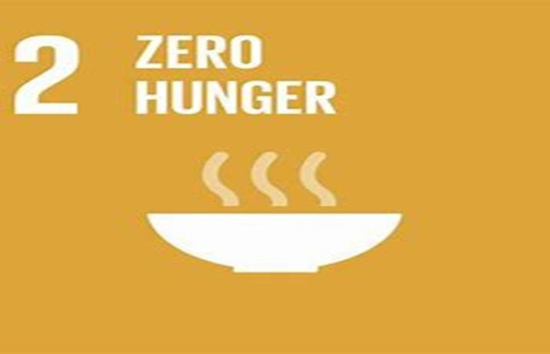
Thank you!
Prof. Dr. Luciana Brandli
Titular professor at the University of Passo Fundo / College of Engineering and Architecture brandli@upf.br
Prof. Dr. Rudi Pretorius
College of Agriculture and Environmental Sciences, University of South Africa
pretorw@unisa.ac.za
Prof. Dr. Dr. Walter Leal
Head of Research & Transfer Center Sustainability & Climate Change Management at HAW Hamburg walter.leal2@haw-hamburg.de

