Slide 1
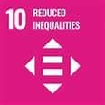
Introduction to SDG 10 (Reduced Inequalities) and review of
Regional specificities for Africa, Latin America and
Europe
A brief overview of the OER teaching materials developed for SDG 10 as part of the collaborative project funded by Deutscher Akademischer Austauschdienst (DAAD) – German Academic Exchange Service
Digital Introduction to the Sustainable Development Goals in Higher Education Teaching
Regional Aspects in Implementing the SDGs from Latin America, Europe and Africa
Developed by academics from Unisa (South Africa), UPF (Brazil) and HAW Hamburg (Germany)

Slide 2
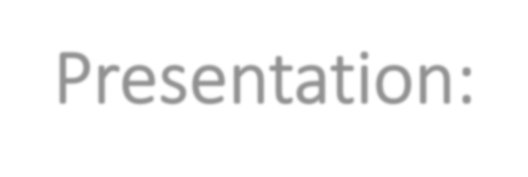
Presentation:
Teacherˈs manual for SDG 10
Introduction
Defining SDG 10
Global crises and SDG 10 – Focus on Africa, Latin America and Europe
Progress towards the achievement of SDG 10
Case Studies and best practices
Assessment and exercises
Closing words

Slide 3
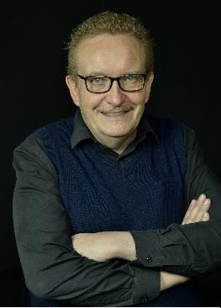
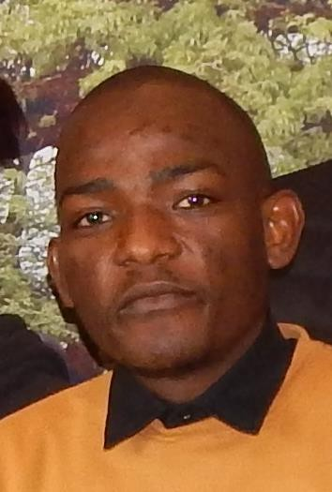
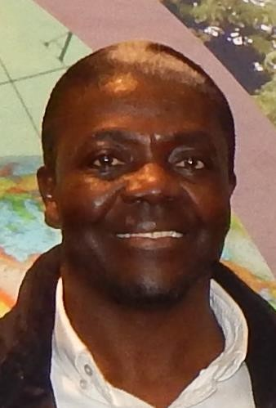
Development team of this presentation
Prof Rudi Pretorius
Prof Melanie Nicolau Mr Lindokuhle Sibiya
Department of Geography University of South Africa January 2024
Dr Zongho Kom

Slide 4
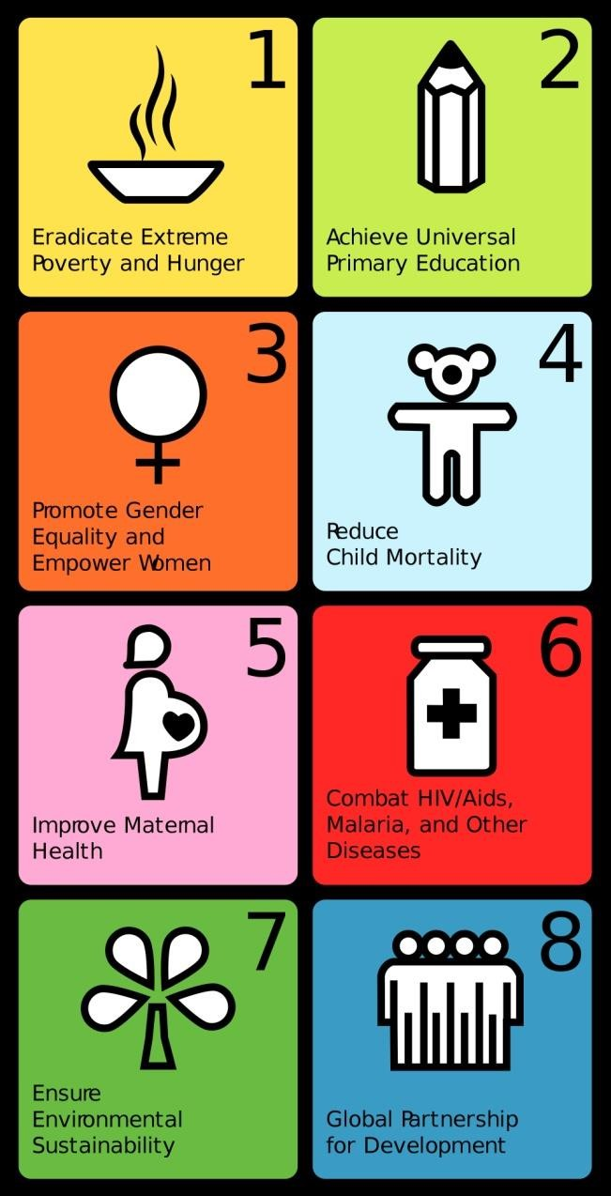
1. Introduction
In 2001 the eight MDG’s were launched, following
pre-2000 concerns on several global issues
Commitments for international cooperation to address these issues, 2001-2015
Emphasized human capital, infrastructure and human rights
Close to end of period: Uneven progress evident, some countries high achievers, others lagging behind

Slide 5
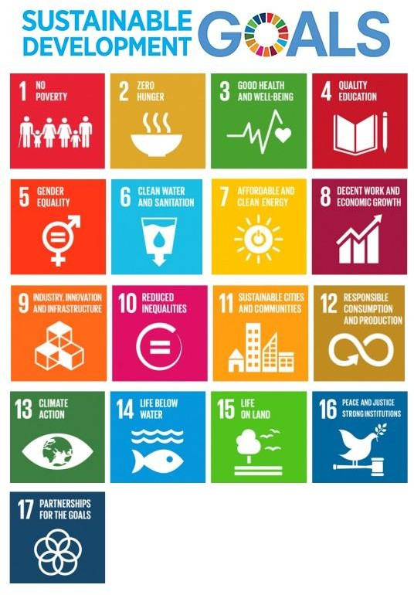
MDG’s were replaced with 17 SDGs in 2015
SDG’s link up with five critical areas: People,
Prosperity, Planet, Peace & Partnership
They consist of Goals, Targets & Indicators
Connection/interaction between SDGs of prime importance
This teacher’s manual is about SDG 10 – Reduced Inequalities (Area of Prosperity)
Of critical importance due to ncreasing disparities in wealth observed around the world over the past decades, as well as the political reaction to these disparities

Slide 6
2. Defining SDG 10
Ten targets and eleven indicators covering three different types of inequality (MacNaughton, 2017):
Horizontal inequalities - inequalities between social, ethnic, linguistic, or population groups
Vertical inequalities - inequalities of wealth, income, or social outcome
Inequalities between countries

Slide 7
Target | Ikon | To be achieved by 2030 | How to measure progress (Indicators)
10.1 |  | Reduce income inequalities | Achieve income growth of bot-tom 40% of population at a rate higher than national average
10.2 |  | Promote universal political, social and environmental inclusion | Proportion of people living below 50 per cent of median income
10.3 |  | Ensure equal opportunities and end discrimination | Proportion of population reporting having felt discriminated against in previous 12 months

Slide 8
Target | Ikon | To be achieved by 2030 | How to measure progress (Indicators)
10.4 |  | Adoption of fiscal and social policies promoting equality | Labour share of GDP, comprising wages and social protection transfers
10.5 |  | Improve regulation of global financial markets and institutions | Financial soundness indicators
10.6 |  | Enhanced representation of developing world in financial institutions | % of members & voting rights of developing countries in such organizations

Slide 9
Target | Ikon | To be achieved by 2030 | How to measure progress (Indicators)
10.7 |  | Responsible and well managed migration policies | Recruitment cost borne by employee in destination country Number of countries having migration policies facilitating responsible migration and mobility
10A |  | Special, differential treatment of developing countries | Proportion of tariff lines applied to imports from least developed countries and developing countries with zero tariff

Slide 10
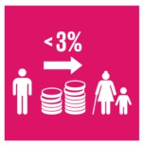
Target | Ikon | To be achieved by 2030 | How to measure progress (Indicators)
10B |  | Encourage official develop-ment assistance and financial flows to States where the need is greatest | Total resource flows for develop-ment
10C |  | Reduce transaction costs for migrant remittances | Remittance costs as a proportion of the amount remitted

Slide 11
SDG 10
Three Thematic Areas
Within-country inequalities
Between country inequalities
Implementation towards greater equality
Within-country | Between countries | Implementation
Targets 10.1, 10.2, 10.3 and 10.4 address within-country inequalities These targets transcend social, economic, and political dimensions, thereby aiming to expand prosperity, inclusion, and social protection The spread of COVID-19 has intensified structural and systemic discrimination and pervasive inequalities From 2017-2021 ± one in five people have experienced some discrimination prohibited under international human rights law Women are twice as likely as men to experience discrimination based on their gender | Targets 10.5, 10.6 and 10.7 address inequalities between countries These targets give attention to cross-border flows of finance and people and the distribution of voice in global institutions While decreasing with 3.8% from 2013-2017, it is estimated that between-country income inequality rose with 1.6% from 2017 to 2021 This increase is largely due to the impact of the COVID-19 pandemic, may become entrenched and affect households in low-income countries disproportionally This halts the steady decline in income inequality observed since 1988 | Targets 10.a, 10.b and 10.c address implementation Propose steps for attaining greater equality by directing resource flows toward those most in need In terms of progress, decline in the labour share of in-come from 2014-2019 Europe and North America is driving decline, while Oceania, Central and Southern Asia also show significant declines, thus ex-acerbate income inequality However, sub-Saharan Africa, Latin America & the Caribbean, and Eastern & South-Eastern Asia are showing in-creases, although occurring from a lower starting point

Slide 12
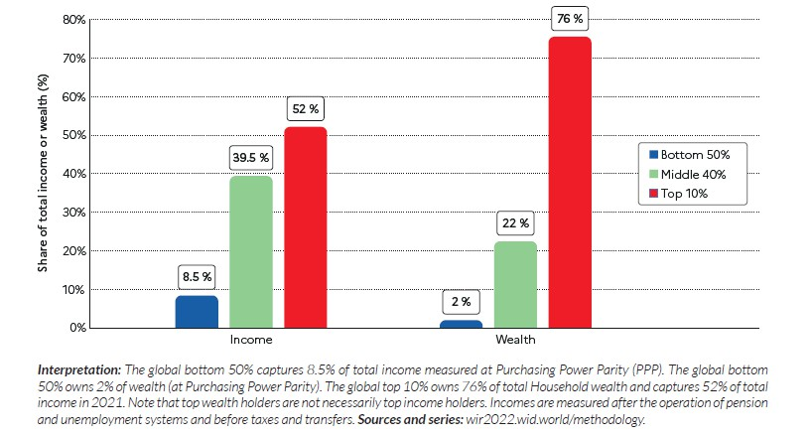
Significance of SDG 10 (1)
SDG 10 firstly refers to inequalities in income and wealth, which are generally accepted to be severe and continue to be widening globally (Oxfam, 2023)
The richest 10% of world population earns 52% of global income, with poorest half only 8.5% of it
Wealth inequalities even more pronounced
The poorest half of world population barely owns any wealth (2% of total) while richest 10% owns 76% of all wealth (Chancel et al., 2022)

Slide 13
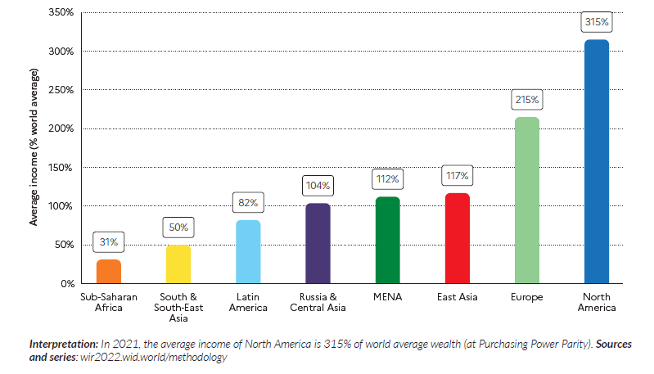
Significance of SDG 10 (2)
Regarding economic inequality between countries and regions, the picture revealed by the World Inequality Report (Chancel et al., 2022) is equally worrying
The figure shows average income across world regions, expressed as
% of global average income of
€16,700/y
Average income varies from 0.31 (31%) of global average for SSA to to more than X3 the global average for North America
Average North American earns 6 to 10 times more than the average SSA resident (Chancel et al., 2022)

Slide 14
Significance of SDG 10 (3)
Regarding economic inequality within countries and regions, the picture is equally worrying (Chancel et al., 2022)
In no country or region, the poorest 50% of the population captures more than 20% of the national income
This can be as low as 9% to 12% in Latin America, MENA, Sub-Saharan Africa and South and Southeast Asia
But it is not only about the reduction of economic inequality, within and between countries, but also acknowledgement that a variety of legal, social, and economic changes are required to reduce inequality in terms of material position as well as social standing (Oestreich, 2018)

Slide 15
Interdependencies of SDG 10
SDG 10 cannot be implemented in isolation, and attainment of its targets depends on the various synergies and trade-offs between the different SDGs
In addition, as so-called “foundational goal”, progress with SDG 10 Targets
would speed-up progress across the entire sustainable development agenda
For example, if inequality continues to exist, it will be difficult to meet SDG 1 (to eradicate poverty). SDG 10 also supports SDG 8 (on decent work and economic growth) through enhancing the potential of the population to join the work force
Several interdependencies also exist between SDG 10 and the SDGs related to “Planet”, with the UNGC noting that many environmental SDGs can benefit from a reduction in inequality (UNGC, 2018)

Slide 16
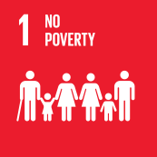
Examples of interdependencies between SDG 10 and some other SDGs
Poor people experience challenges to access basic resources, often leading to their social exclusion and marginalization, which further exacerbates poverty and inequality
Inequalities in access to health services are exacerbated in poor countries and populations
Inequality, especially in term of income, can be reduced by education, which enables upward socioeconomic mobility and is regarded as a key to escaping poverty
Increased gender equality can increase access to education and employment for women and girls, thus initiating greater economic equality
Marginalised peoples are affected disproportionately by unequal access to clean water and sanitation
Provision of access to sustainable energy can improve living standards and productivity of poor and marginalized people, thereby supporting a reduction in inequality

Slide 17
Advantages of SDG 10
The agreement by the global community on the need for a specific SDG on reduction of inequality can be regarded as a significant success in international cooperation and distinct advantage of SDG 10
An advantage of the ten targets of SDG 10 is that they cast a wide net which captures multiple drivers of inequality (UNDESA & World Bank, 2019), but this leads to difficult and complex goal to achieve
Another advantage of SDG 10 is its universal applicability, within which it creates opportunity to shift the accepted development paradigm towards human rights acknowledgement (Saiz & Donald, 2017)

Slide 18
Some advantages of SDG 10
The “Leave no one behind” principle resonates with SDG 10 with advantage that poverty needs to be addressed together with steps to achieve Goal 10 and to address human rights deprivations
By addressing SDG 10 it will be possible to counter many of the detrimental effects of economic inequality on human rights
A distinct advantage of SDG 10 lies in its focus on discrimination and to confront it proactively in all its different forms. This is because inequality goes together with discrimination
Unlike the MDGs which placed the greatest burden on the poorest countries, the advantage of SDG 10 is that it challenges global inequality
While increased inequality can work against the attainment of other SDGs, the advantage of reducing inequalities is that it will have a positive effect on all the SDGs

Slide 19
Challenges in the implementation of SDG 10 (1)
The SDG 10 Targets come across as vague/weaker than most of the other SDGs due to the “softer” language used, thus it is unlikely that such targets will be achieved or result in significant transformation
This vagueness causes challenges for implementation and monitoring – e.g., Target 10.1, calling for growth in wealth of bottom 40% of income earners at rate higher than national average, but does not specify how fast
SDG 10 is vulnerable to neglect or backlash since of all the goals it will
probably require the most impactful changes to the “business-as-usual”
economic model

Slide 20
Challenges in the implementation of SDG 10 (2)
The last challenge is that SDG 10 does not fall under any thematic body with mandate to oversee this goal. This means it runs the risk of becoming an “orphan” goal which might be neglected or implemented half-heartedly

Slide 21
Challenges to achieve SDG 10, and how to address them
Specific challenge | Required actions
Targets and indicators are vague and contain imprecise language that could jeopardise implementation | Lobby for reformulation of targets and indicators
Backlash due to the profound and lasting changes which are required | Incentivise states to drive implementation of SDG 10
No institutions at national/international level with mandate to drive actions to achieve this goal | Hold governments & other actors accountable for their actions or lack thereof to advance SDG 10
Lack of basic information, apart from income and wealth, about inequality | Improve capability to measure and monitor the other dimensions of socioeconomic disparities, such as gender and environmental inequalities

Slide 22
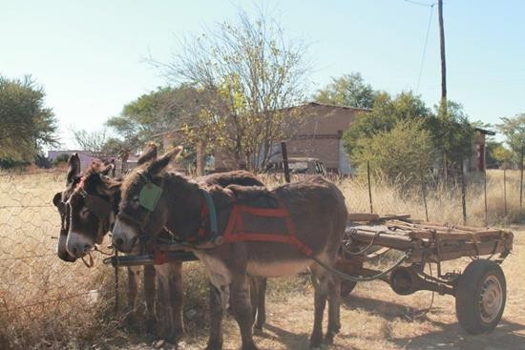
Summary global orientation of inequalities and the need for SDG 10
SDG 10 Reduced Inequalities (youtube.com)

Slide 23
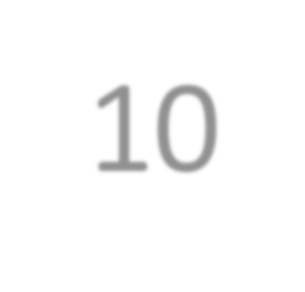
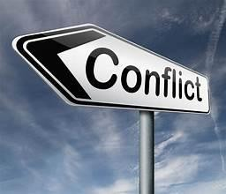
3. Crisis and the achievement of SDG 10

Slide 24
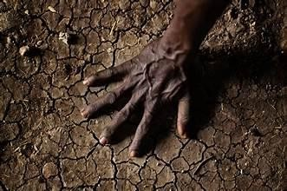
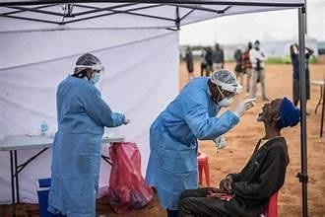
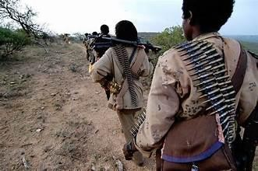
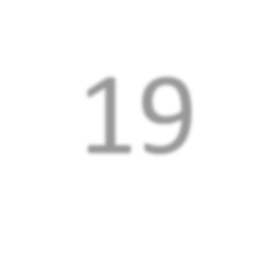
3.1 Global crises and SDG 10 Focus on Africa
CLIMATE CHANGE
COVID-19

Slide 25
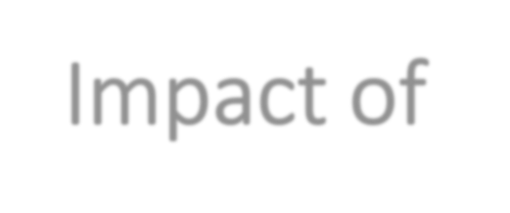
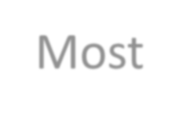
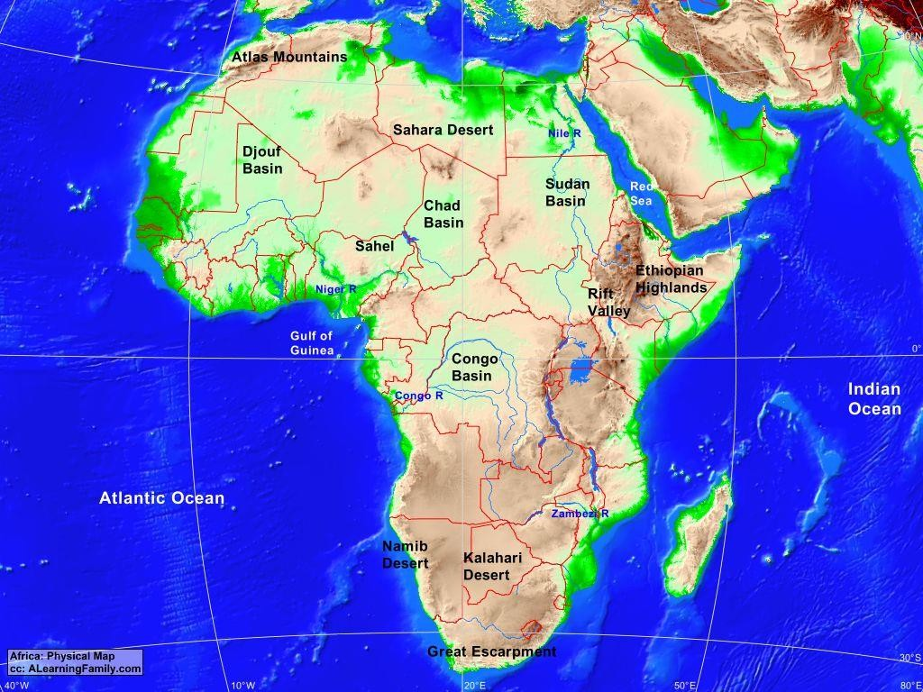
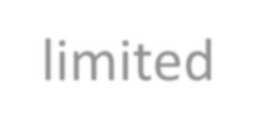
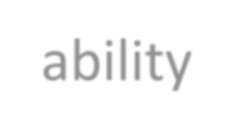
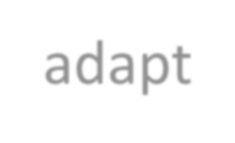
Impact of CLIMATE CHANGE on inequality in the region
Most vulnerable region in the world to Climate Change due to limited ability to adapt or mitigate the change.
Climate change limits the potential for industrialisation, innovation, and infrastructure development in Africa.
Environmentally induced refugees across the globe.
By 2050, the West African countries could see up to 32 million internal climate migrants.
Average temperature increase estimated to be between 3 ̊ and 6 ̊ C higher than global average

Slide 26
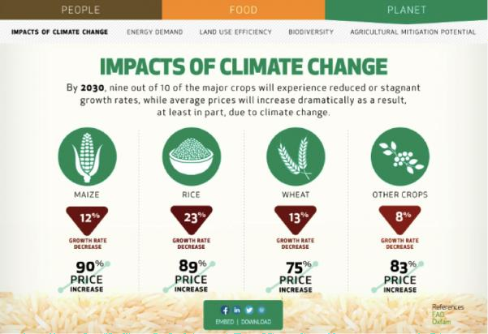
Impact of CLIMATE CHANGE on Inequalities in the region
Leading causes of inequality in the world over the last decade (affects the poorest and vulnerable)
More infectious and respiratory diseases due to climate change and especially in warmer countries
Climate change affects the productivity and profitability of agriculture (reduced yield, increase in pest and disease outbreaks)
Agriculture accounts for about 23% of Africa’s GDP and around 60% of its
labour force is involved in this sector.

Slide 27
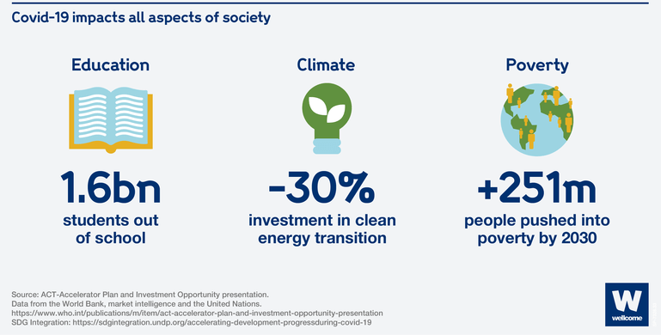
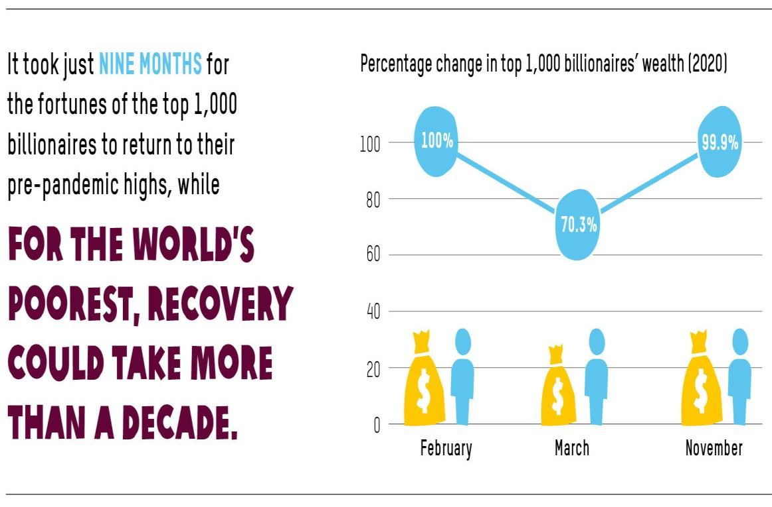
COVID-19 in the region
COVID-19 increased the global Gini index by 0.7 point and global extreme poverty (using a poverty line of $2.15 per day) by 90 million people

Slide 28
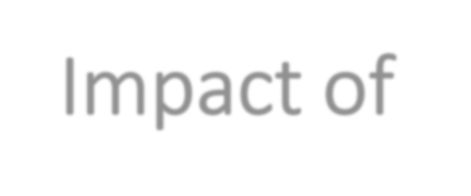
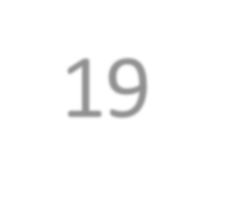
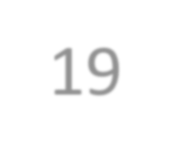
Impact of COVID-19 on Inequalities in the region
The COVID-19 pandemic can be called a
pandemic of inequalities
Spatial differences of direct and indirect impact
In 2020 alone, estimated to have pushed 30 million people into extreme poverty in sub- Saharan Africa
Vulnerable and marginalised groups – high risk of infection, mortality, income loss and food insecurity
Diverted resources and attention from other health priorities
Limited the access to quality education, and health care in Africa, which is crucial for human development and social inclusion
Highlighted the need for more resilient and
equitable healthcare systems
Disrupted global economic activities, loss of jobs, reduced incomes, and increased poverty, hunger, and instability
Disrupted supply chains, leading to food and medical shortages, and distress in financial markets, disrupting global trade
COVID-19 was twice as deadly in low-income countries.

Slide 29
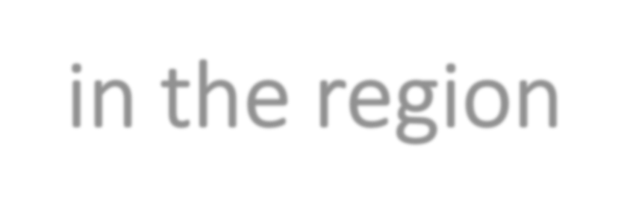
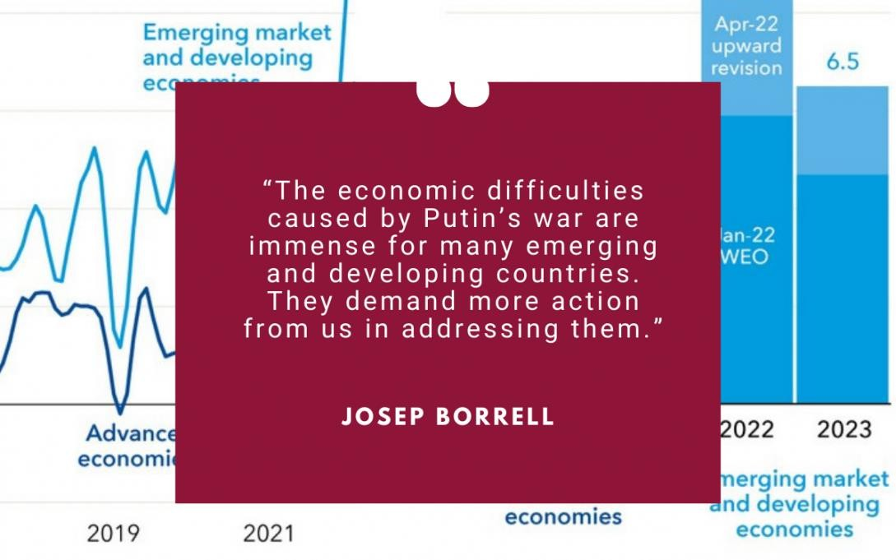
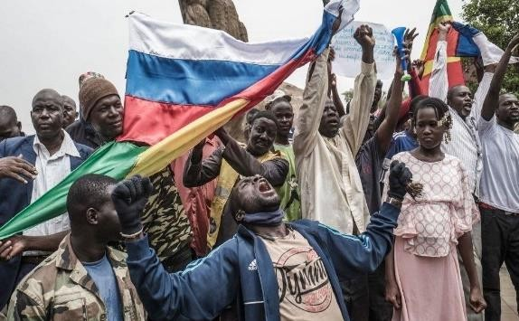
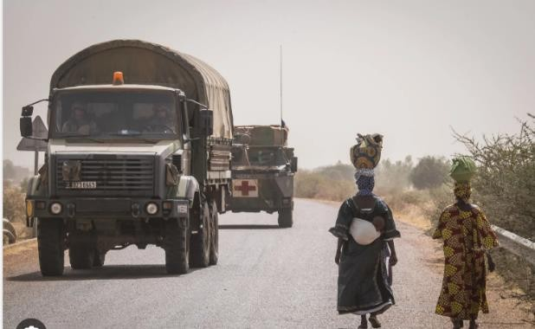
CONFLICT in the region
In 2021 it was estimated that there were 82.4 million forcibly displaced people in the world and 36 million of these people are in Africa (Brown, 2023).

Slide 30
Impact of CONFLICT
Environmental destruction and danger,
Displacement of people from their homes
Increases humanitarian needs.
Forces children from the classroom,
Worsens gender inequality,
Exposes people to extreme levels of
violence.
Economic recession
Political instability
Energy prices escalation
War destroys key infrastructure that supports daily life, from water systems to energy centres to hospitals.
War disrupts food production systems causing rapid inflation of food prices and preventing people from earning money to buy food.
Africa is often ironically described as a “‘continent on the move”’

Slide 31
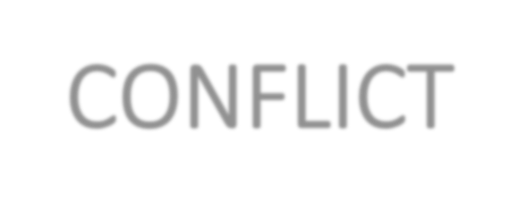
Factors that have contributed to CONFLICT in the region
Colonialism and slavery created artificial borders, ethnic divisions, and economic dependency
Authoritarian and corrupt regimes that violate human rights, repress dissent and mismanage natural resources
The impact of climate change and environmental degradation that exacerbate food insecurity, water scarcity, and displacement
The interference of external actors that fuel proxy wars, exploit resources and undermine sovereignty

Slide 32
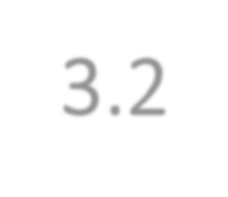
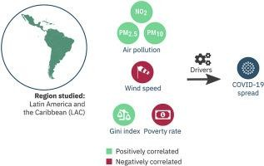
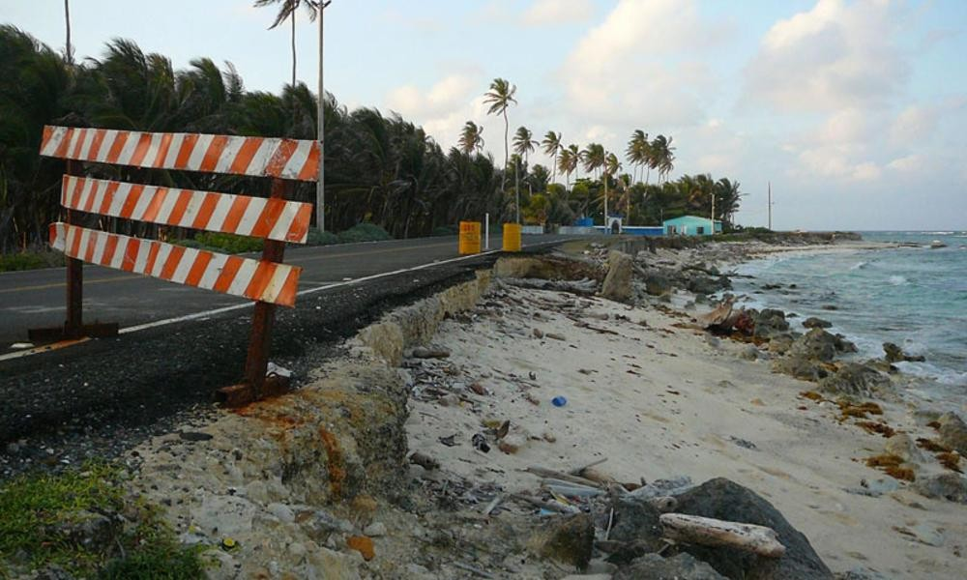
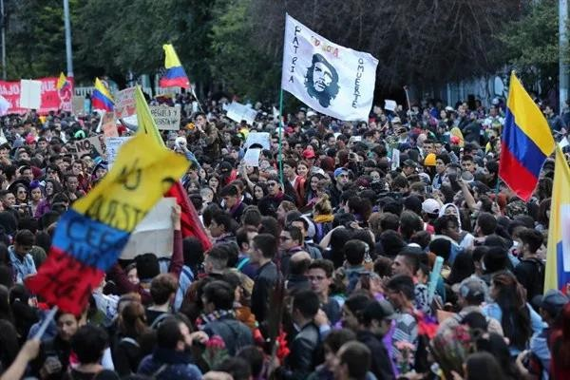
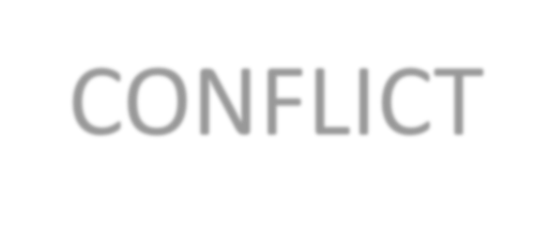
3.2 Global crises and SDG 10
Focus on Latin America and the Caribbean
CLIMATE CHANGE
COVID-19
CONFLICT

Slide 33
Impact of CLIMATE CHANGE on inequality in the region
Climate change impacts associated with the retreat of glaciers, water scarcity; increased frequency of extreme weather events and damaging infrastructure, and agriculture yield
An average of 150,000 and 2.1 million people are pushed into extreme poverty due to natural disasters. By 2030, this number will increase to 3 million people (World Bank, 2021)
The increased temperature levels lead to health impacts associated with the dissemination of infectious diseases (with dengue being particularly endemic in Latin America).
Disasters and extreme weather events expose inequalities more clearly, affecting minorities such as women, children, and indigenous people disproportionally
Average temperature increase rate of 0.1 °C per decade from 1961 and 1990 and between 1991 and 2021 was of 0.2 °C.

Slide 34
Impact of COVID-19 on Inequalities in the region
Latin America and the Caribbean regions were hardest hit in terms of COVID-19's impact on inequality
The pandemic caused higher levels of food insecurity and reduced access to basic services (health and education)
Latin America and the Caribbean had more job losses in groups (women and youth) that were already more vulnerable socially.
There was an increase in food insecurity but limited access to health care system and education
Poor families witnessed malnutrition and food deprivation that could lead to long-term impacts on child development Poorer families were also severely impacted by lower access to medical services

Slide 35
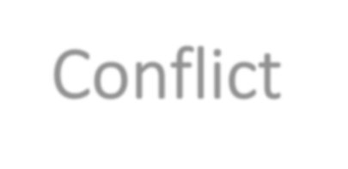
Impact of Conflict in the region
The region suffer from both regional conflicts, displacement and migration and international events that affect poverty and inequality
Economic and trade slowdown and inflation
Higher food and energy prices
A setback in the labour market, which can lead to an increase in the inequality gap, and a fight against poverty and extreme poverty
Higher inflation is forcing central banks to raise policy rates
Vulnerability of low-income households to price increases
Losses in GDP, an increase in food insecurity, and jobs at risk are affecting the most the
vulnerable and marginalized household
This unstable situation also affects education and security
An increase in poverty levels is expected to cause almost 8% of children to abandon their studies to go work, and gender-violence
levels keep increasing, affecting 7 out of 10 women (Care, 2022)

Slide 36
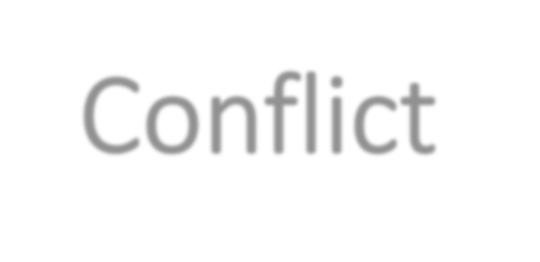
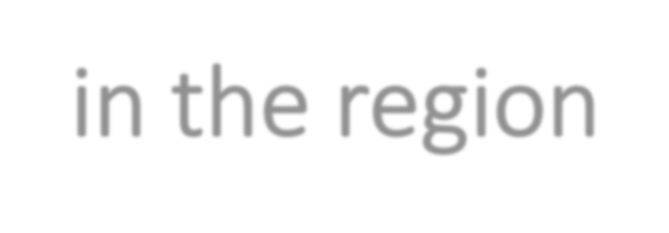
Factors contributing to Conflict in the region
The region has a long history of violent conflict over mineral resources
Government conflicts (in which rebel movements attempt to win control of the central government) and secessionist conflicts (to establish an independent, sovereign state)
The present of slow or volatile economic growth, weak and undemocratic governance, and violent insurgencies
The impact of climate change extremes events and environmental degradation that exacerbate food insecurity and internal displacement
Authoritarian, political dysfunction, and corrupt regimes that violate human rights, and mismanage natural resources

Slide 37
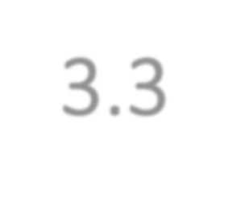
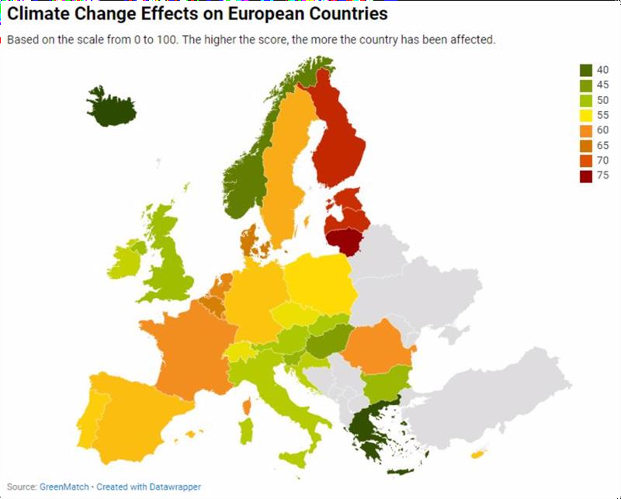
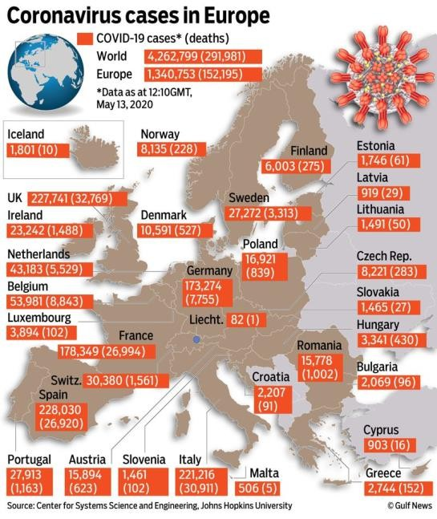
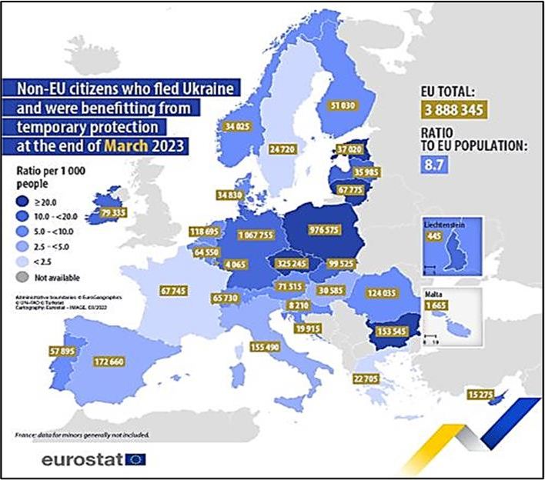
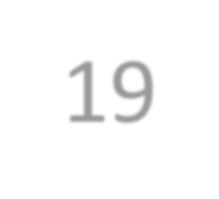
3.3 Global crises and SDG 10 Focus on Europe
CLIMATE CHANGE
COVID-19
CONFLICT

Slide 38
Impact of CLIMATE CHANGE on inequality in the region
The year 2020 was recorded as the warmest year in Europe with anomaly temperature between 2.53°C and 2.71°C above the pre-industrial levels” (European Environment Agency, 2023)
Climate impacts increase inequality because women, children and marginalized groups
suffer from the economic downturn
Marginalized groups often face a higher risk when faced with extreme weather events
Europe's commitment to target 10.3 — eliminating discriminatory laws, policies, and practices — becomes even more pertinent in the context of climate change
The significance of Target 10.4, advocating for policies that promote greater equality, is amplified as climate change puts additional stress on social protection systems (Markkanen & Anger-Kraavi, 2019)
Europe is warming faster than the global average: “The mean annual temperature over European land areas in the last decade
was 2.04 to 2.10 °C warmer than during the pre-industrial period

Slide 39
Impact of COVID-19 on Inequalities in the region
The pandemic's pivot to remote learning exposed the digital divide, particularly evident in countries like Greece and Portugal
Migration is a central theme of target 10.7, took on new dimensions in the pandemic era
The pandemic's disruptions underscored the need to ensure the safe and orderly mobility of people, safeguarding the rights and dignity of migrants
After lockdowns and outbreaks had decreased in the EU, the European economies had recovered to nearly pre-pandemic levels with an annual growth of real GDP per capita of 3.3 % in 2022 compared with 2021 (European Commission, 2023)
COVID-19 pandemic severe negative affected the economic and health issues in all sectors
The pandemic's impact has rippled across Europe, casting disparities and exacerbating the challenges in achieving the specific targets of SDG 10.
There was an economies unemployment surged, countries sectors like tourism
40% of the population, already economically vulnerable, faced even graver uncertainties
With relates to social and economic the pandemic's disproportionate health among the minority communities and higher mortality rates
halted, and dependent on

Slide 40
Impact of CONFLICT on Inequalities in the region
SDG target 10.1 in the context of conflicts, have cascaded across borders and disrupted economic and trade relations
Conflicts have illuminated concerning issues of discrimination and marginalization
Regarding conflict's divisive nature has intensified inequalities across various demographic dimensions
Conflict's ripple effects have disrupted equal opportunities, impeding educational and healthcare access for these vulnerable population
Unplanned nature of migration stemming from the conflict presents challenges for hosting nations
Conflicts challenges extend across economic stability, social inclusivity, and political empowerment

Slide 41
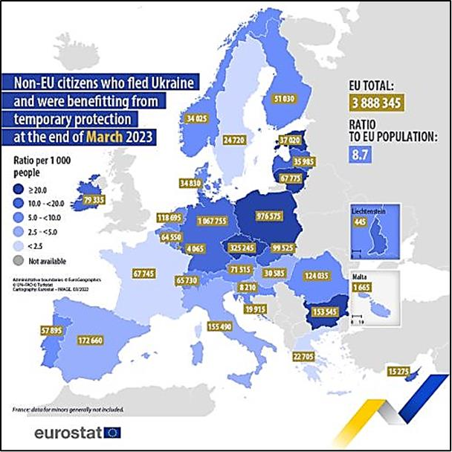
Factors that have contributed to CONFLICT in Europe
Non-EU citizens who fled Ukraine and were benefitting from temporary protection (Eurostat, 2023)
Unprecedented surge of migration into the European Union has taken place due to several conflicts around the world (Syria, Afghanistan, Venezuela)
Russian invasion of Ukraine started in 2022, many people have been fleeing the war to seek protection in the EU.
The economic repercussions, which in the context of the war, have cascaded across borders and disrupted trade relations
Internally displaced persons (IDPs) and refugees in
Unplanned nature of migration stemming from the
Due to the Russian and Ukraine war, the EU received 881,220 first-time asylum applications, which is an almost 64% increase since 2021 (EUROSTAT, 2023
countries like Ukraine
conflict zone

Slide 42
4. Progress towards achieving SDG 10
(Source: Sachs et al., 2023)

Slide 43
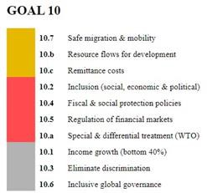
AFRICA Progress towards achieving SDG 10
The World Population Review (2023) indicates that eight of the ten most unequal countries in the world are in Africa
Northern – Southern differences
In most African countries an average of 25% of the wealth is held by only 1% of the population (World Inequality Database, 2023)
High levels of gender inequality; urban vs racial
inequality and high levels of racial inequality
especially in Southern and East Africa (Oxfan, 2022)
Progress in the achievement of the sub-targets
10.7.2; 10.7.3; 10.7.4; 10.b.1 and 10.c.1 has been
made – e.g. Uganda

Slide 44
LATIN AMERICA Progress towards achieving SDG 10
In the first two decades of this century, Latin America and the Caribbean experienced robust economic growth, poverty and wage inequality went down, (progress began to stall from 2015) .
Latin America and the Caribbean remains around 37% showing very little or no progress.
The poorest 50% of the population earns just 10% of total income, while the wealthiest 10% earns 55%, according to the World Inequality Report (Chancel et al. 2022).
Source: https://ecastats.uneca.org/unsdgsafrica/sdgs

Slide 45
EUROPE Progress towards achieving SDG 10
Variations but moderate progress
Various policy initiatives and instruments
The Anti-Discrimination Plan, the LGBTQ Equality Strategy, and the Cohesion Policy Fund
Source: https://ecastats.uneca.org/unsdgsafrica/sdgs

Slide 46
5. Case studies and best practices
Purpose of the case studies is to provide students with actual examples of good case studies that have attempted to address the indicators of the SDG
Each case study provides suggestions on how the case study can be replicated in other communities

Slide 47
Uganda: Promoting the rights of refugees through the effective application of SDG I0 and the related indicators 10.7.2 and 10.7.4
Third largest host of refugees and asylum seekers in 2023 mostly from the DRC and South Sudan
Promotes the rights of refugees and Asylum seekers (SDG 10.7.2 –
planned and well-managed policies)
The Ugandan Refugee Act of 2006 has been praised worldwide as being a progressive law that best meets international protection standards
The Act allows refugees the right to work, significant freedom of movement and access to basic services
Allocates small plots of land to each refugee household to facilitate a development-based approach
2020 Voluntary National Review documented the methodology of tracking the proportion of its population who were refugees (SDG 10.7.4)

Slide 48
Tanzania: Joint programme to support Tanzania’s Productive Social Safety
Net (PSSN)
In 2018, 27.6 million people lived below the US $1.9/day, stagnant at
49% between 2011/12 and 2018 – (fast-growing poor population).
The rural-urban inequalities remain huge in the education, health, water, sanitation, nutrition, and youth employment dimensions.
With the support of a joint programme, the Government of Tanzania decided in 2018 to scale up one of its existing programmes, the Tanzania Productive Social Safety Net (PSSN).
Reach all people living below the food poverty line, pregnant women and children under five.
Raise awareness about the importance of family planning and
promote employment and education to escape extreme poverty.
More than 10,272 PSSN beneficiaries – entrepreneurship skills, sustainable livelihoods and resilience mechanism.

Slide 49
Cameroon: Joint programme in Buea, southwest region, to reduce
inequality
Low-income, located in Central Africa and has a total population of 28,539,789 (World Population Review, 2023)
Poverty rate (25.3% in 2021), Gini co-efficient (47.9 in 2019), 90%
of wealth is owned by 5% of the population
Collaboration between Social Development International (SODEIT), several agencies of the United Nations, international NGOs as well as local stakeholders
Created entrepreneurship opportunities for low-income groups
(disabled, women and youth)
Training and income-generating workshops, unlimited access to healthcare/clinic without any discrimination
Reduced the underemployment rate from 75.8% to less than 56%
by 2020. More than 4,000 indirect and direct beneficiaries

Slide 50
Ecuador: The “Bono de Desarrollo Humano” programme
Located in the northwest of the region, with a population of approximately 17 million and her economy is based on extractive industry, such as agriculture and crude oil
Currently, over 25% of the population is living below the poverty line
As a strategy to improve the living conditions in 2003. The “Bono de Desarrollo Humano” aims to offer financial aid through pensions and insurance to families living below the poverty threshold
The programme help vulnerable demographics for all age groups. For children the anticipated outcomes focus on diminishing chronic malnutrition and elderly with disabilities
440,000 families have benefited from the programme from 2003 until 2015
(Inter-American Development Bank (BID, 2023)
Joaquín Gallegos Lara Voucher: A value of US $240 per monthly to the legal guardian of individuals with severe disabilities, catastrophic illnesses, or children under 18 years old with HIV

Slide 51
Chile: Tuition-free public higher education
Has an estimated population of 19 million people and classified as a high-income country with most stable economies in the region
like many countries in the LAC region, it faces challenges of inequality. Regarding
access to quality services and opportunities for all
Approval of the State Universities Law in 2016, leading up to 2018, 70% of the vulnerable young population were given the opportunity to study at a university. As education emerged as a potent tool for addressing socio-economic disparities and promoting a more equitable society
The programme directly aligned with SDG 4, “Quality Education,” and indirectly contributes to SDG 10, “Reduce Inequalities,” leading to a more equitable and just society
With the acquisition of advanced knowledge and skills, they can secure higher- paying jobs, and uplifting the economic condition of poor families and breaking the cycle of generational poverty
Chile's commitment to free public higher education for all also contributes to creating a more inclusive society, where education is the driver for progress and equality

Slide 52
Brazil: Support Program for the Relocation of Refugees (PARR)
Brazil is the largest country in the region and biggest population of 214.3 million, also an upper-middle-income country
In 2021, about 30% of the Brazilian population experienced some form of
poverty and 8.4% of the population lived in extreme poverty (IBGE, 2022)
A significant influx of migrants and refugees to seek safety and a better life has caused limited access to education, healthcare, and employment opportunities
In 2011, the Support Program for the Relocation of Refugees (PARR), or "Programa de Apoio para a Recolocação dos Refugiados” was established, the aim goes beyond merely receiving refugees and a pathway to escape from poverty
The project raise awareness in companies, public and private institutions, and
the general population about the status of refugees
Project helps refugees and immigrants to become self-sufficient and socially integrated

Slide 53
Sweden: Democratic accountability, the rule of law and human rights in practice, global aid donor
The economy was expected to contract by 0.3% in 2023 and grow by 1.4% in 2024.
The government established the Equality Commission, a committee focused on enhancing economic equality and social mobility in the long term
The policy is built on democratic accountability, the rule of law, and human rights, aiming to promote political and social rights, equity, and gender equality
A Convention on the Rights of the Child was enacted as Swedish law in 2020
Vulnerability is particularly high for youth, labour migrants, asylum seekers, undocumented immigrants, and persons with disabilities in the labour market, as highlighted in Statistics Sweden's 2020 report, "Leaving no one behind."
Basic social protection, lower income taxes for pensioners, increase unemployment insurance benefits, and raise housing benefits, maintenance allowances, and child benefits
Sweden's ODA expenses between 2014 and 2022 were significantly influenced by the costs associated with hosting refugees

Slide 54
France: United Against Hatred – combating all forms of discrimination, and improving the reception and integration of foreigners
France's GDP grew by 2.6% in 2022, and it is expected to grow by 0.6% in 2023 and 1.4% in 2024. Similar projections are made by the OECD (0.6% growth in 2023 and 1.2% growth in 2024)
United Against Hatred is a comprehensive plan devised to tackle racism and anti-Semitism, comprising four key strategies (EQUINET, 2023; European Commission, 2023)
A social and tax reforms were introduced, to enhance the redistribution of resources to support the most disadvantaged segments of population. A comprehensive asylum reform law in July 2015 was passed for migrant reception and integration
A comprehensive social welfare system that includes universal healthcare, social assistance, and unemployment benefits, aimed at reducing inequalities and providing support to
vulnerable populations
Introducing anti-discrimination laws and policies to combat racism, xenophobia, thereby promoting equal opportunities and social inclusion. A law was introduced that prohibits discrimination based on race, skin colour, religion, nationality and gender
Implementing a comprehensive social welfare system that includes universal healthcare, social assistance, and unemployment benefits. That reduce poverty and improve the well- being of vulnerable populations in other countries

Slide 55
Bulgaria: The "We can too – 2” project – improving access to the labour market for unemployed people from disadvantaged groups, and support for refugees and migrants
The National Employment Agency implemented “We can too – 2" project dedicated to enhancing labour market accessibility for unemployed individuals from marginalized communities through skill-building services
The project objective of policies until 2030 is to foster more inclusive and sustainable growth, and regional disparities
Ministry of Education and Science launched the Active Inclusion in the Pre-school System project, aiming to widen access to pre-school education for children from vulnerable and impoverished backgrounds
In 2015, the Government adopted a comprehensive National Strategy on Migration, Asylum, and Integration according to which people with refugee or humanitarian status were granted the right to work
In 2019, about 32,035 self-identified Roma who were unemployed, ensuring employment for 14,804 individuals supported by the National Roma Integration Strategy

Slide 56
6. Assessment and Exercises
The assessment provided in the study material ranges from quick and immediate responses to demonstrate competences achieved to longer term projects that the teacher can consider
At the end of each section a variety of measures to assess the achievement of the learning goals are posed and these include:
Multiple choice questions
Short Quizzes
Questions that require answers ranging from short sentences to paragraphs
Inequality Gallery Walk: Create a gallery walk in your classroom or school where students display posters, infographics, or artwork related to various forms of inequality. Allow students to walk around, observe, and discuss the exhibits, fostering conversations about the causes, consequences, and potential solutions for each form of inequality.
Inequality Case Studies: Provide students with a set of case studies or real-life scenarios that highlight different aspects of inequality. Divide students into groups and ask them to analyze the case studies, identify the underlying factors contributing to the inequality, and propose strategies or policies to address them.
Inequality Awareness Campaign: Assign students the task of creating an awareness campaign to address a specific aspect of inequality. They can develop posters, videos, social media campaigns, or presentations to educate their peers and the wider community about the issue.

Slide 57
Closing words
This manual provides an introduction to some crucial aspects regarding SDG 10, while turning the focus to global crises currently having a negative impact on its achievement and its progress in regional contexts
We trust that this presentation kindled your interest in SDG 10 and why it is important
Similarly, we trust that the manual will em-power you to offer a class or a series of classes on SDG 10, and/or to be innovative and develop your own classes, while using some of the information and resources as provided

Slide 58
Prof. Dr. Luciana Brandli
Titular professor at the University of Passo Fundo / College of Engineering and Architecture brandli@upf.br
Thank you!
Prof. Dr. Rudi Pretorius
College of Agriculture and Environmental Sciences,
University of South Africa pretorw@unisa.ac.za
Prof. Dr. Dr. Walter Leal
Head of Research & Transfer Center Sustainability & Climate Change Management at HAW Hamburg walter.leal2@haw-hamburg.de

Slide 59
References
Care, I. 2022. Ukraine conflict causes soaring debt and increased poverty and inequality across Latin America and the Caribbean. Available at: https://www.care.org/news-and-stories/press- releases/ukraine-conflict-causes-soaring-debt-and-increased-poverty-and-inequality-across-latin- america-and-the-caribbean/. Accessed: 7 August 2023.
Chancel, L., Piketty, T., Saez, E., Zucman, G. et al. 2022. World Inequality Report 2022. World Inequality Lab. Available at https://wir2022.wid.world Accessed 16 June 2023.
EQUINET. 2023. EQUINET statement on call to action to unite against all forms of hatred: “No place for hate – a Europe united against hatred”. Available at: https://equineteurope.org/equinet-statement-on- commissions-and-high-representatives-call-to-action-to-unite-against-all-forms-of-hatred-no-place-for-hate- a-europe-united-against-hatred/
European Commission. 2023. European Pillar of Social Rights: Building a fairer and more inclusive European Union. Available at: https://ec.europa.eu/social/main.jsp?catId=1226&langId=en. Accessed 23 August 2023.
EUROSTAT. 2023. Analysis of EU short-term progress towards the SDGs in the face of multiple crises. Available at: https://ec.europa.eu/eurostat/statistics-explained/index.php?title=Analysis_of_EU_short- term_progress_towards_the_SDGs_in_the_face_of_multiple_crises.

Slide 60
References
Markkanen, S. and Anger-Kraavi, A. 2019. Social impacts of climate change mitigation policies and their implications for inequality. Climate Policy, 19(7), 827–844. Available at: https://doi.org/10.1080/14693062.2019.1596873.
MacNaughton, G. 2017. Vertical Inequalities: Are the SDGs and Human Rights Up to the Challenges? International Journal of Human Rights, 21(8),1050.
Oestreich, J. E. 2018. SDG 10: Reduce inequality in and among countries. Social Alternatives, 37(1), 34-41.
Oxfam. 2023. Survival of the richest. Oxfam, GB: Oxford.
Sachs, J.D., Lafortune, G., Fuller, G. and Drumm, E. 2023. Implementing the SDG Stimulus. Sustainable Development Report 2023. Paris: SDSN, Dublin: Dublin University Press, 2023. 10.25546/102924. Saiz, I. & Donald, K., 2017. Tackling inequality through the Sustainable Development Goals: human rights in practice. The International Journal of Human Rights, 21(8), 1029-1049.
UNDESA & World Bank, 2019. Sustainable Development Goal 10 – Reduced Inequalities: Progress and Prospects. An Expert Group Meeting in preparation for HLPF 2019: Empowering people and ensuring inclusiveness and equality. Geneva, 2-3 April.

Slide 61
References
United Nations Global Compact (UNGC), 2018. Reduced inequalities. In Blueprint for business leadership
on the SDGs. Available at: https://blueprint.unglobalcompact.org/sdgs/sdg10/ Last accessed 18 June 2023.
World Atlas. 2023. https://www.worldatlas.com/ Accessed 8 January 2024
World Bank. 2021. Promoting Climate Change Action in Latin America and the Caribbean. Available at: https://www.worldbank.org/en/results/2021/04/14/promoting-climate-change-action-in-latin-america-and- the-caribbean. Accessed 1 August 2023.
World Population Review (2023). https://worldpopulationreview.com/. Accessed 8 January 2024.
World Inequality Database (2023). https://wid.world/ . Accessed 8 January 2024.

